Slide 1
Ecosystems
Environmental Sciences 11/12

Slide 2
Last Days Nuggets
What are the two main type factors that impact an ecosystem? Give an example of each.

Slide 3
Last Days Nuggets
What are the 6 characteristics of a living thing?

Slide 4
Last Days Nuggets
What are the 6 Kingdoms? Give an example of an organism in each.

Slide 5
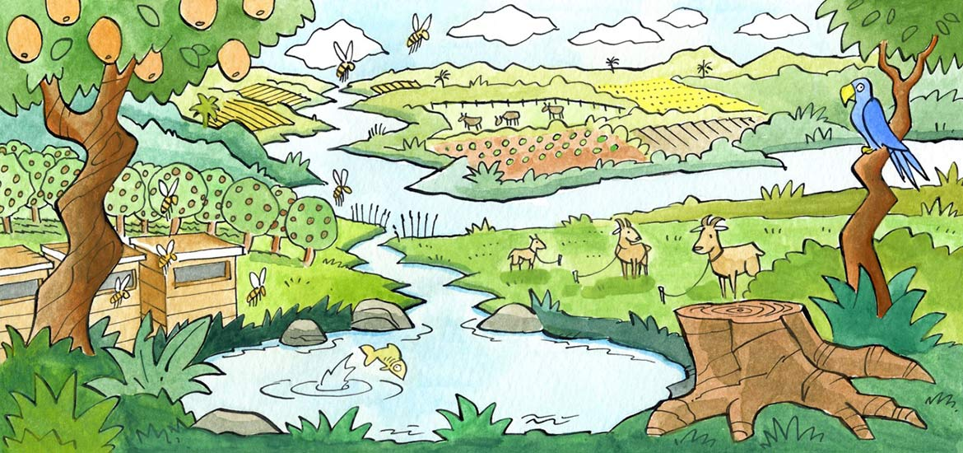
What is an Ecosystem?
A biological community of living and non-living things

Slide 6
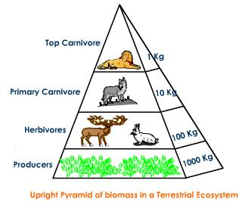
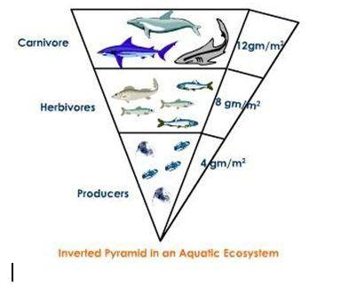
Ecosystem Biomass
the mass of living biological organisms in a given area or ecosystem at a given time
Terrestrial biomass decreases as you move up trophic levels
Aquatic biomass increases as you move up tropic levels

Slide 7
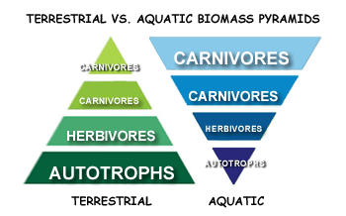
Ecosystem Biomass

Slide 8
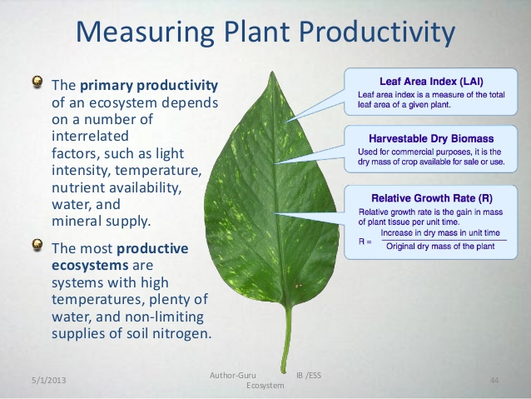
Ecosystem Productivity
The rate of generation of biomass in an ecosystem
How fast are plants and animals reproducing healthy offspring?
The amount of organic matter accumulated over a period of time

Slide 9
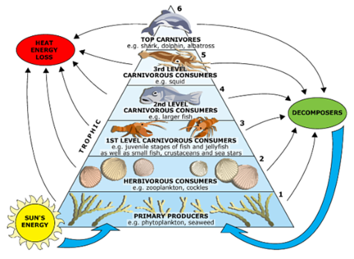
Energy Flow in an Ecosystem
Energy can not be created or destroyed, only transferred
Trophic levels (nutrition)
Primary Producers:
Autotrophs (make own energy)
Consumers
Heterotrophs (must consume energy)
Saprotrophs (decomposers – detritovores)
Organisms only hold on to 10% of the energy they ingest
Limiting factors: water and temperature

Slide 10
Ecological Niche
The role of the organism in it’s environment
Habitat
When it is active
What it uses for resources

Slide 11
Ecosystem Biodiversity
Genetic diversity allow for ecosystem stability

Slide 12
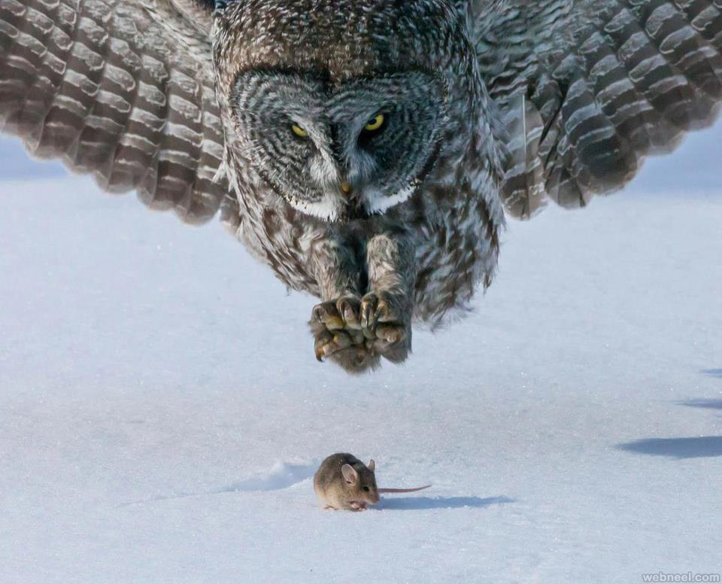
Ecosystem Relationships
Predator – an organism that actively preys or hunts other organisms in the ecosystem
Prey – the organism that is hunted or eaten by another

Slide 13
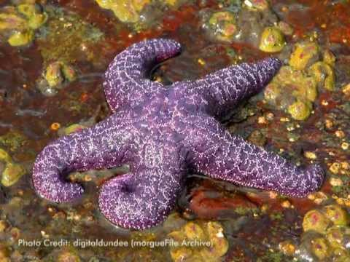
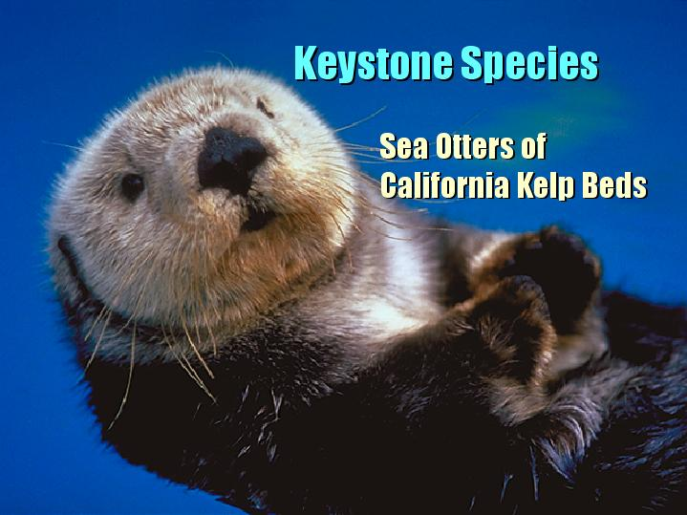
Keystone Species
A keystone species is a plant or animal that plays a unique and crucial role in the way an ecosystem functions.
Without keystone species, the ecosystem would be dramatically different or cease to exist altogether.

Slide 14
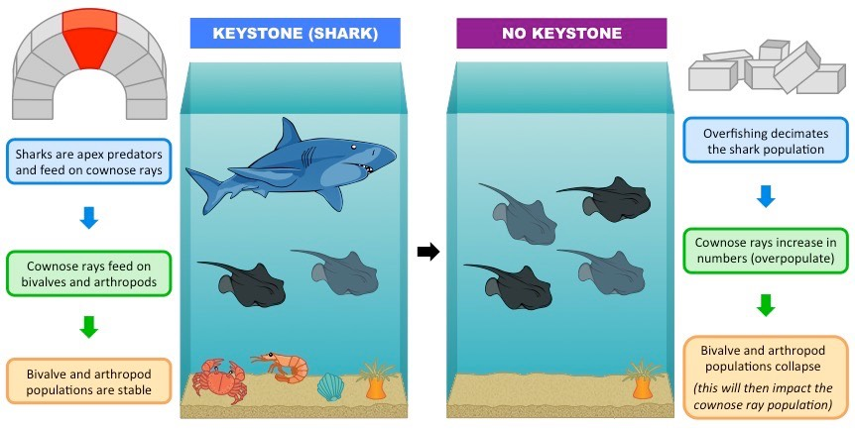

Slide 15
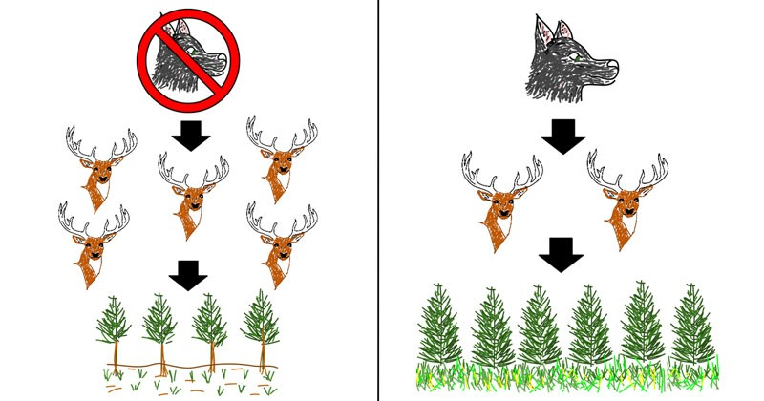
Trophic Cascade
powerful indirect interactions that can control entire ecosystems
when predators in a food web suppress the abundance of their prey, it allows the next trophic level to thrive
the addition or removal of top predators causes changes in the populations of predator and prey through a food chain

Slide 16
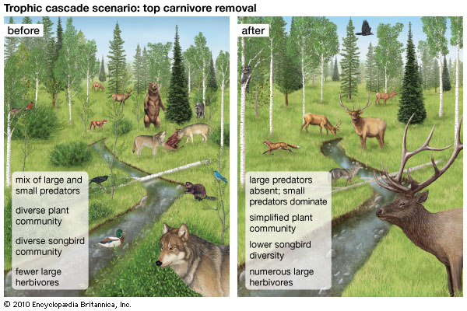

Slide 17
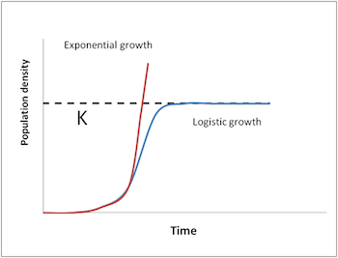
Carrying Capacity (K)
Populations will have a carrying capacity
Max number of organisms the community can handle
There will be increased deaths as you approach “K”
Due to density dependent limiting factors
restrictions on food, shelter, disease

Slide 18
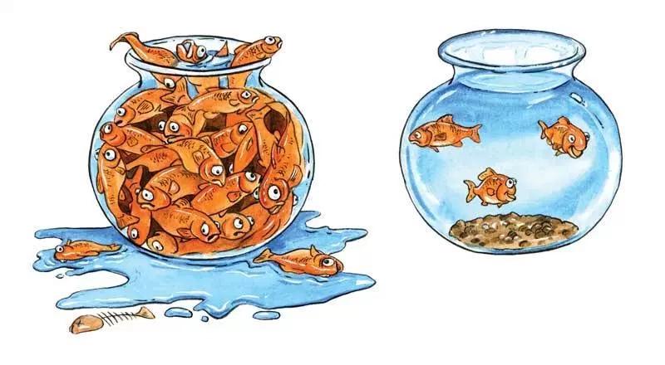
Which bowl will have more successful organisms? Why?

Slide 19
The Biggest Little Farm
Journal Reflection:
What did you enjoy in the documentary?
What did you find surprising in the documentary?
How did they set up a balanced ecosystem?
What symbiotic relationships did you see in the documentary?

Slide 20
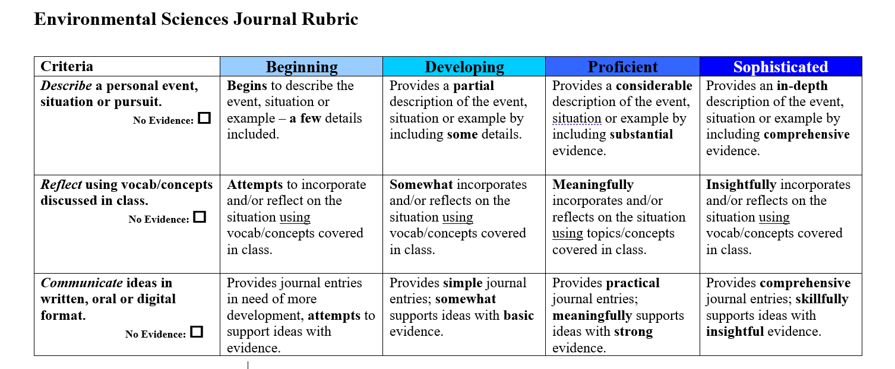
Journal Entry The Biggest Little Farm

Slide 21
Yellowstone Wolves Case Study

Slide 22
Yellowstone Wolves Case Study
Questions:
What are some positive and negatives about having wolves in an ecosystem?
A wolf can be described as a keystone species. What is the evidence of this?
What are some density dependent and density independent factors that impact the wolf population?
Looking at the data, what do you think is the carrying capacity of the YSP wolf population?

Slide 23
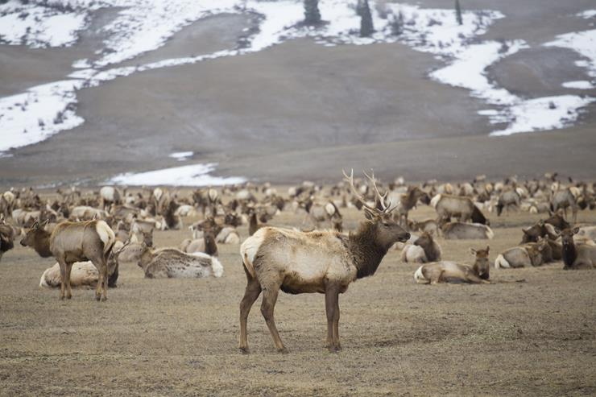
Yellowstone Wolves Case Study

Slide 24
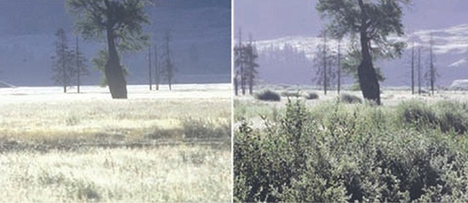
Yellowstone Wolves Case Study

Slide 25
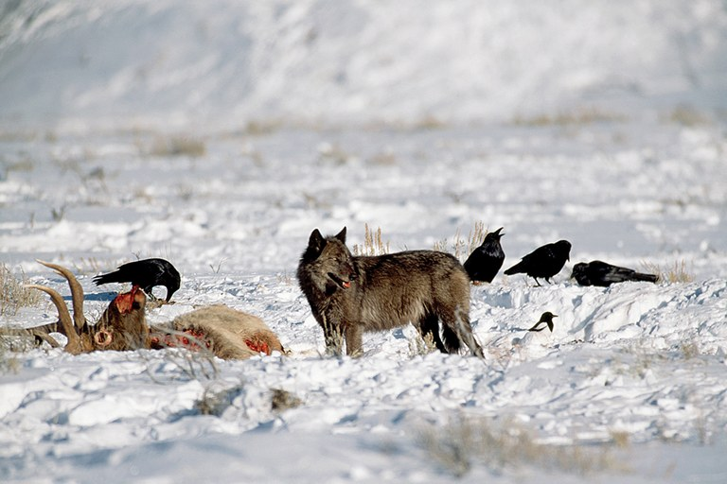
Yellowstone Wolves Case Study

