Slide 1
Biological Management
Environmental Sciences 11/12

Slide 2
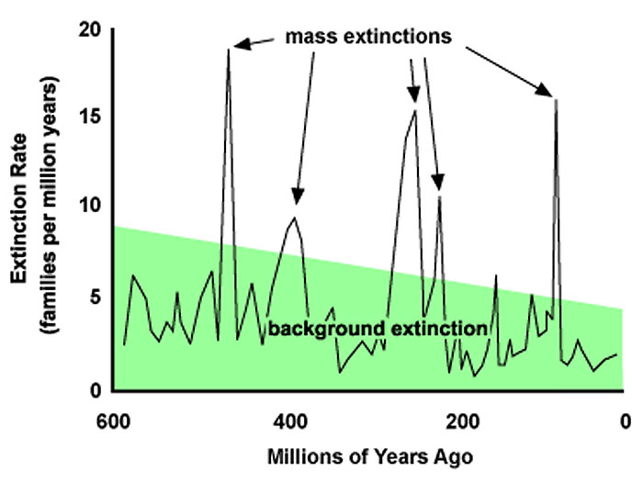
Extinction and Changing of Populations on Earth
Sharks have existed on Earth or millions of years
Other organisms, like the dinosaurs, are now extinct
There are some period of mass extinction in Earth’s history (Pre-Cambrian)
Create opportunities for new species to thrive

Slide 3
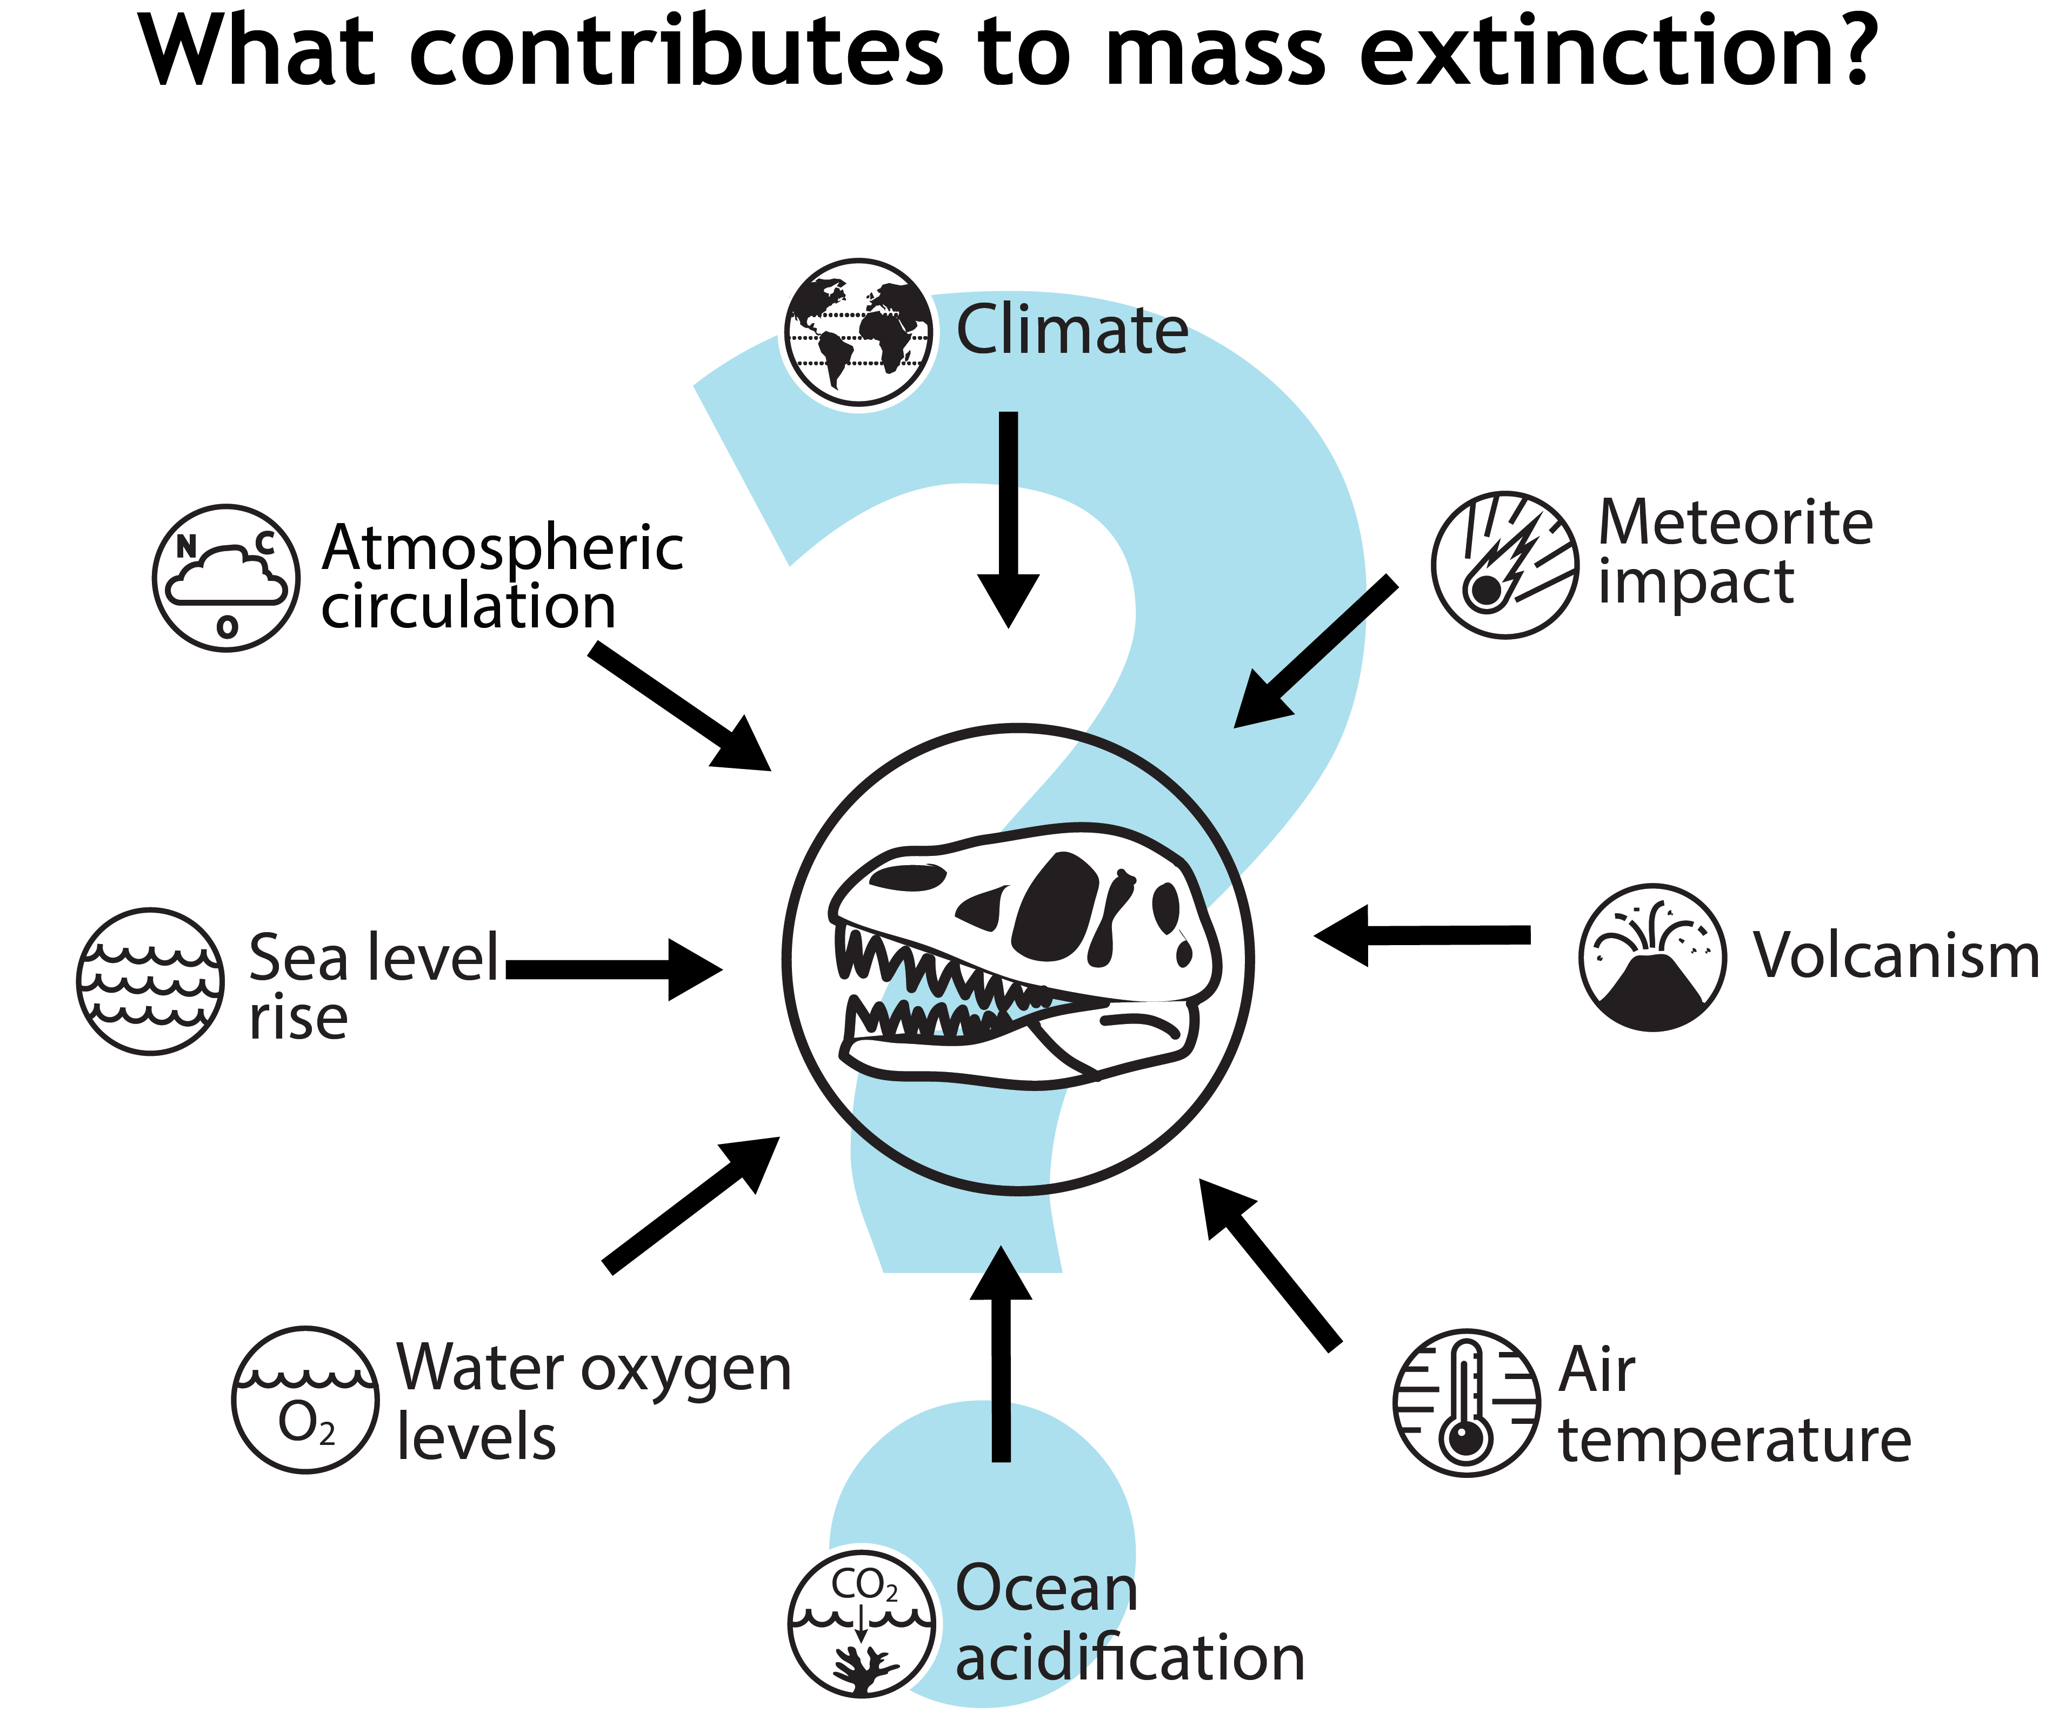

Slide 4
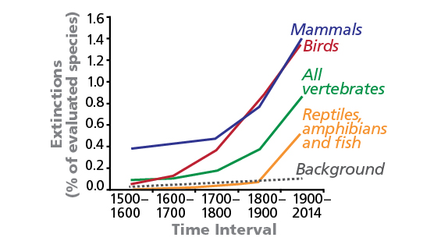
Rates of Extinction Are Rising
Rates of extinction are rising as of 200,000 years ago
Human migration has been followed by species extinction
Scientists estimate that wild species extinction rate has increased 1000X
It is estimated that Earth is entering it’s 6th mass extinction
Big cats will exist only in captivity
Elephants, rhino, apes will go extinct
50% of Earth’s plants will go extinct

Slide 5
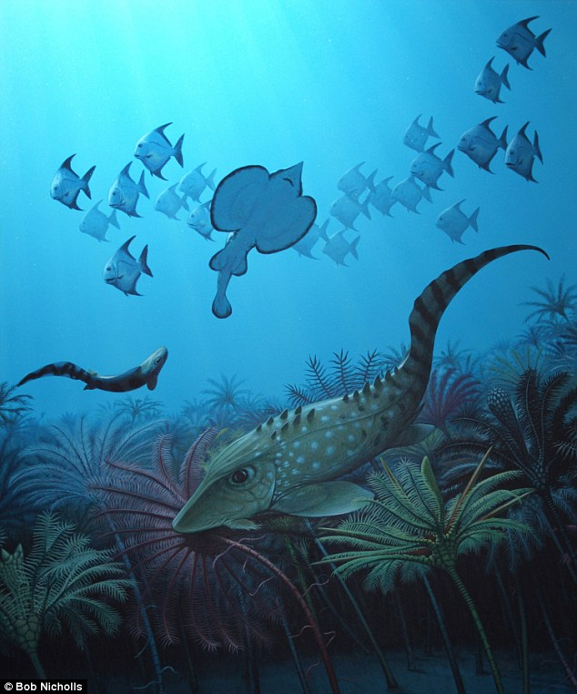
Previous Mass Extinctions
Time Period | Hypothesized Cause | Impact on Species
65 Million Years Ago (MYA) | Asteroid | Dinosaurs and 70% of species
200 MYA | Floods of lava | 75% of organisms, mammal-like and amphibians
250 MYA | Comet or Asteroid | 90 - 96% of species
360 MYA | Comet | 70% species, reef and ocean organisms
440 MYA | Rapid Glaciation | 85% of marine life

Slide 6
Biological Control and Management
Humans have been trying to decrease extinction rates
Use living organisms to keep other organism’s population in check
Introduce predator
Cull populations
Capture and release in other territory
Prevent spread of invasive species

Slide 7
Species introduction
Non-native species (exotics, non-indigenous, introduced) are organisms that are introduced to new ecosystems either purposefully or by accident
Compete with native species for food and shelter
Can greatly disrupt ecosystem
Harm keystone species
Cause trophic cascades
Invasive species are non-native species that cause significant harm to the ecosystem

Slide 8
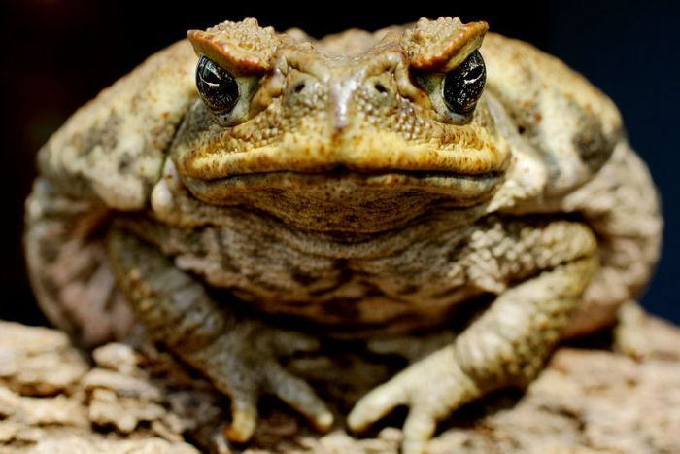
Cane Toad in Australia
Introduced in 1935 to hep control the Cane Beetle that was damaging sugar crops
Cane toad is an INVASIVE SPECIES (non native)
Toads are toxic, which has caused accumulation of toxins in higher predators and even death
No predators now

Slide 9
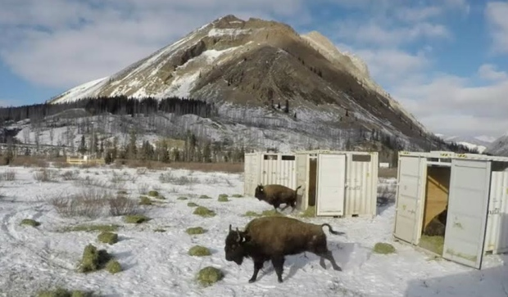
Re-introducing Bison in Banff
Bison were removed from Banff (the last small herd) in 1997
Changes to the ecosystem has caused the Canadian government to rethink this and they are trying to re-introduce the bison into Banff

Slide 10
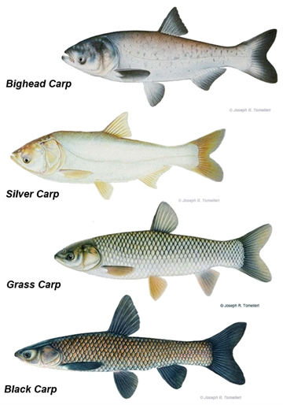
Asian Carp
several species of Asian carp: silver carp, bighead carp, grass carp and black carp
introduced to North America from China in the 1960s and 1970s in an effort to control algae, plants and snails in ponds
they have been spreading throughout waterways across North America

Slide 11
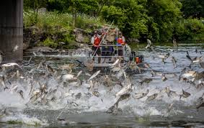
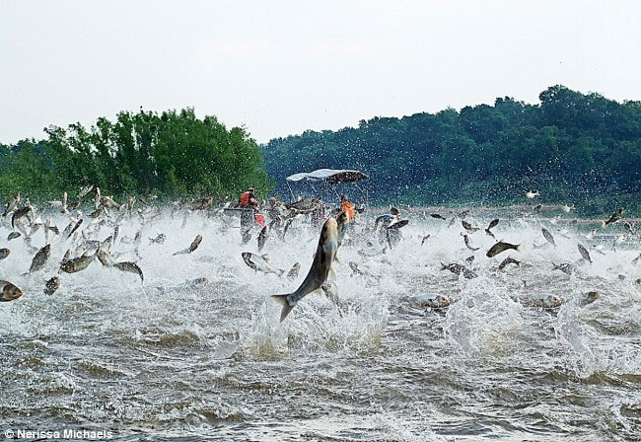

Slide 12
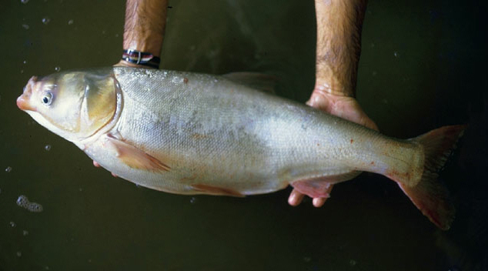
Issues for Ecosystem
Carp consumes very high amount of aquatic plant life
As they forage, they create murky waters
Murky water impacts the hunting of other fish in the pond and decrease the photosynthesis for the bottom plants
Murky water is harmful for young fish of other species
Reproductive rate of carp very fast, lots of eggs

Slide 13
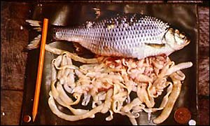
Issues for Ecosystem
Carp also has a tapeworm often in its system that will infect other fish as well
Decline of the native fish is impacting fisheries

Slide 14
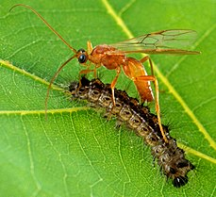
Parasitic Wasp
Aphids are a pest of plants and cause huge damage to plants as they remove nutrients from the plant.
An example of biological control is the release of parasitic wasps to control aphids.
parasitic wasp lays eggs in aphids
aphids will die when the eggs come out and the young wasps start to grow
aphid population will decrease quickly.

Slide 16
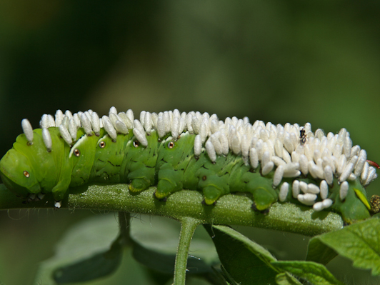
Issues for Ecosystem
Native to Texas, artificially introduce into Hawaii to prey on sugar cane pests
Can impact the decomposers, which will impact rate of forest litter recycling

Slide 17
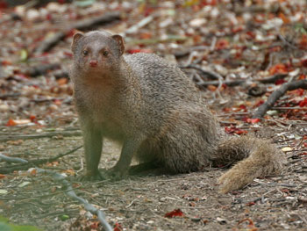
Asian Mongoose
Introduced to Hawaii in order to control rat population
Rats are nocturnal (active at night) and mongoose are diurnal (active in day)
Mongoose has decimated the Hawaiian bird population
Hawaii has introduced $1000 fine if cause breeding or keeping any mongoose
Opportunistic feeder (will eat anything that lands in its way)

Slide 18
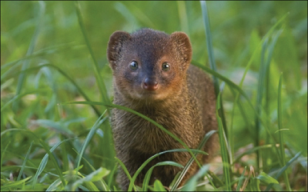

Slide 19
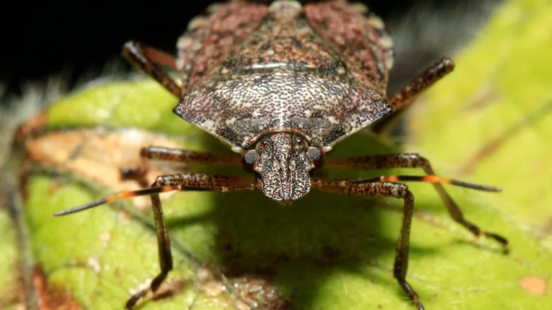
Invasive Species Stick Bug
Brown Marmorated Stink Bug is an invasive species in the Okanagan
Introduced to North America in 2010.
Harms stone fruit crops (peaches and apricots) and apples
Reproduce quickly in warmer areas (impact Okanagan greatly)

Slide 20
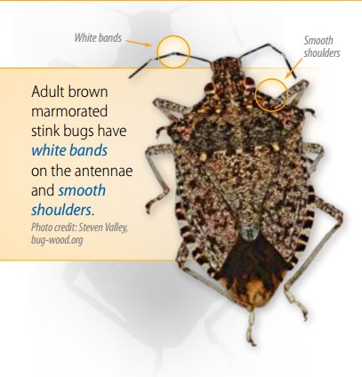

Slide 22
BC Wolf Cull
Watch the linked video
Take notes
Share notes with table team at the end to bulk up your notes ☺

Slide 23
Become the Expert on a Point of View
Group 1 – Caribou Biologist
Group 2 – Wolf Biologist
Group 3 – Landscape Ecologist
Group 4 – Food Web Interactions
Read your articles and form an argument for or against the wolf cull based on your readings

Slide 24
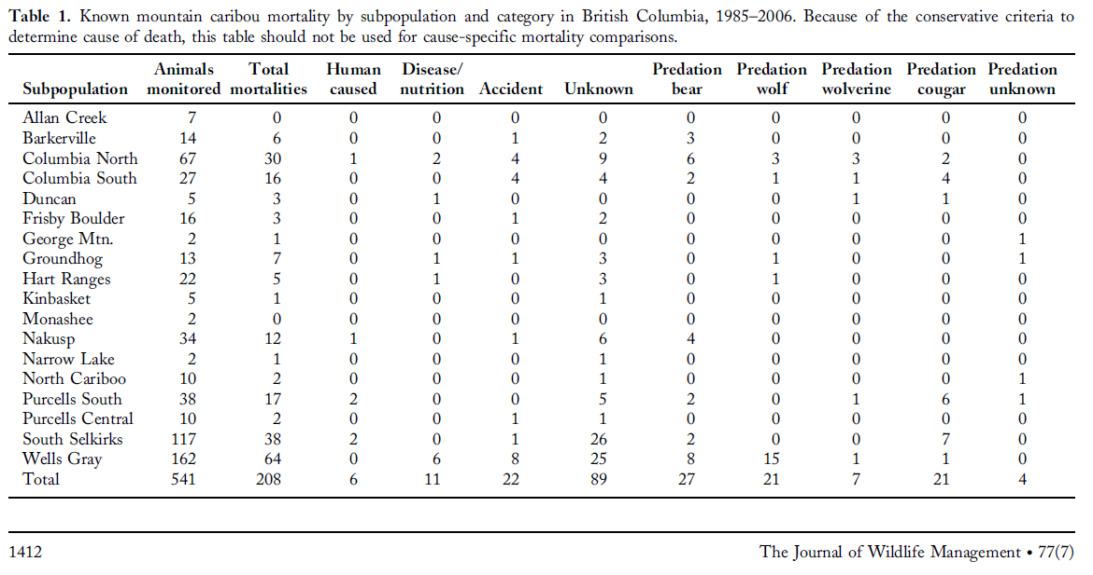
What does this data tell us?

Slide 25
What does this data tell us?

Slide 26
Your Task
As a table team do some research you have about the current wolf cull
Use the ipads to research information about the wolf cull
What are the statistics about caribou depletion?
What are the issues about wolf population increases?
What are BOTH sides of view and what are BOTH sides justification for their stance?
What is the history of the BC wolf culls (how did it work in the past)?
Share as a class and take notes on the issue and sides of the issue

Slide 27
Ecological Control Become The Expert
As a table team you will research and put together a video ( about 3 – 4 minutes) about the ecological control scenario you have chosen
You are you include information about
General ecosystem characteristics
Organisms in ecosystem
Control approach
Reason for involvement
Impact of involvement (positive and negatives, all organisms impacted)
Keystone species in area, any population issues (density dependent), any trophic cascade issues
Tell a story of the animal and the situation

Slide 28
Make a video
imovie
Perfect video

Slide 29
Ecological Control Examples
Put your names by the topic you have chosen
Cane Toad (Australia 1935)
Common Rabbit (Australia 1859)
Burmese Python (Florida Everglades)
Nile Perch (Lake Victoria)
BC Wolf Kill (1980’s and 2017)
Re-introduction of turkeys into Ontario
Re-introduction of bison to Banff (2017)
Re-introduction of California Condor in California
Prickly Pear and Moth
Asian Oyster into Chesapeake Bay
Brown Trout into BC lakes

Slide 30
Block 2 – Organisms to Know
Organism | When/Where | Why | Positives | Negatives | Long Term Consequence
Trout
Nile Perch
Common Rabbit
Python
Turkey | Ontario
Bison | 2017 (Banff)

