Slide 1
DNA Structure
Science 10
Day 1

Slide 2
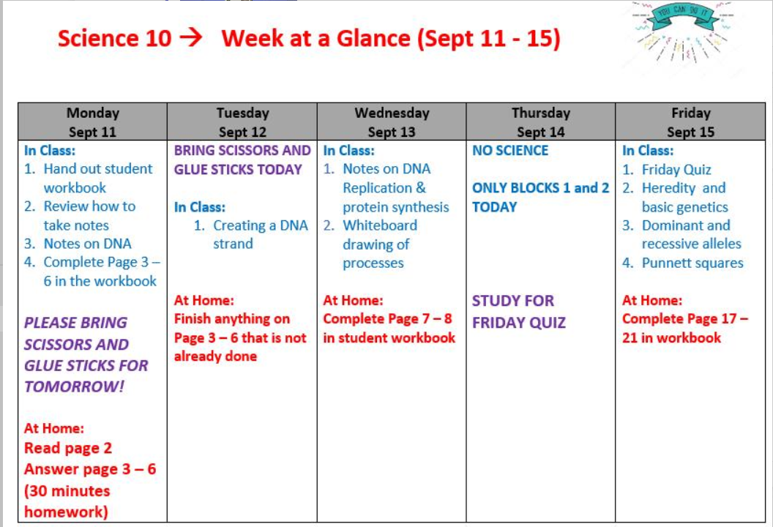

Slide 3
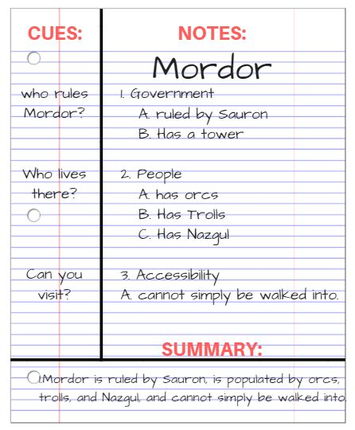
Ways to Take Notes

Slide 4
Ways to Take Notes

Slide 5
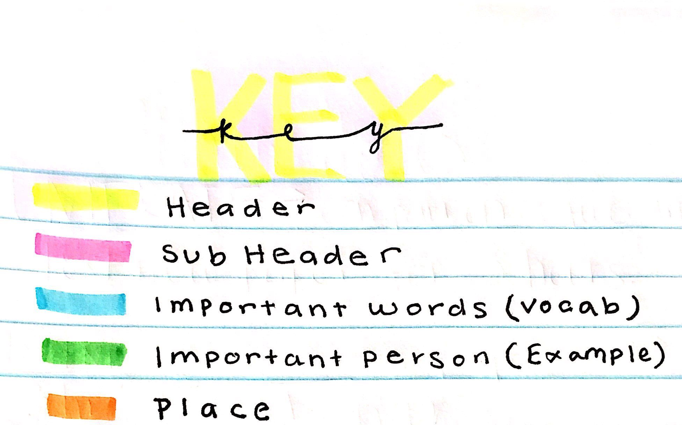
Ways to Take Notes

Slide 6
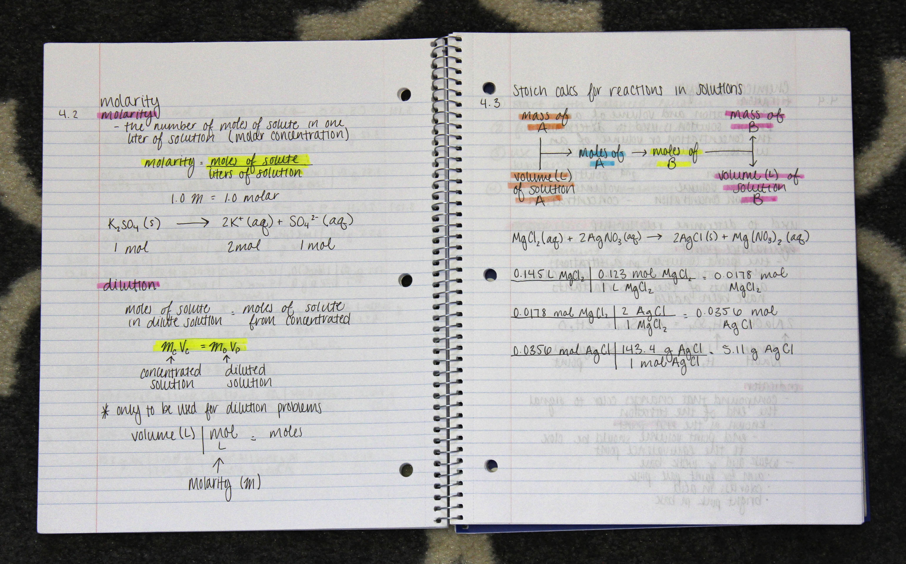
Ways to Take Notes

Slide 7
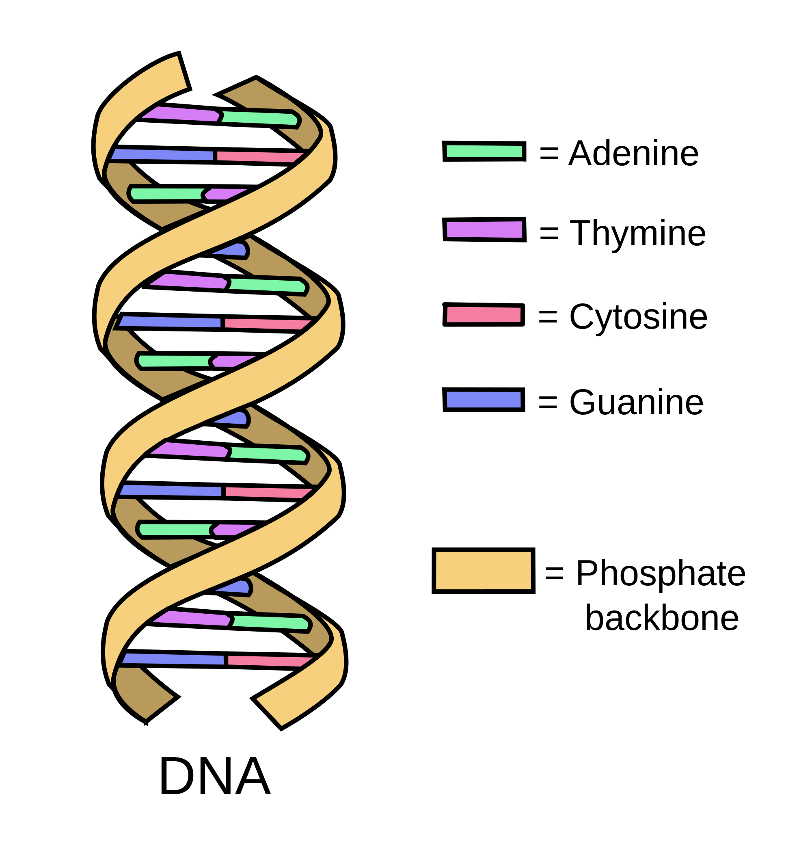
DNA Structure
DNA and RNA are a type of biomolecule called a NUCLEIC ACID
Made up of repeating structures called a NUCLEOTIDE
DNA and RNA help code for how to made the various proteins of your body

Slide 8
DNA Structure
Sketch this in your notes!

Slide 9
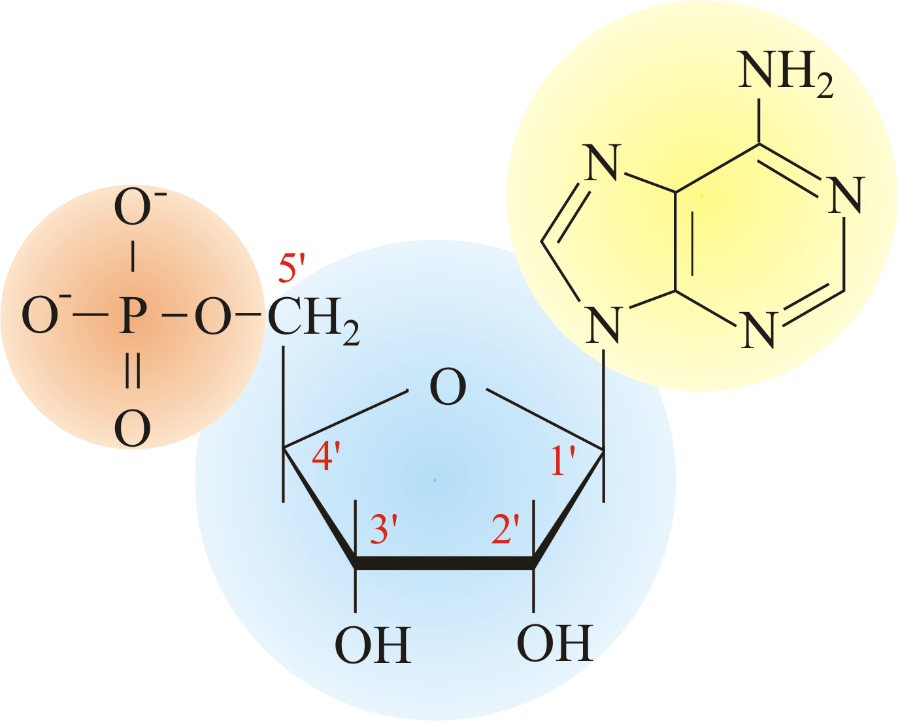
What is a NUCLEOTIDE?
The make up of the MONOMER of DNA & RNA
Nucleotide:
Sugar (ribose)
Phosphate (to attach to the next sugar)
Nitrogen base pair (“the code”)

Slide 11
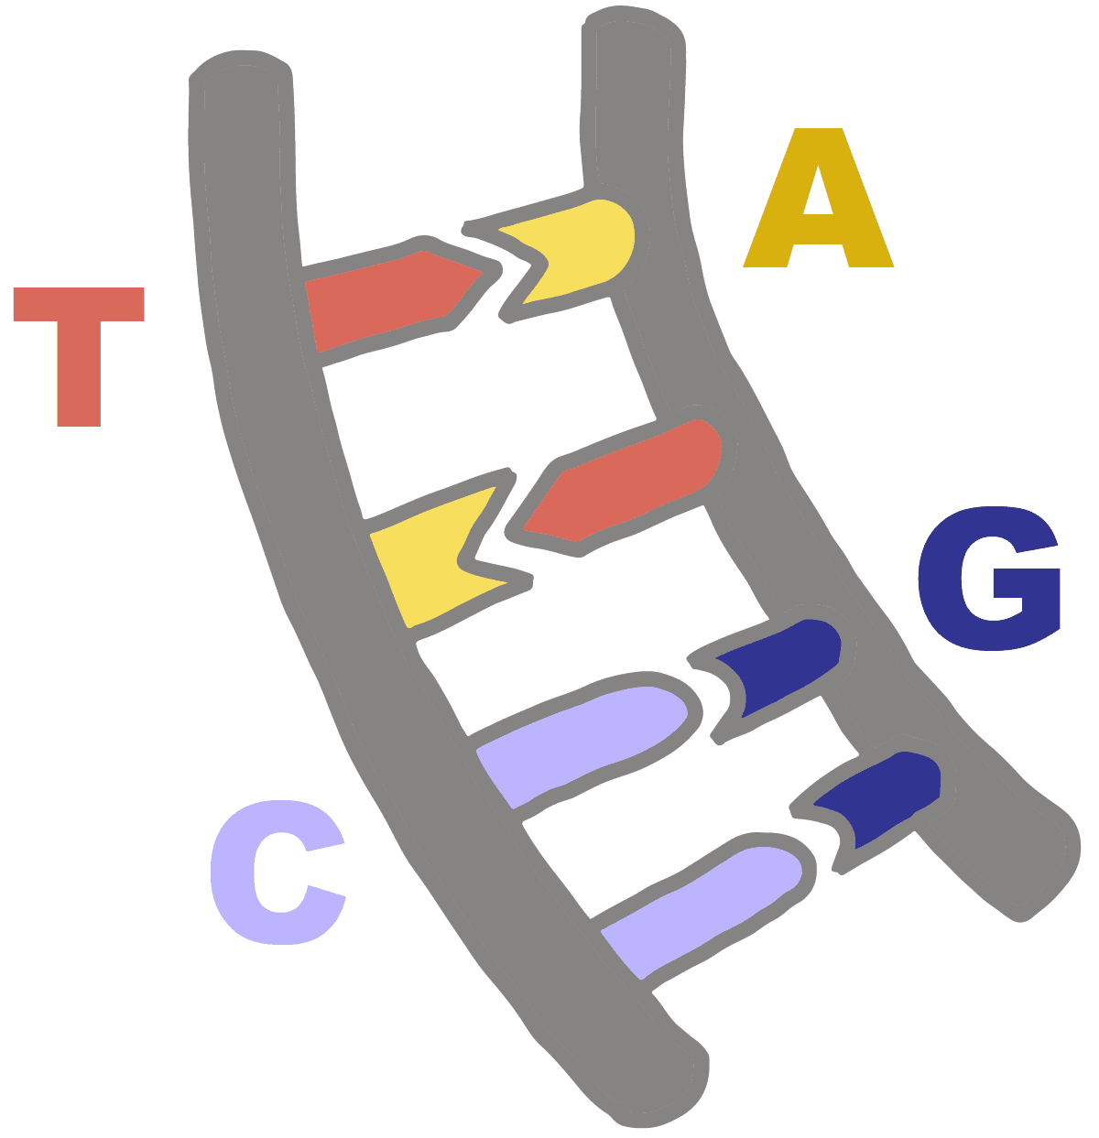
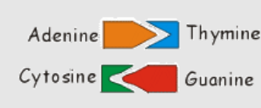
Complimentary Base Pairs

Slide 12
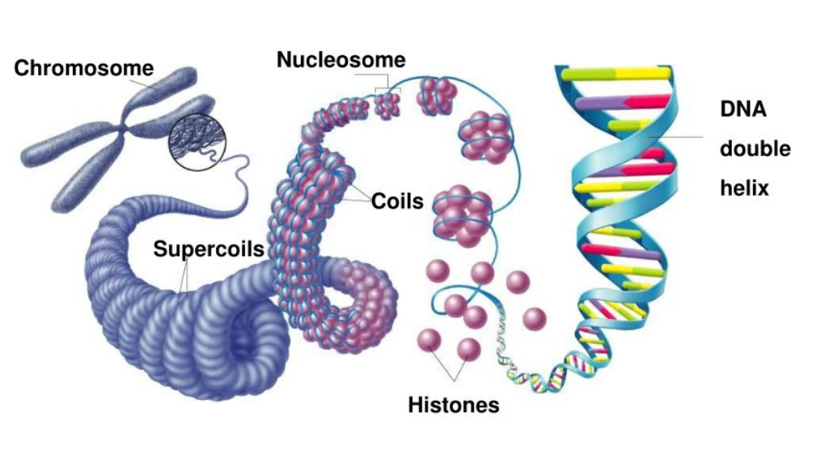
Organization of a chromosome
DNA is coiled around proteins to package it tightly
Uncoiled DNA is called CHROMATIN
When DNA is coiled it is a CHROMOSOME

Slide 13
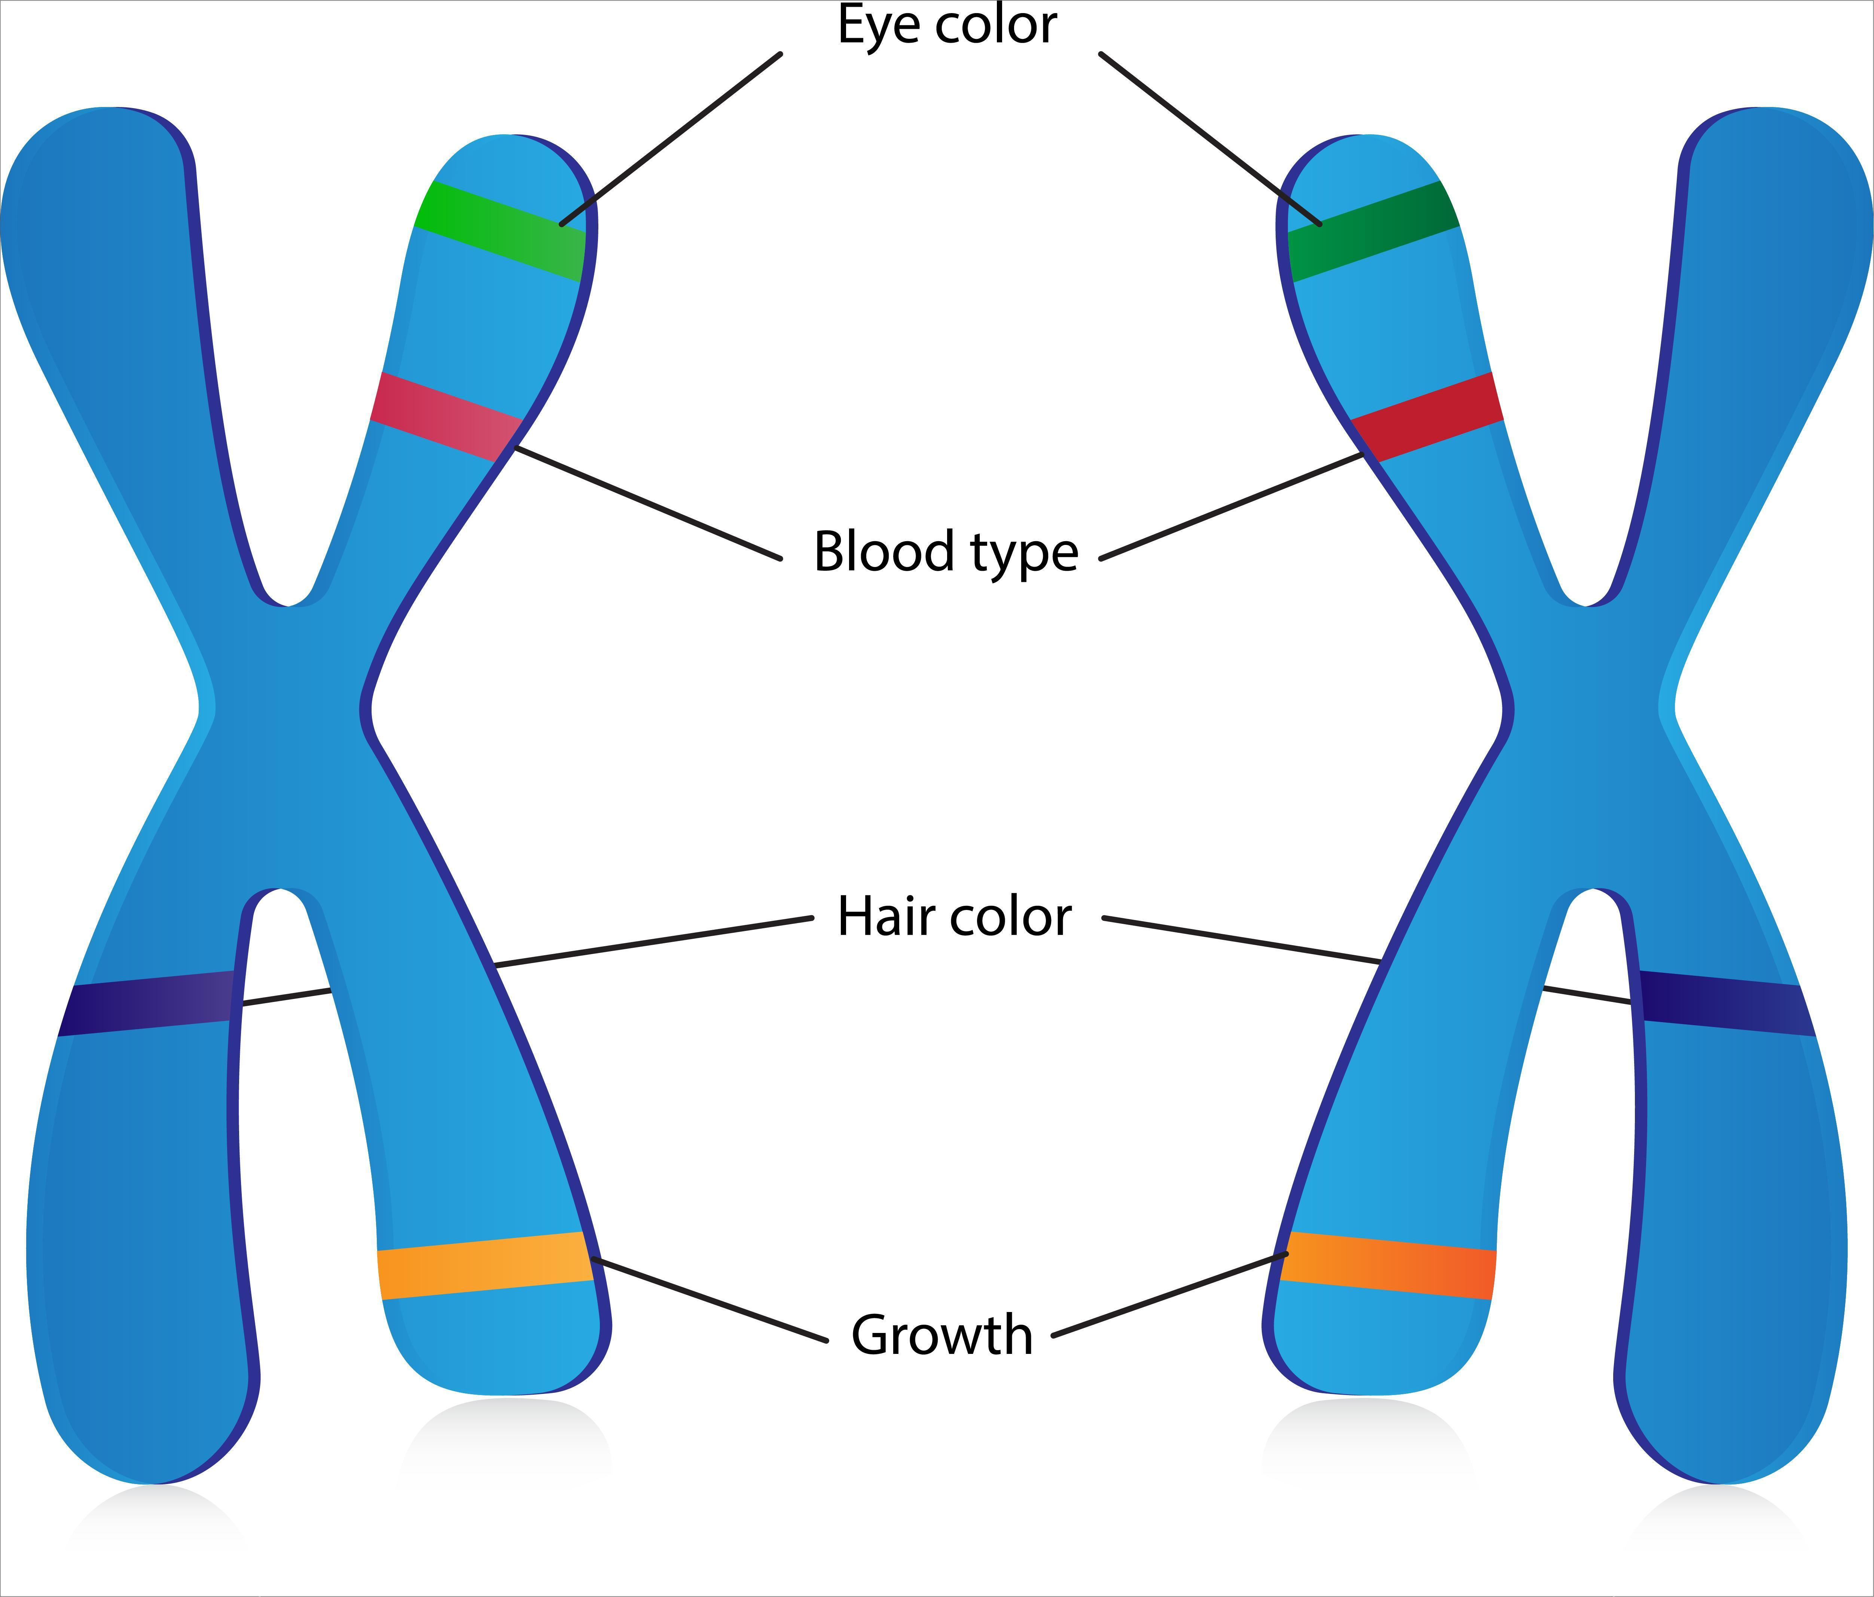
Human chromosomes
A GENE is codes for a specific trait (like eye colour)
An ALLELE is a characteristics of the trait, such as BLUE EYES

Slide 14
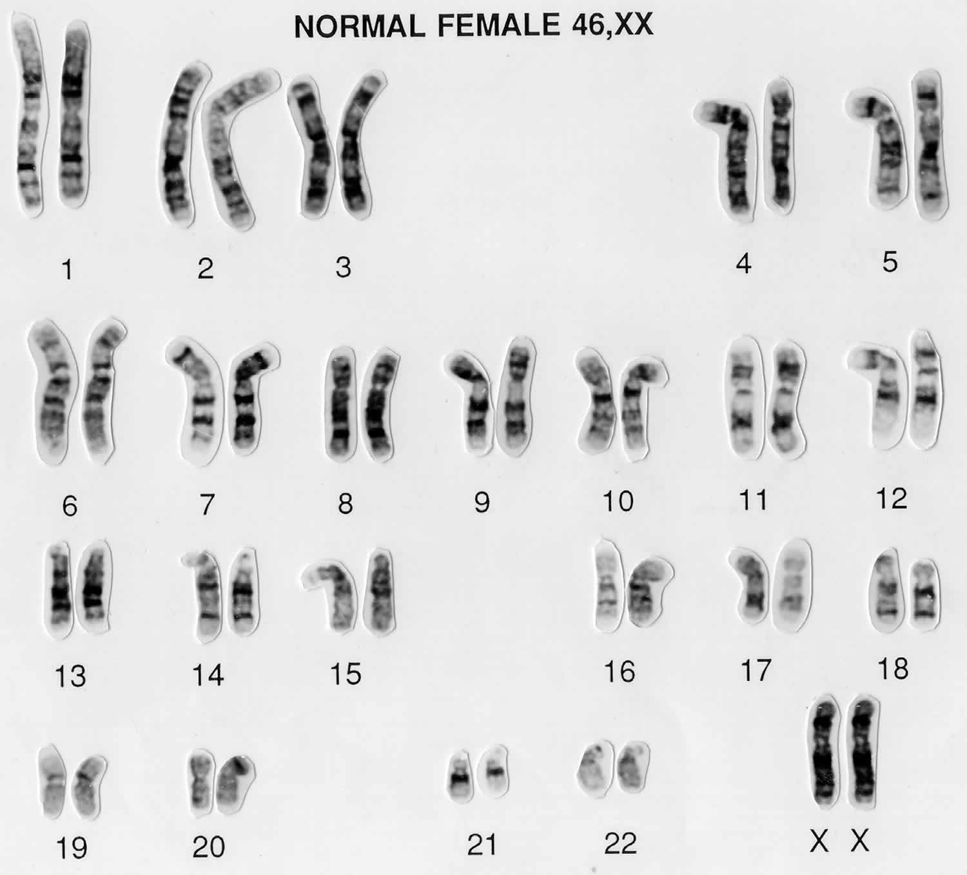
Human chromosomes
A KARYOTYPE is a picture of the chromosomes of a person
Humans have 23 PAIRS (total of 46) of chromosomes
22 autosomes
1 sex chromosome that codes for birth gender

Slide 15
Human chromosomes
Male
Female
What do you notice?

Slide 17
Home Practice
Read page 2
Answer page 3 - 6

