Slide 1
Inquiry Peer Review
Find someone AT A DIFFERENT TABLE and swap your inquiry write up with them
Quietly read EVERY WORD and complete the peer review assessment form
Scientists HELP EACH OTHER and BRING OUT THE BEST in each other. Be sure you give detailed suggestions as to how they can IMPROVE their inquiry write up

Slide 2
DNA Replication
Biology 12

Slide 3
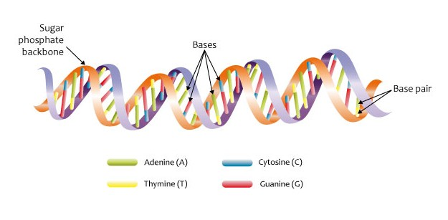
WHAT IS DNA?
DNA is a nucleic acid made up of a repeating structure of a deoxyribose (5 carbon sugar), phosphate group, and a nitrogen base
The coding of the nitrogen bases create the code that will create your proteins
DNA → RNA → Protein

Slide 4
How does DNA fit into a nucleus?

Slide 5
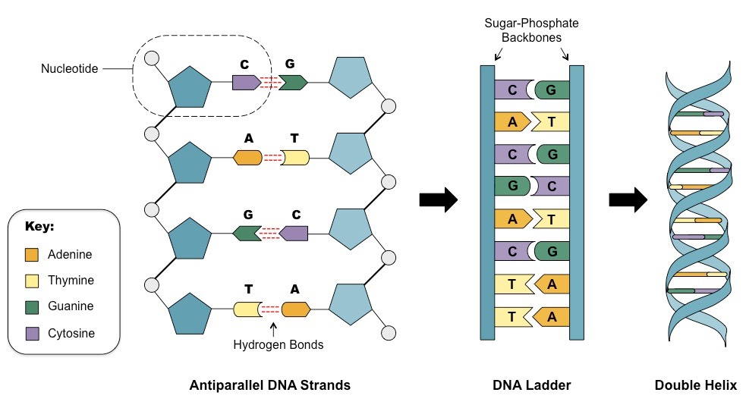

Slide 6
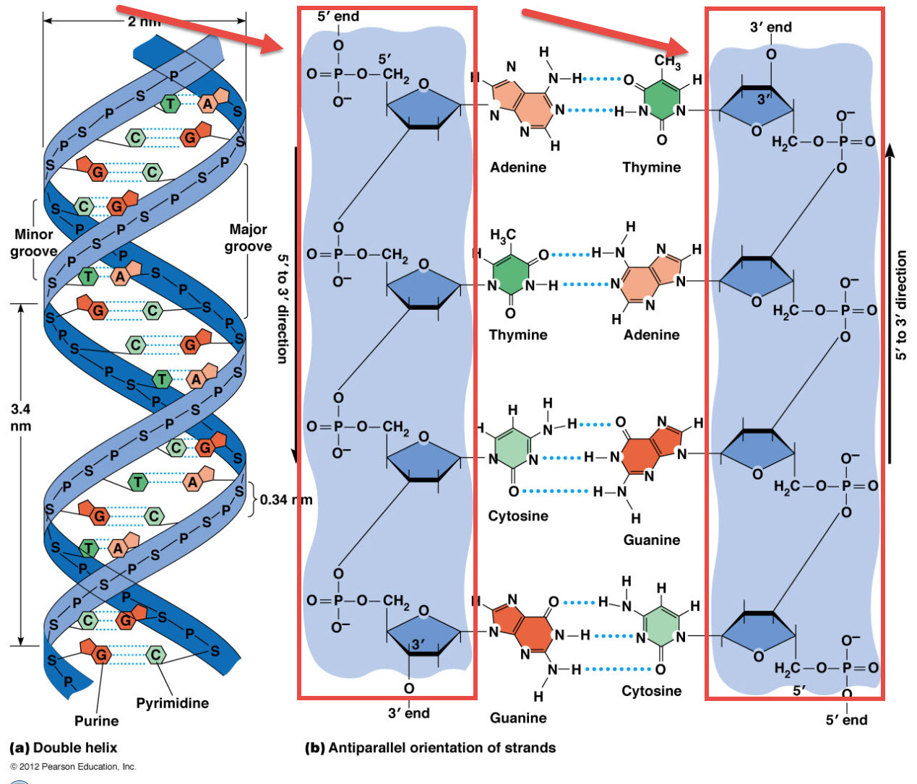

Slide 7
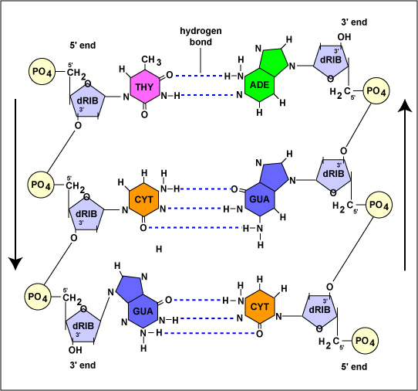

Slide 8
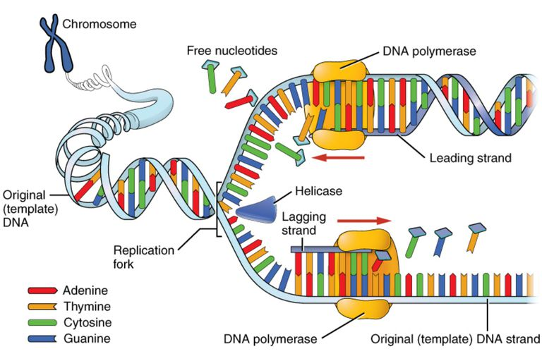
DNA Replication
Click to watch video

Slide 9
Enzymes for Replication

Slide 10
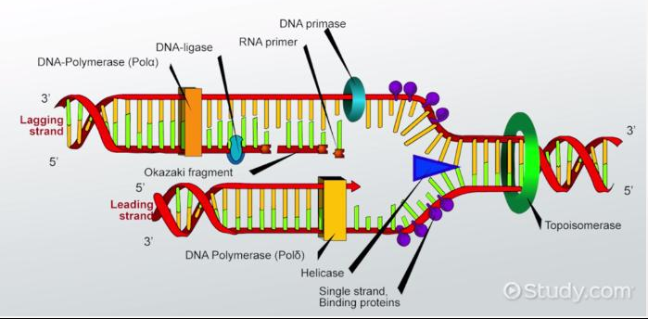
What words would you use to describe what is happening here?

Slide 11
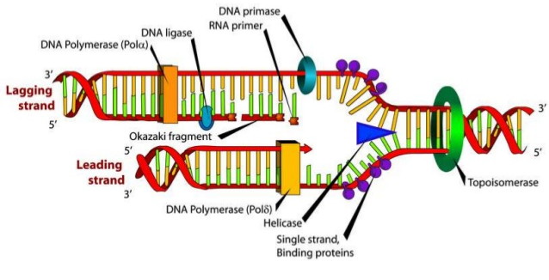
Window Art
With a whiteboard marker, draw and make labels to show how DNA replication occurs
Be sure to include the following structures:
Label 3’ and 5’ sides of DNA
Lagging Strand
Leading Strand
Helicase
Topoisomerase
DNA polymerase III
DNA polymerase I
RNA primase
RNA primer
Ligase
Okazaki Fragments

Slide 12
You Are Not the Mother Of Your Children Case Study
Read Part 1 together as a table team
Questions:
Why must a mother’s DNA match the DNA of her children? Why would Damian expect half of the children’s DNA to come from their mother? Why not 30% of it? Or 70% of the DNA?
What is the process by which DNA is transmitted to offspring? How does only half of the genetic material of the parents get transmitted to the child?
Do you think that Lillian is telling the truth? Why or why not? Does the evidence support her claim?

Slide 13
Humans get DNA from their parents and, accordingly, their DNA should match their parents’ DNA.
In humans, each parent contributes half of their nuclear DNA to their gametes through the process of meiosis.
The segregation of homologous chromosomes in meiosis I, followed by the segregation of sister chromatids in meiosis II, usually ensures that only half of the chromosomes are passed on to the offspring.
In most cases where either more or less than half of the chromosomes is passed on, the resulting embryo will be aneuploid, having more or less than the normal number of chromosomes, and will not survive

Slide 14
You Are Not the Mother Of Your Children Case Study
Read Part 2 together as a table team
Questions:
What is a chimera?
Why does Dr. Vijayvergia think the mother (Lillian) can be a chimera and not appear abnormal?
How could Dr. Vijayvergia’s hypothesis be tested? What could you do to ﬁnd out if Lillian was a chimera?

Slide 15
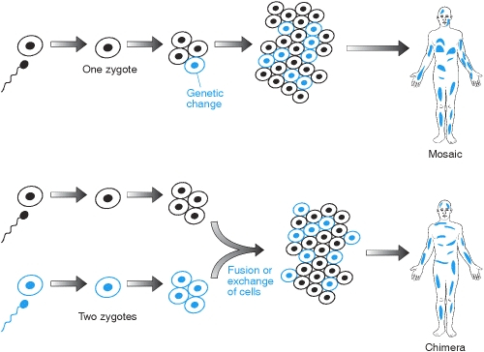
What is a chimera?
a chimera is “an organism composed of cells that are embryologically derived from two different individuals.”
Most chimeric individuals are identified because of ambiguous genitalia. A person with two sets of cells that both had the same genetic sex would develop normally as either male or female. Without noticeable anatomical abnormalities, there would be no reason to suspect a person would be composed of two genetically distinct cell lines, and no reason to do the genetic testing required to identify someone as being chimeric.
Dr. Vijayvergia’s hypothesis could be tested by analyzing the DNA from different parts of Lillian’s body. While in the ideal case one could sample Lillian’s ovaries, in practice this would be avoided because it would involve invasive surgery. However, by sampling different easily accessible parts of her body it should be possible to detect cells of different genotypes.

Slide 16
You Are Not the Mother Of Your Children Case Study
Read Part 3 together as a table team
Questions:
Using your knowledge of the normal process of gametogenesis and fertilization, formulate a hypothesis as to how a chimeric individual could form. In addition to paternity testing, DNA testing is now used legally in many civil and criminal cases.
In what kinds of cases other than parentage could the presence of chimerism cause problems? Propose a situation in which DNA testing of a chimeric individual might lead to an unjust legal decision.

Slide 17
The most common hypothesis is that chimeras result from the fusion of two separately fertilized oocytes. Another hypothesis is that the chimera is the result of a fusion between a fertilized oocyte and a separately fertilized first or second polar body.

Slide 18
Homework
Watch and take notes on Bozeman Science DNA Replication video (use worksheet for notes)

