Slide 1
Lung Capacity & Respiratory Illnesses

Slide 2
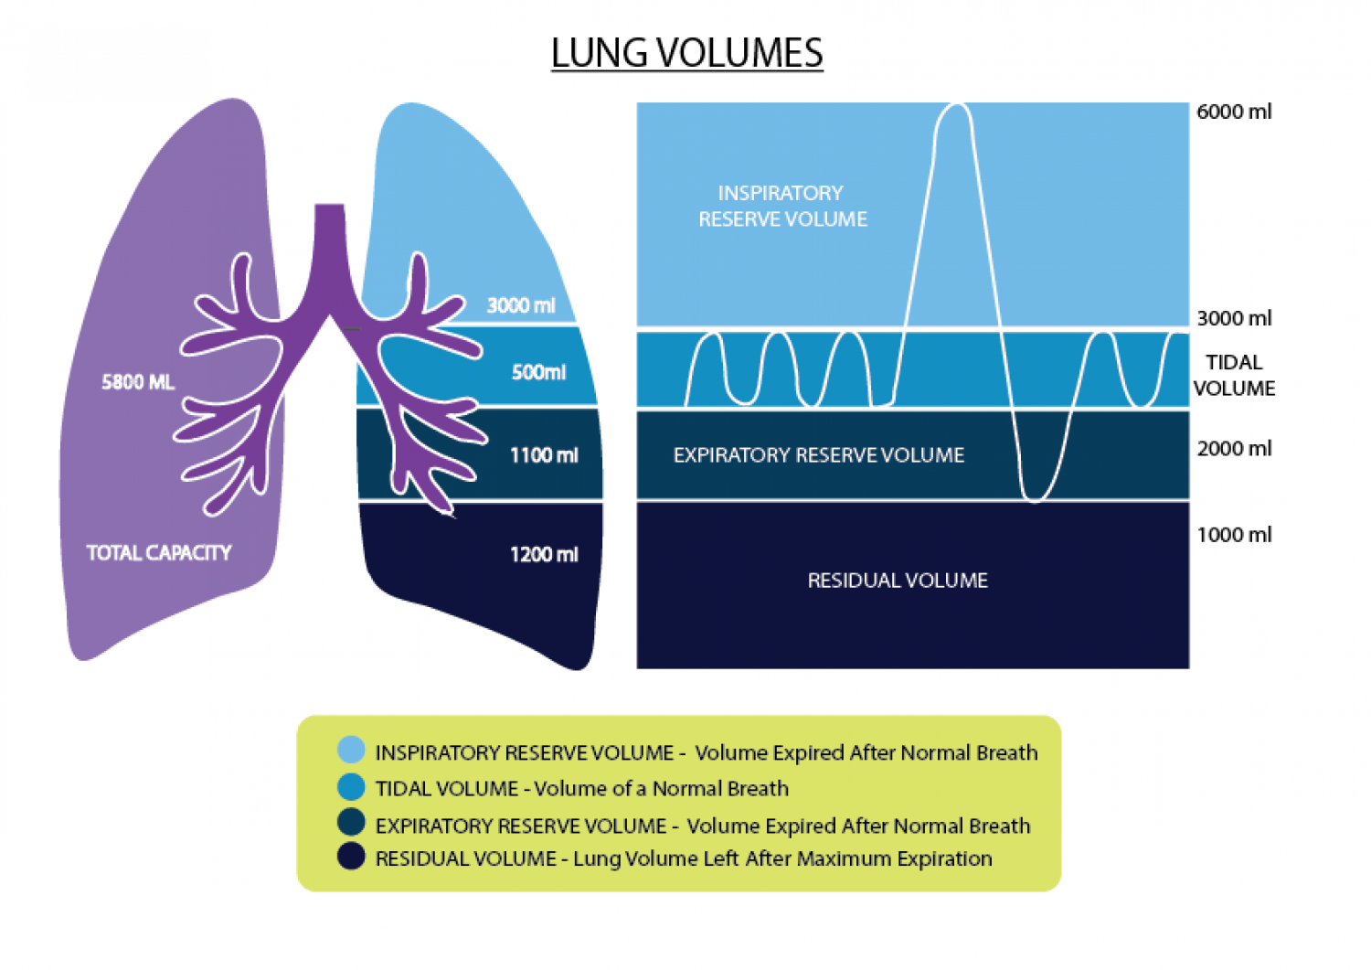

Slide 3
Lung Capacity’s measured
Volume Definition | What is it? | Approx. volume
Total Lung Capacity | What volume of air fits in the alveoli at full capacity | ~5.5-6L
Tidal Volume | Normal breathe in and out | 0.5L
Inspiratory reserve | Breath allowed IN after normal breath | 3L
Expiratory reserve | Breath allowed OUT after normal breath | 1L
Residual volume | Air stuck in lungs at all times | 1L

Slide 4
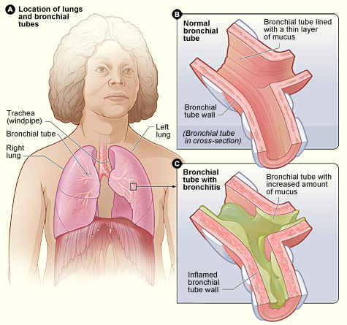
Bronchitis
inflammation of the bronchi tubes
increased mucus production
often a secondary infection (viral)
may be accompanied by a high fever

Slide 5
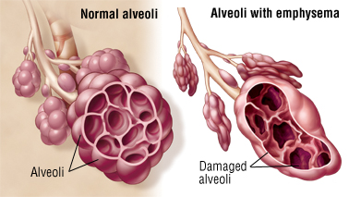
Emphysema
gradual damaging of the air sacs of the lungs
one of the disease of COPD (chronic obstructive pulmonary disease)
smoking is leading cause

Slide 6
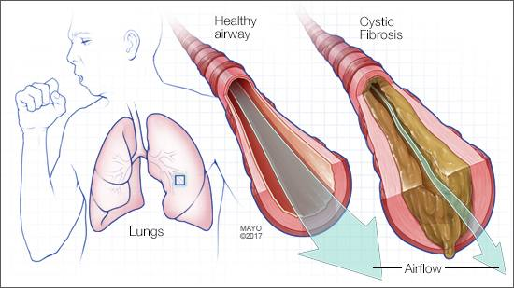
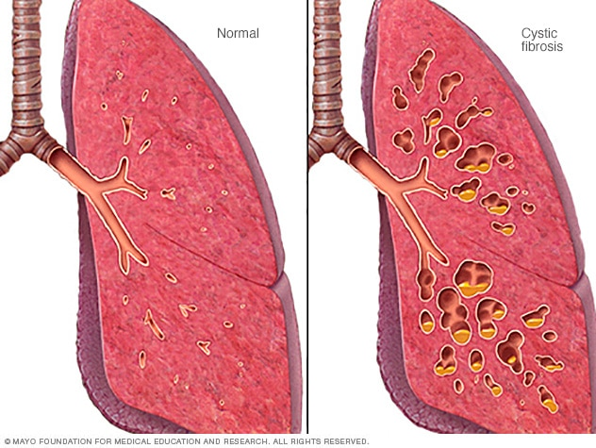
Cystic Fibrosis
hereditary
loss of lung tissue
can not absorb proteins
loss of pancreatic enzymes functioning

Slide 7
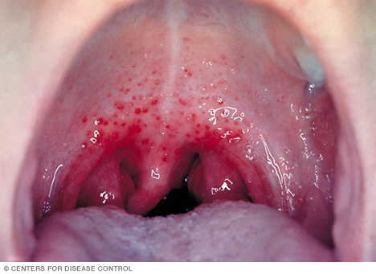
Strep Throat
caused by streptococcal bacteria
can cause kidney inflammation and rheumatic fever (joint pain)
painful swallowing

Slide 8
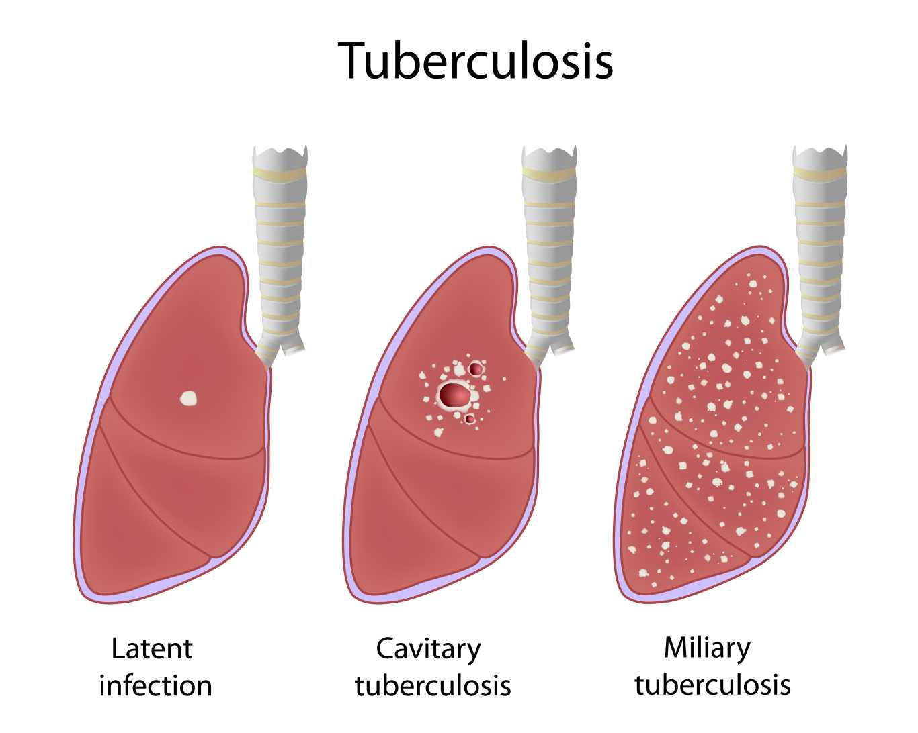
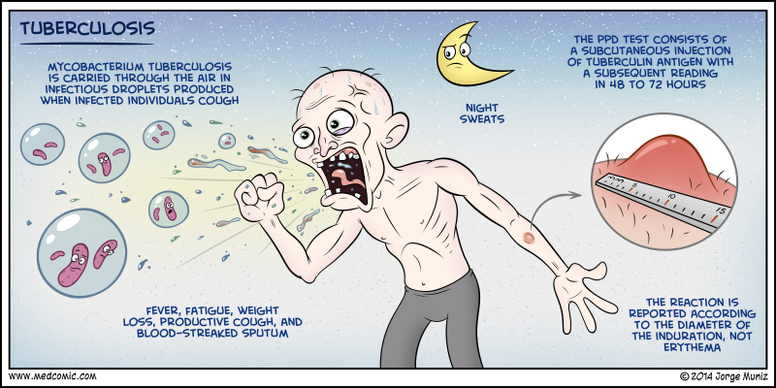
Tuberculosis
caused by bacteria that is spread by air droplets
can impact your lungs, kidney, and brain
many strains are drug resistent

Slide 9
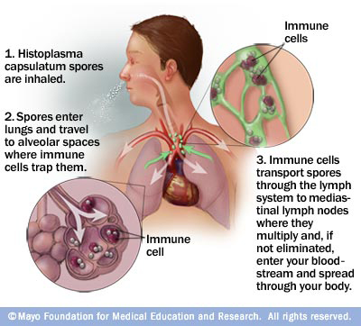
Histoplasmosis
spores from fungus infect lungs
from feces of birds and bats
not contagious
not an issue if stays in lungs. Can be fatal is spreads through body

Slide 10
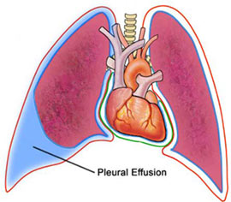
Pleural Effusion
abnormal amount of fluid accummulate at base of lung in space of pleural cavity
secondary issue from pneumonia
due to body not handling fluid properly

Slide 11
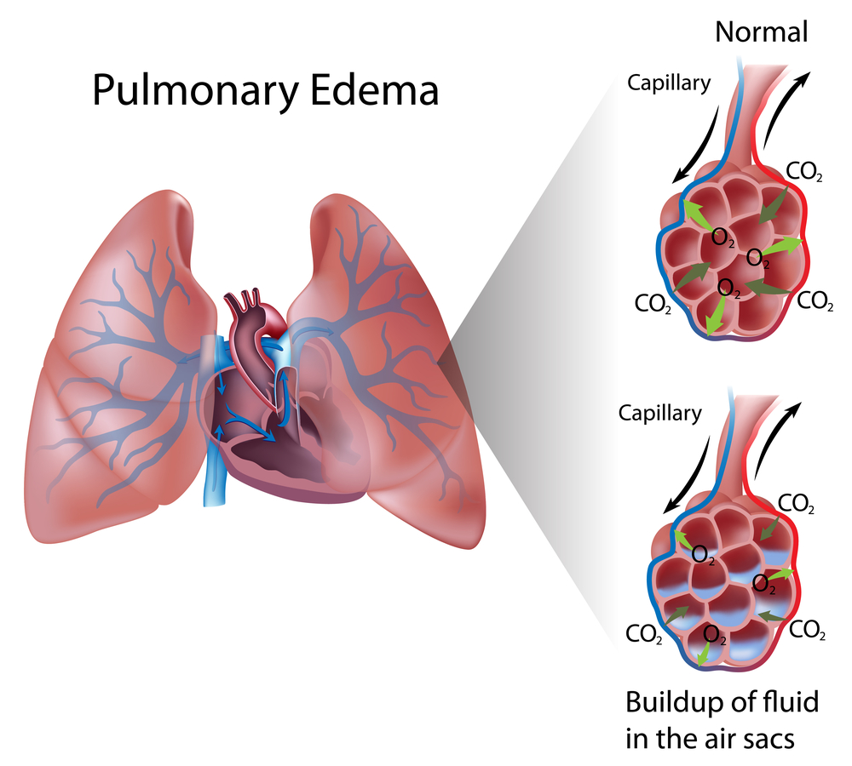
Pleural Edema
fluid retention in the alveoli sacs
can be a symptom of heart failure
frothy sputum with bloody colour

Slide 12
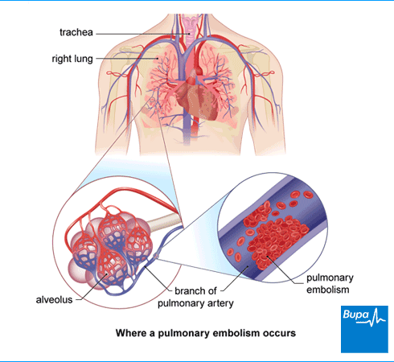
Pleural Embolism
blockage of one of the pulmonary arteries
mostly caused by blood clots that travel from the lungs
connected to deep vein thrombosis (DVT)

