Slide 1
Parallel and Perpendicular Lines
FOM 11

Slide 2
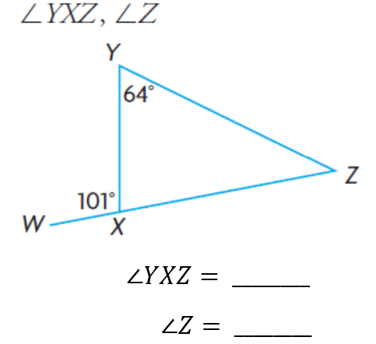
Warm Up
What is YXZ and Z?

Slide 3
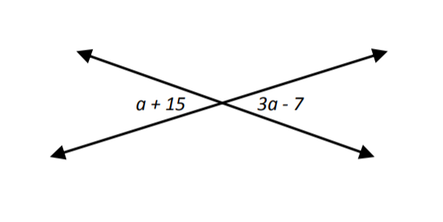
Warm Up
What is a?

Slide 4
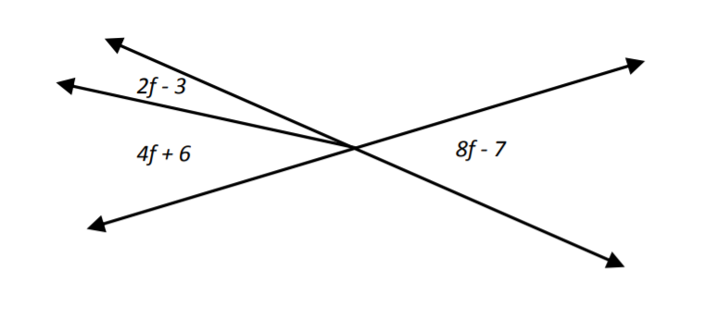
Warm Up
What is f?

Slide 5
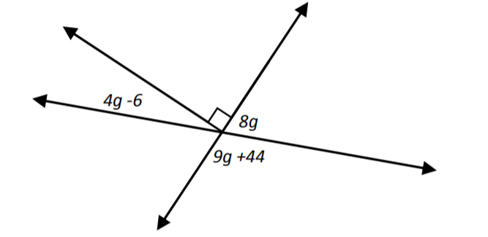
Warm Up
What is g?

Slide 6
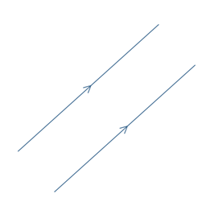
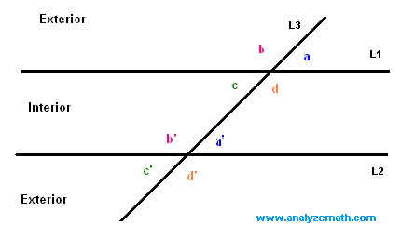
What does PARALLEL mean?
Lines that will continue and never intersect
Will stay the same width apart when extended

Slide 7
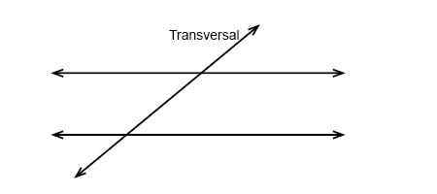
Vocab To Know
Transversal is a line that bisects lines
If thee lines are parallel there are some specific properties that result

Slide 8
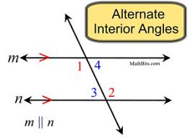
PARALLEL lines and angles
Opposite interior angles are the same
Same side interior angles are supplementary

Slide 9
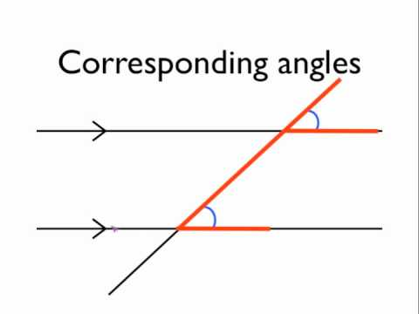
PARALLEL lines and angles
Corresponding angles are the same

Slide 10
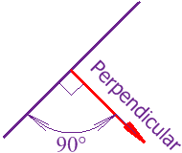
What does PERPENDICULAR mean?
When one line bisects another at a 90º angle

Slide 11
To Do
Worksheet #1 (3 pages)
Worksheet #2 (2 pages)
Ask questions!!! ☺

