Slide 1
Contraception
Biology 12

Slide 2
Types of Contraception
Barrier Method:
Stops gametes from meeting
Condom (male and female)
Diaphragm
Cervical cap
Sponge
Sterilization
Chemical Method:
Prevents ovulation and thickens cervical mucous
Mini Pills (Prog only)
Combo Pills
IUD
Injection
Patch
Implant
NO STI protection

Slide 3
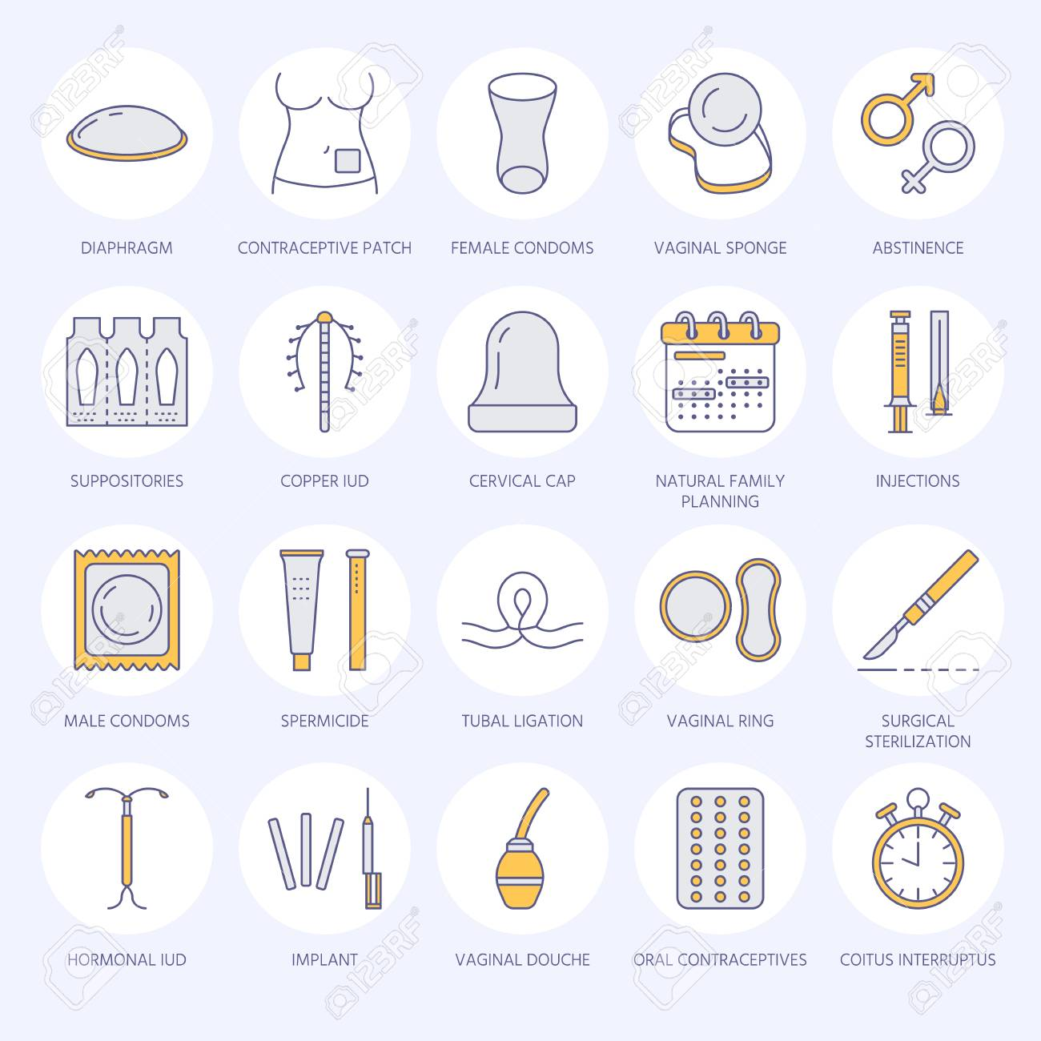
Types of Contraception
Watch video

Slide 4
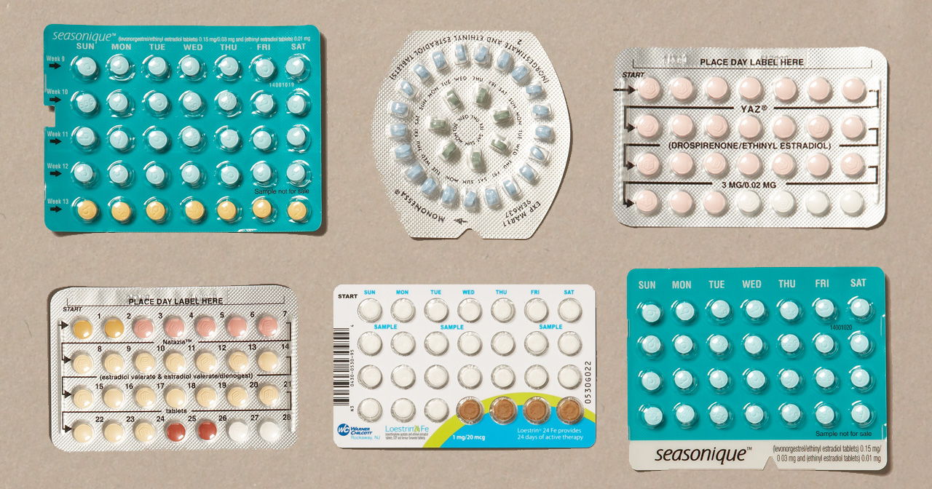
Birth Control Pills
Watch video

Slide 5
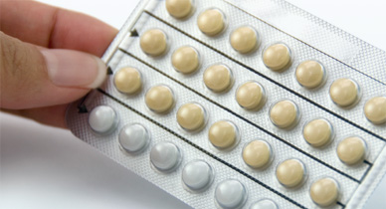
Mini Pills (Progestin only)
Progestin-only birth control pills, sometimes called “mini-pills,” have several effects in the body that help prevent pregnancy:
The mucus in the cervix thickens, making it difficult for sperm to enter the uterus and fertilize an egg
They stop ovulation, but they do not do so consistently. About 40% of women who use progestin-only pills will continue to ovulate
They thin the lining of the uterus
NO STI Protection!!!

Slide 6
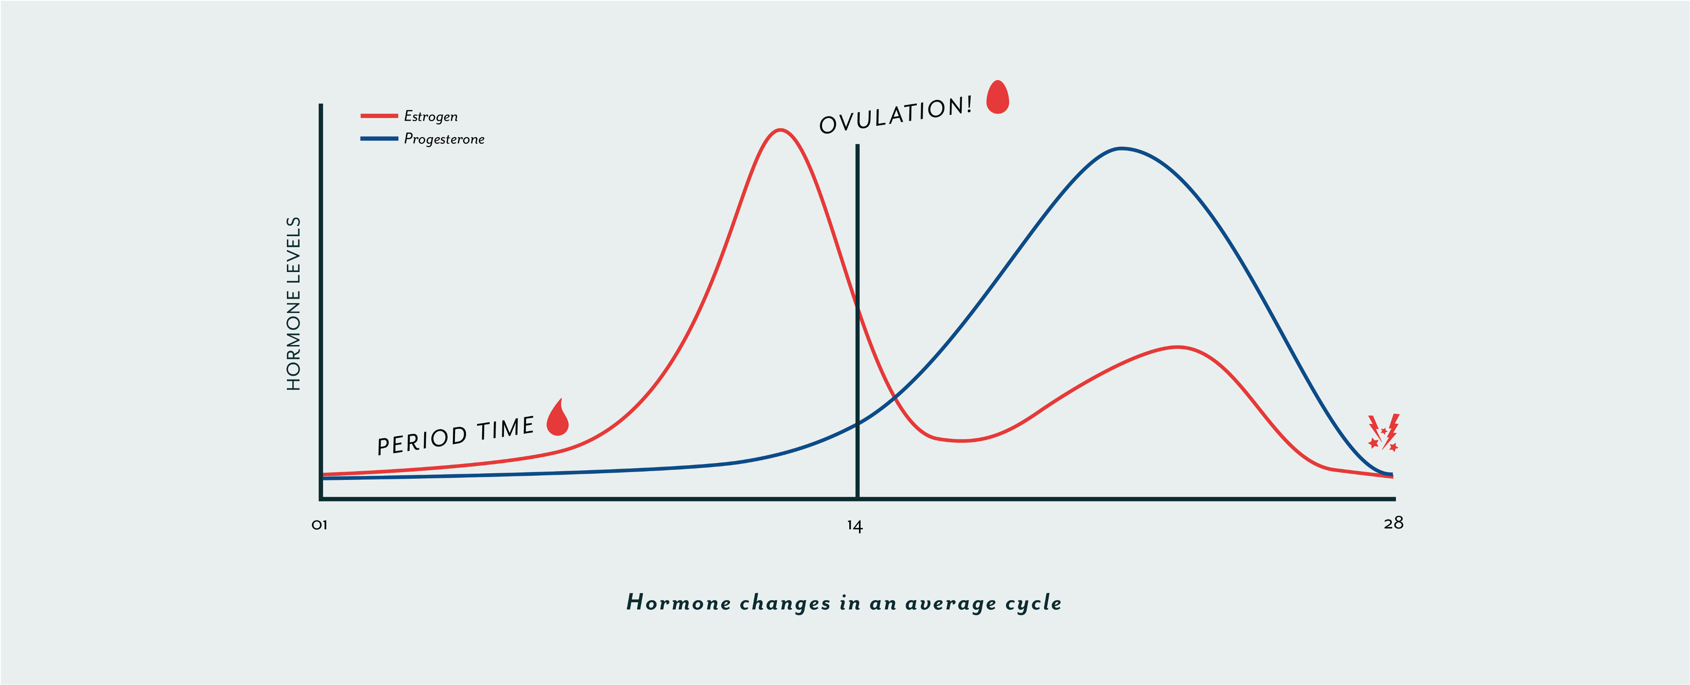
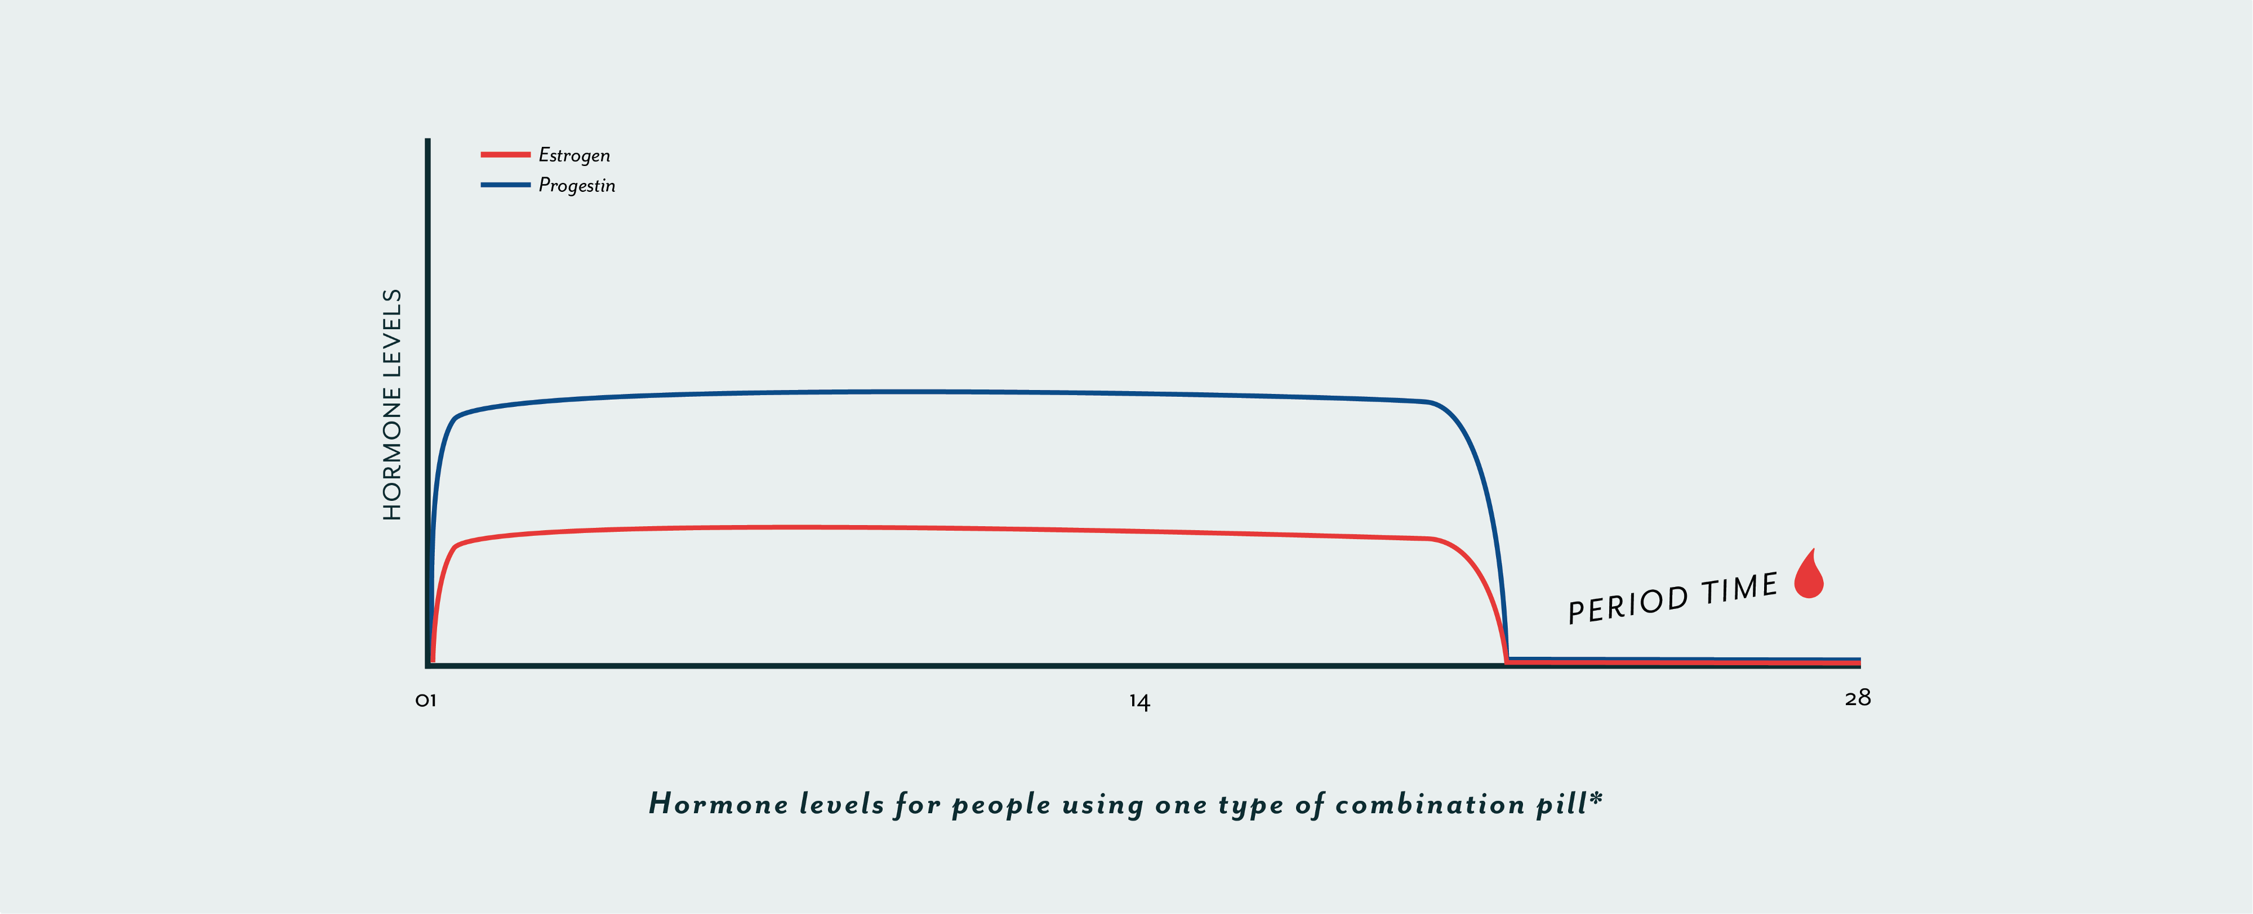
Combination Pills (Progesterone and Estrogen)
The heightened levels of progesterone and estrogen suppress FSH and LH from maturing and releasing another ova…no ovulation

Slide 7
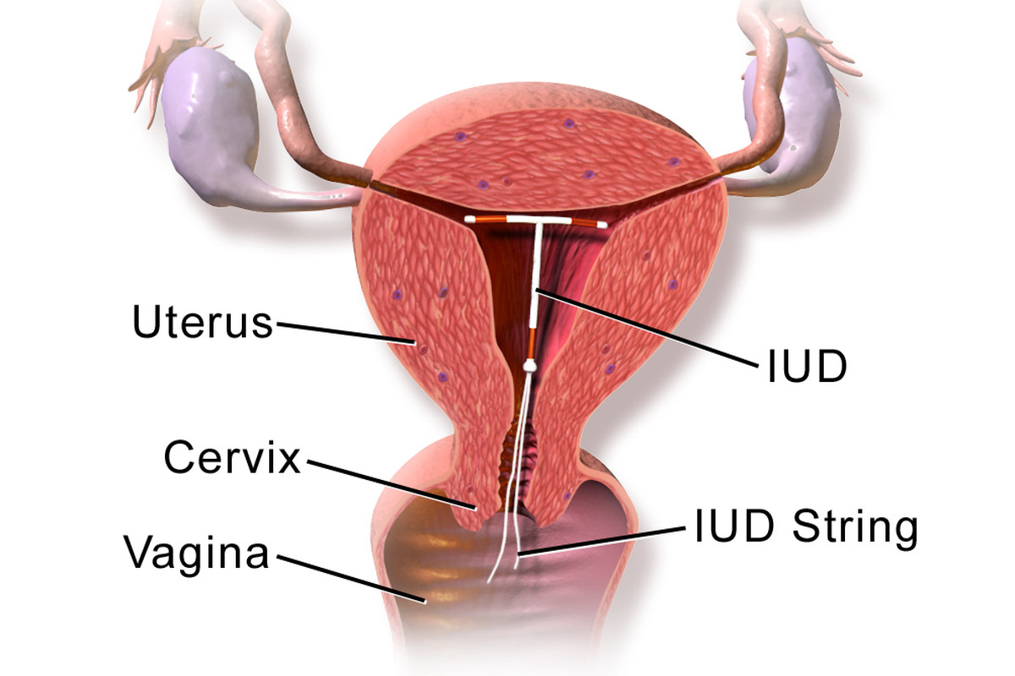
I.U.D
99% effective
Can be plastic with hormone release or copper
Prevent sperm from successfully making it through the uterus
Copper kills sperm
NO STI Protection!!!

Slide 8
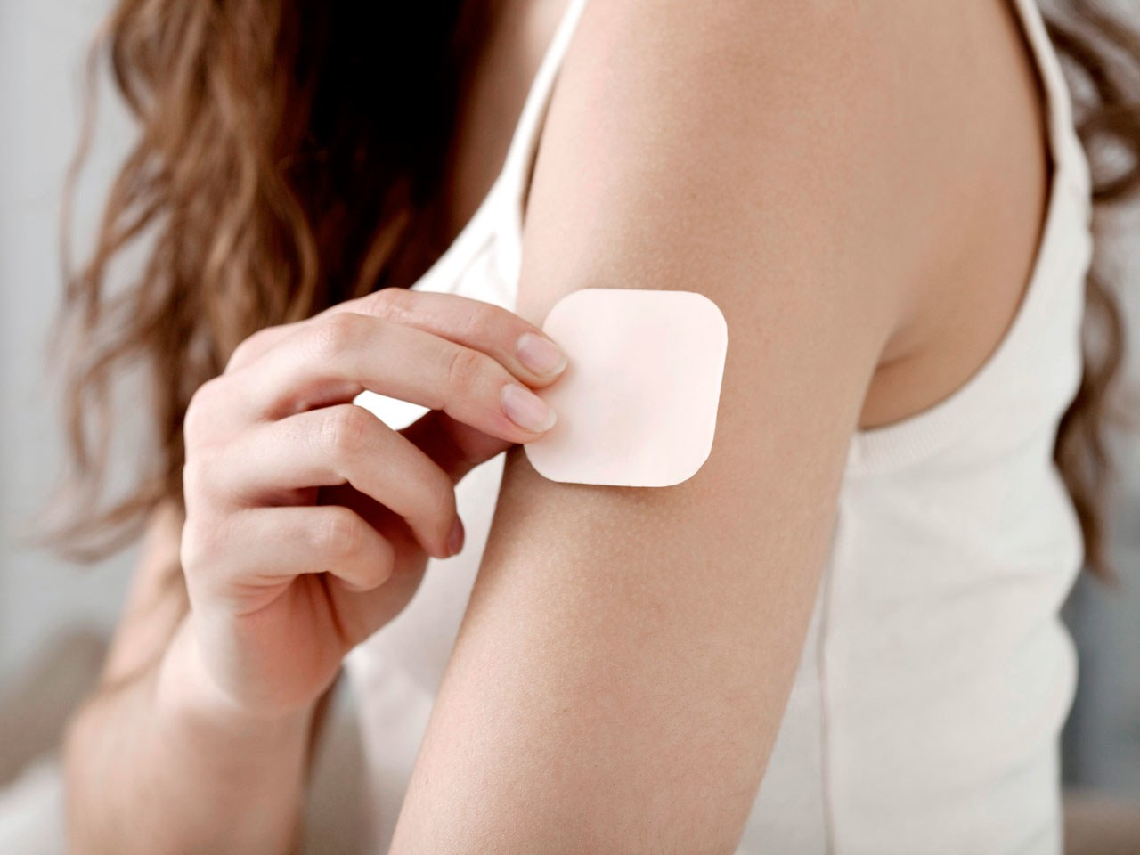
Birth Control Patch
Releases hormones through the skin
Contains estrogen and progesterone
Prevents ovulation and thickens cervical mucous
Put on new patch each week
NO STI Protection!!!

Slide 9
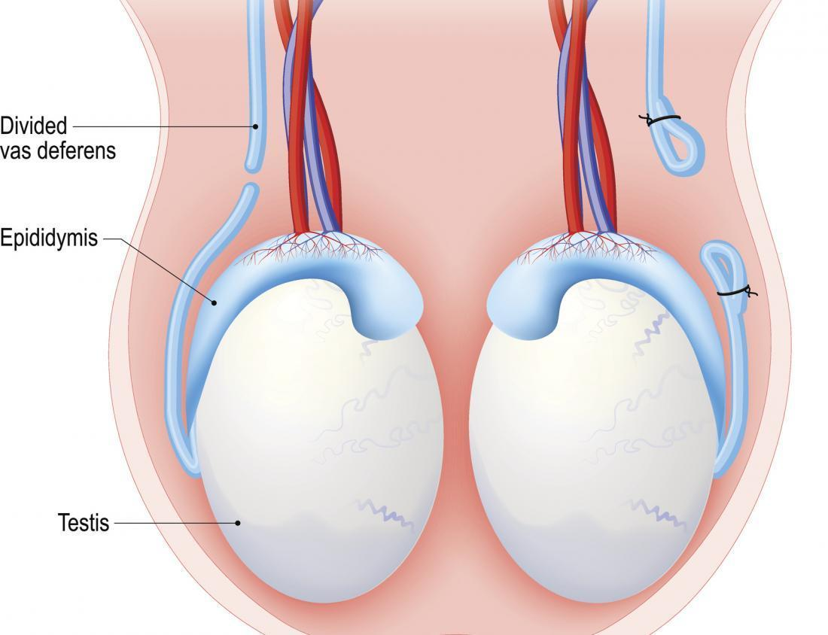
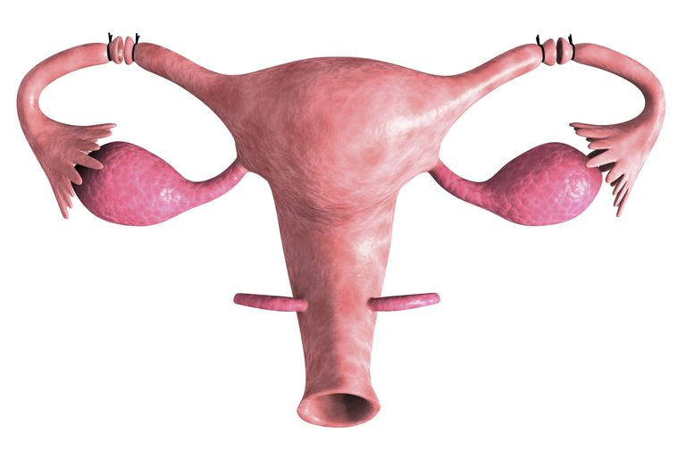
Sterilization
NO STI PROTECTION
Vasectomy
Males
Tubal Ligation
Females

Slide 10
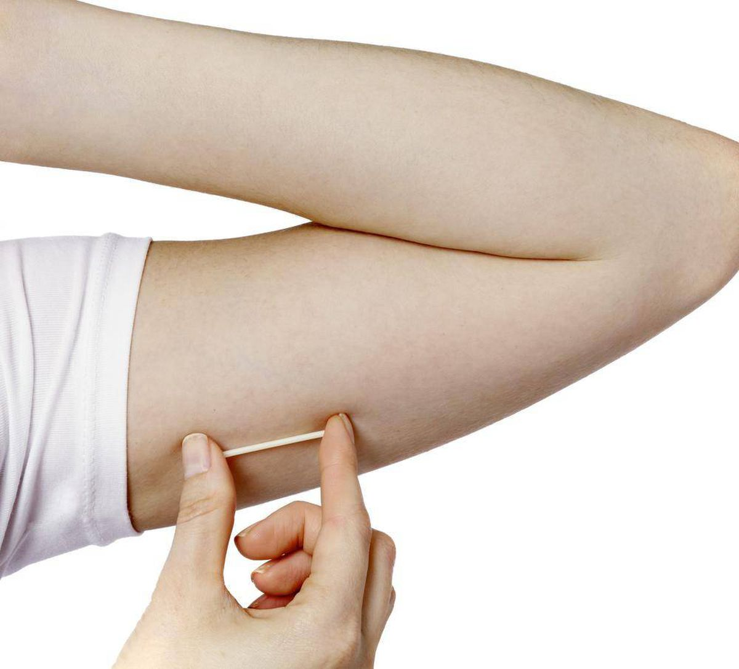
Nexplanon
Implant in the arm
Releases progestine
Lasts 5 years
Doctor implants
NO STI Protection!!!

Slide 11
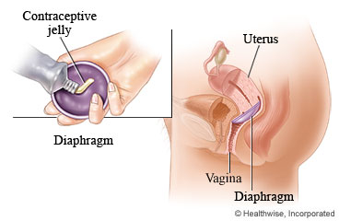
Diaphragm
Acts as a barrier to prevent sperm from going up uterus
Used in conjuction with spermicidal jelly which contains a chemical which will kills sperm
NO STI Protection!!!

Slide 12
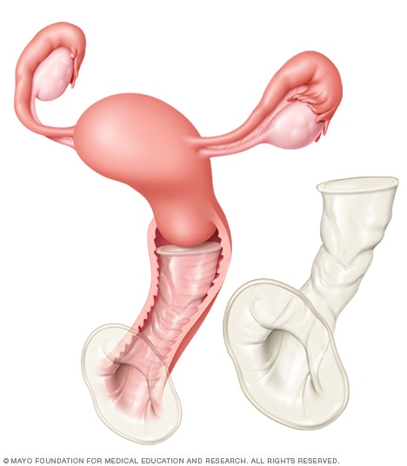
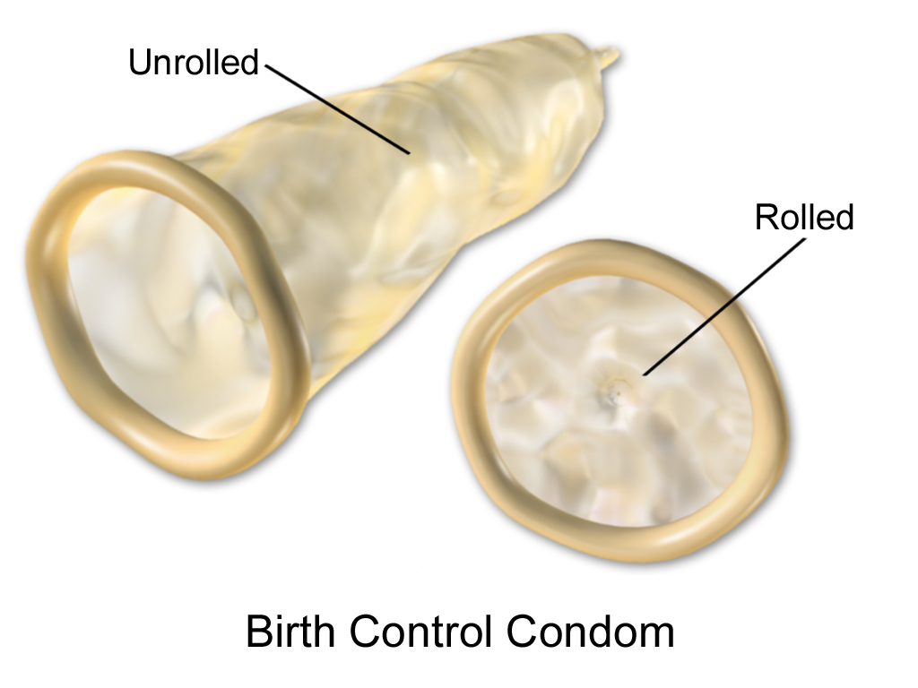
Condoms
The only form of contraception which has SOME protection against STI infections
Acts as a barrier so that gametes do not meet. If gametes do not meet, fertilization can not occur
Male Condom
Female Condom

