Slide 1
Compound Interest and Loans
FOM 11

Slide 2
You invest $950 in a simple interest account at 7.5% per annum for 6 years. How much money do you have at the end of your investment?

Slide 3
Sam has invested $12,000 in a 6 year investment compounded yearly at a rate of 4.1% per annum. What is the value of the investment at the end of the 6 years?

Slide 4
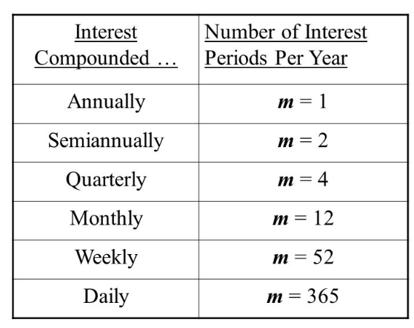
Compounding Periods

Slide 5
Is having more frequent compounding periods a good thing?
You invest $5000 at 8% compounded annually for 10 years
You invest $5000 at 8% compounded semi-annually for 10 years
You invest $5000 at 8% compounded quarterly for 10 years

Slide 6
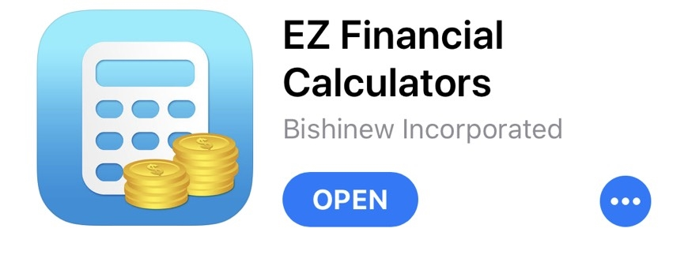
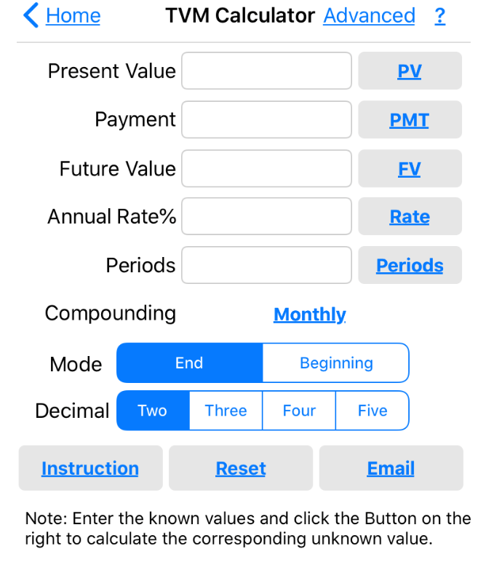
Using a TVM Solver
TVM
Time Value of Money

Slide 7
Jack would like to invest money so that he will have $9000 in 5 years. The bond he would like to invest in predicts an annual interest rate of 2.75% compounded quarterly. How much should his initial investment be?
Periods = #years x #Comp peri/year
ie. (5)(4)

Slide 8
Annuity
A series of equal payments made at regular time intervals. There are 3 types of annuity:
1. a regular savings plan
2. paying off a loan or a mortgage
3. Retirement income

Slide 9
Beth invests $600 in a savings account quarterly. If the account pays interest at 7% per year compounded quarterly, what is the value of the investment at the end of the 3 years?

Slide 10
Bill wants to set up a fund for his granddaughters. The girls had to choose between the following two options:
$2000 will be invested each birthday between age 27 and 64 inclusive. The money will stay in the account until age 65.
$2000 will be invested each birthday between age 19 and 26 inclusive. The money will stay in the account until age 65.
Both options will receive interest at a rate of 10% per year compounded annually until age 65.
Which should they choose and why?

Slide 11
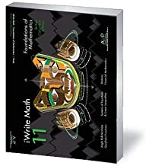
Homework
Page 333 #1 – 12
Use your TVM Solver for 3 - 12

