Slide 1
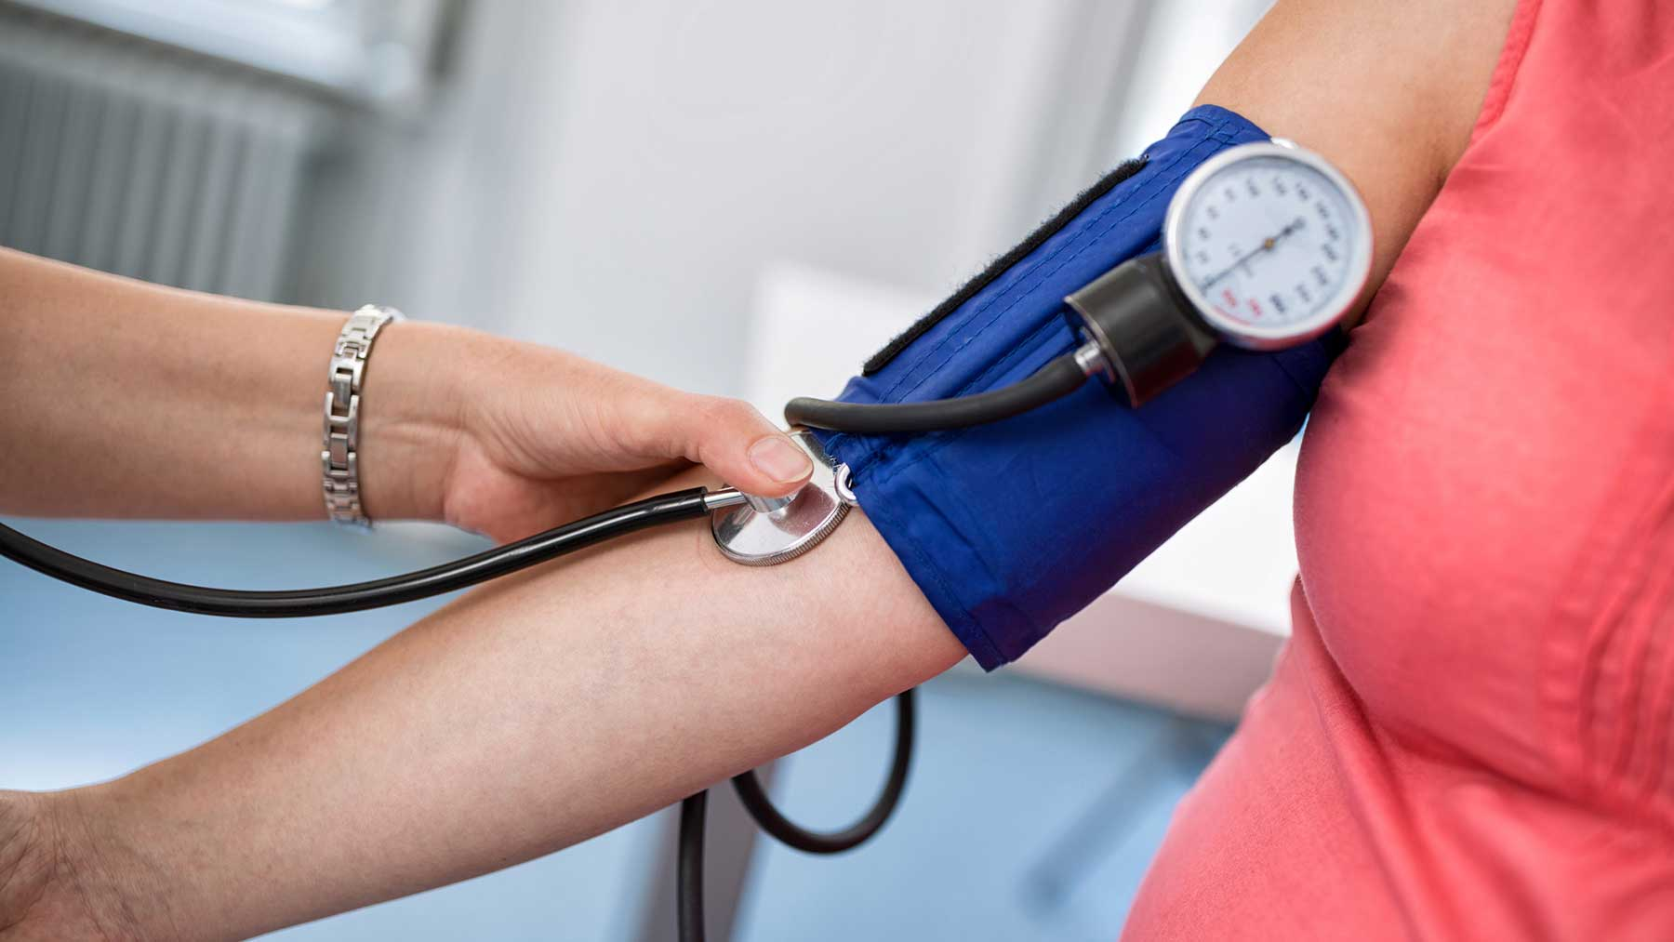
Circulation & Respiration Inquiry Lab
Biology12

Slide 2
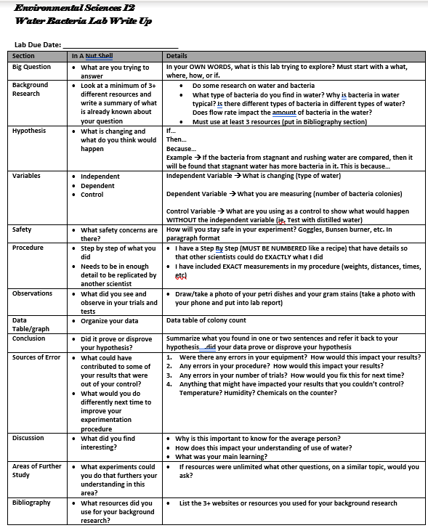

Slide 3
What is your BIG QUESTION?
How does…
Does…
Something to do with pulse, breathing rate, blood pressure
Use everyday language

Slide 4
What BACKGROUND RESEARCH is needed for you to understand your question?
Ask 4 questions for research:
How does breathing rate speed up or slow down?
How does heart rate speed up or slow down
Neurotransmitters involved
Nerves involved
What is already known about your topic?

Slide 5
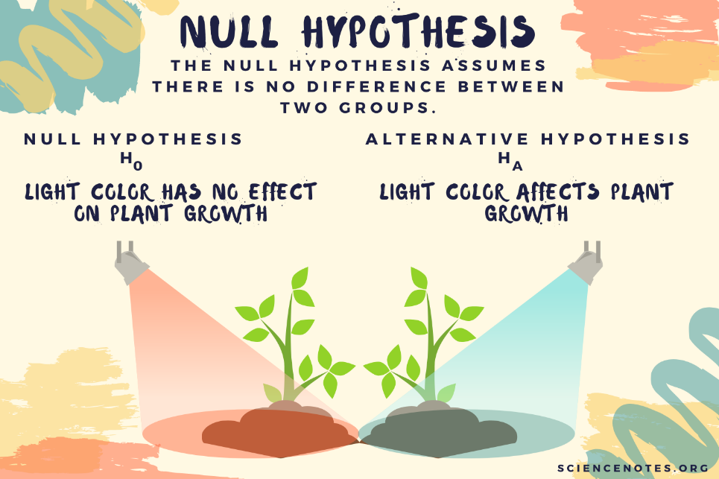
What is your HYPOTHESIS?
If, then, because
Come up with your hypothesis now…
Share out with your partner…

Slide 6
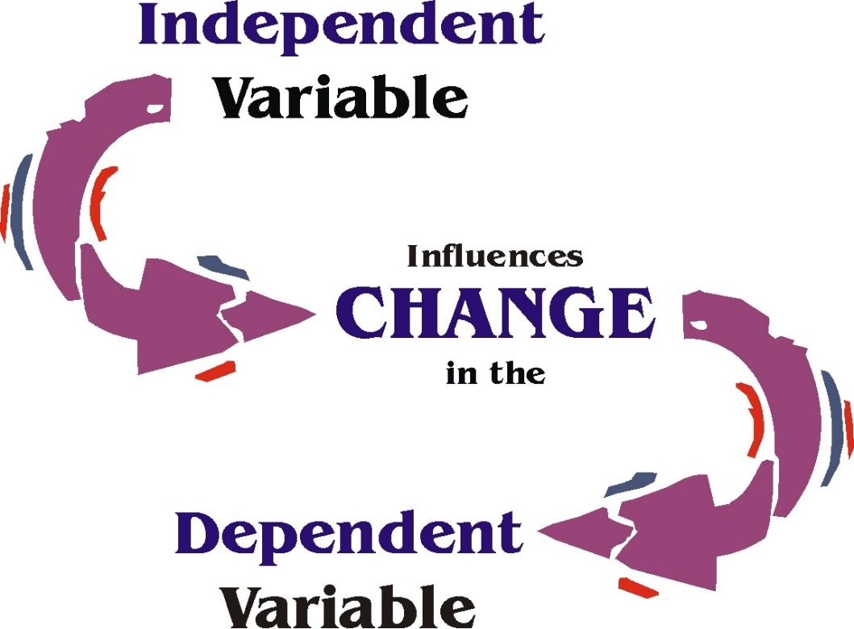
What are your VARIABLES?
Independent variable → what you are changing
Dependent variable → what you are measuring for
Controls → what are you controlling for (temp, same number of reps, randomization of people)

Slide 7
What OBSERVATIONS can you make?
photos of set-up is appropriate
What did you notice about participants (can use I statements here)

Slide 8
Data To Collect
Pulse (heart beat per minute) – heart health
Breathing rate – lung health
Blood pressure – vessel health
Collect 2 of these 3 options

Slide 9
Data Table
Data table #1: This table shows the data of heart rate for both per test (baseline), cardio, and strength (beats per minute)
 | Baseline | Cardio workout | Strength workout
Person A | 70 | 200 | 105
Person B | 65 | 190 | 132
Person C | 50 | 176 | 155
Person D | 75 | 199 | 144
Person E | 80 | 176 | 162
Mean | 68 | 188.2 | 139.6
Standard Deviation | 11.5 | 11.8 | 22.4

Slide 10
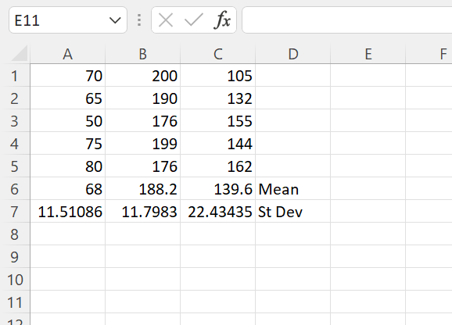
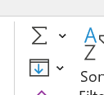
Bar Graph of Mean and SD
Gram Stain each TYPE of colony

Slide 11
Bar Graph of Mean and SD
Gram Stain each TYPE of colony

Slide 12
What is your Conclusion?
Think back to your BIG QUESTION….answer it
What data supports this conclusion?

Slide 13
What are your SOURCES OF ERROR?
Not enough trials
Didn’t label?
Person counting themselves
Thinking about breathing impacts it
Health concerns of individual
Not temperature regulated
Vessel health, colds, respiratory issues
Athletic fitness differ

Slide 14
Have a Discussion why this is important?
What did you learn about the circulatory system and respiratory system (be reflective)?
Why might this be important to know in society?
How might we use this new information to help our community (locally and globally)

Slide 15
What FURTHER STUDIES/EXPERIMENTS interest you in this topic?
What other questions do you have about both/either the respiratory system or circulatory system
What would impact the health of our local or global societies?

Slide 16
State your Bibliography
In your research, what websites did you use?
Include the following details
Author of website, year it was published, Website link

