Slide 1
Biological Control Gone Wrong
Environmental Sciences 11/12

Slide 2
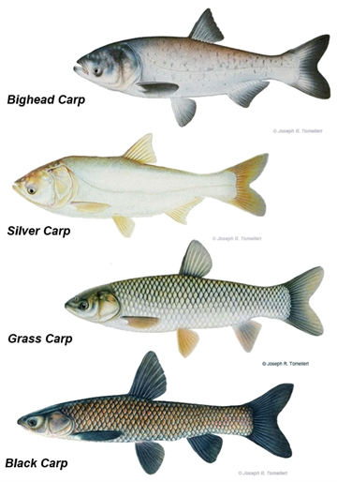
Asian Carp
several species of Asian carp: silver carp, bighead carp, grass carp and black carp
introduced to North America from China in the 1960s and 1970s in an effort to control algae, plants and snails in ponds
they have been spreading throughout waterways across North America

Slide 3
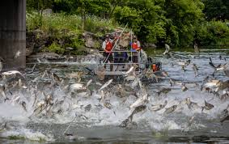
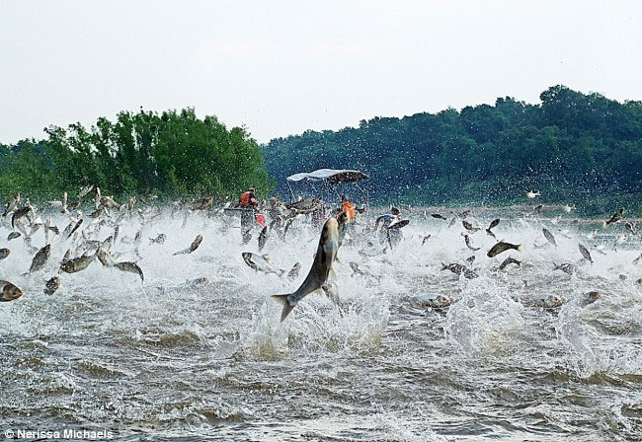

Slide 4
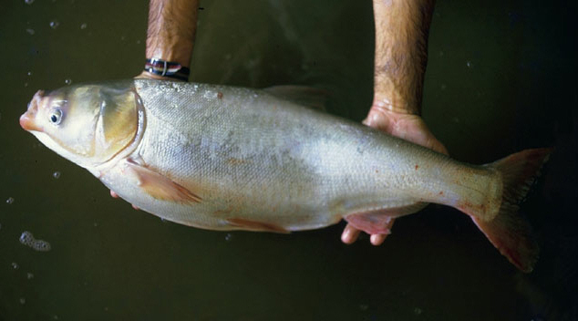
Issues for Ecosystem
Carp consumes very high amount of aquatic plant life
As they forage, they create murky waters
Murky water impacts the hunting of other fish in the pond and decrease the photosynthesis for the bottom plants
Murky water is harmful for young fish of other species
Reproductive rate of carp very fast, lots of eggs

Slide 5
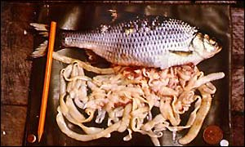
Issues for Ecosystem
Carp also has a tapeworm often in its system that will infect other fish as well
Decline of the native fish is impacting fisheries

Slide 6
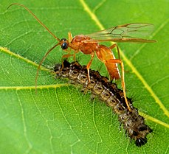
Parasitic Wasp
Aphids are a pest of plants and cause huge damage to plants as they remove nutrients from the plant.
An example of biological control is the release of parasitic wasps to control aphids.
parasitic wasp lays eggs in aphids
aphids will die when the eggs come out and the young wasps start to grow
aphid population will decrease quickly.

Slide 8
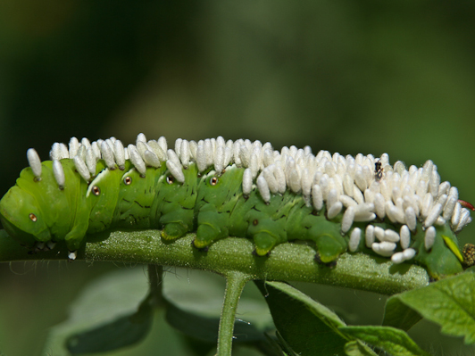
Issues for Ecosystem
Native to Texas, artificially introduce into Hawaii to prey on sugar cane pests
Can impact the decomposers, which will impact rate of forest litter recycling

Slide 9
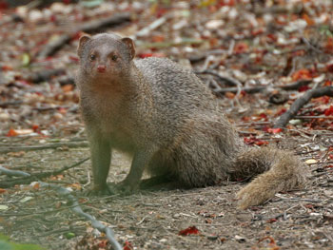
Asian Mongoose
Introduced to Hawaii in order to control rat population
Rats are nocturnal (active at night) and mongoose are diurnal (active in day)
Mongoose has decimated the Hawaiian bird population
Hawaii has introduced $1000 fine if cause breeding or keeping any mongoose
Opportunistic feeder (will eat anything that lands in its way)

Slide 10
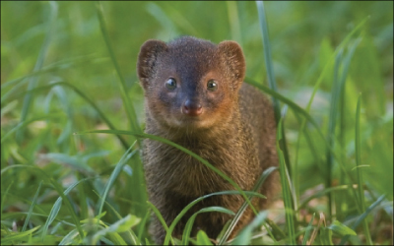

Slide 11
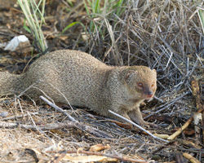
Issues for Ecosystem
Opportunistic feeder
Harming bird population
Very rare birds in Hawaii are going extinct due to mongoose predation
Mongoose are diural, so active during the day
Omnivores, so will eat anything

Slide 12
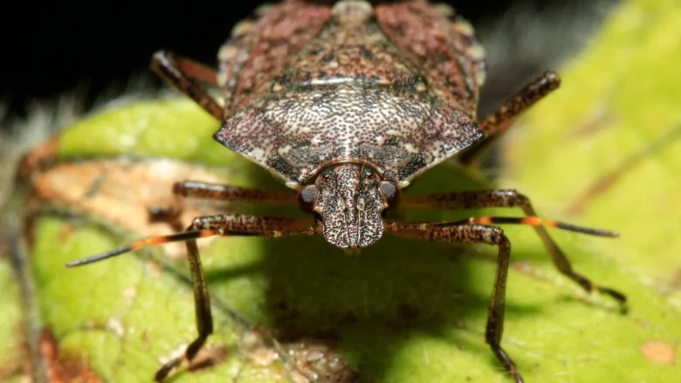
Invasive Species Stick Bug
Brown Marmorated Stink Bug is an invasive species in the Okanagan
Introduced to North America in 2010.
Harms stone fruit crops (peaches and apricots) and apples
Reproduce quickly in warmer areas (impact Okanagan greatly)

Slide 13
