Slide 1
Carbon Sequestration & Recapture
Environmental Sciences 11/12
June 10th, 2020

Slide 2
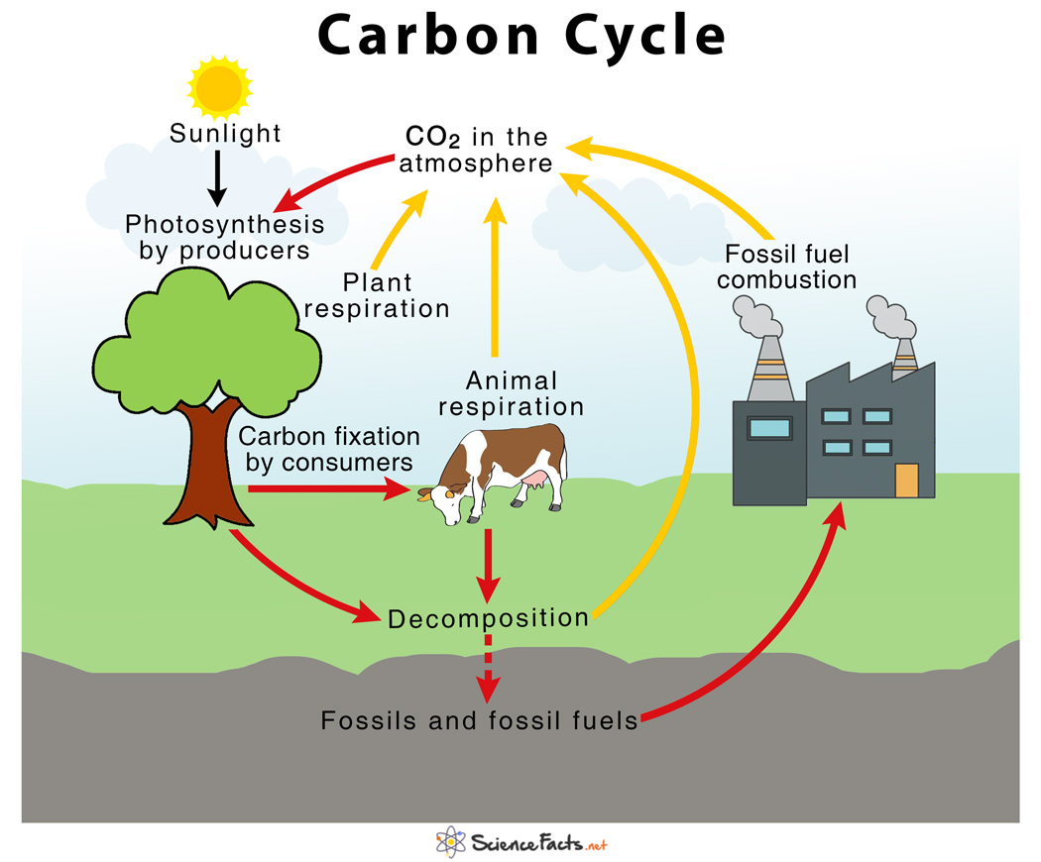
The Carbon Cycle…a natural process
A natural process
However, more anthropogenic sources releasing when compared to natural sources absorbing

Slide 3
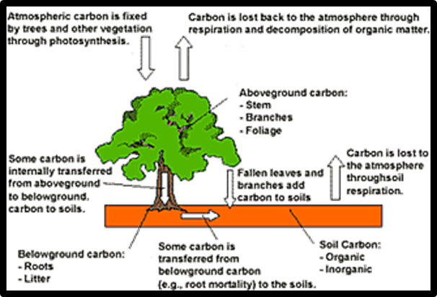
Tree Carbon Dioxide Sequestering
Plants will naturally absorb CO₂ during the day as they photosynthesize
Plants will release CO₂ back into the atmosphere at night when they only do cellular respiration

Slide 4
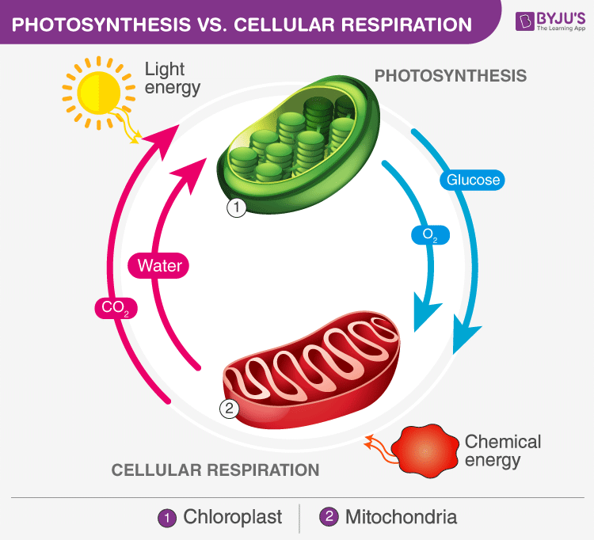
As long as light is available, the CO₂ will under go chemical reaction with water to produce glucose
If not light, CO₂ is released into atmosphere

Slide 5
Tree Carbon Dioxide Sequestering Lab
amount of CO₂ a tree sequesters varies based on the growth rate, age, and species of the particular tree
Young, quickly growing trees uptake significantly more carbon than mature trees with a slower growth rate.
Wet, warm climates support faster tree growth
Go to http://bit.ly/2dKs4H6

Slide 6
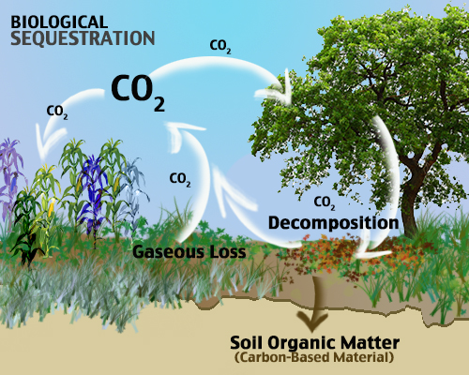
Can Technology Help Speed up this Natural Process?
Carbon sequestration (CS) natural process
Carbon Capture and Storage (CCS) using technology to speed up process of CO₂ recapture

Slide 7
Current Technologies
Pre combustion
Post combustion
Oxy-fuel
The idea is to recapture the CO₂ and then put the inert gas under pressure to create a liquid.
This liquid carbon dioxide is then stored
under ocean
Depleted oil and gas field
porous rock

Slide 8
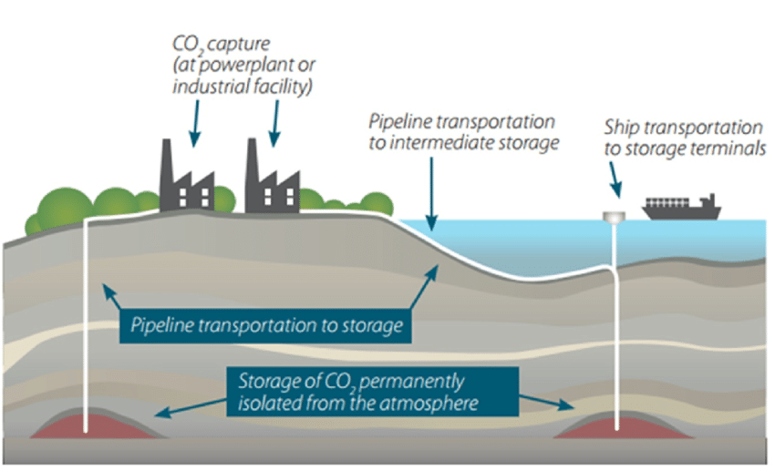
CCS options

Slide 9
Geologic Storage
Capture the CO₂ and make into liquid
Geologic storage
Pumped into the porous rock (like sandstone)
Porous rock under caprock to lock it into ground

Slide 10
Issues with technologies
Smokestack emission recapture not very effective (less than 50% recaptured)
Require a great deal of energy
Challenging to keep carbon dioxide storage completely sealed forever
When CO₂ reacts with water it creates acid (which will then impact cap rock)

Slide 11
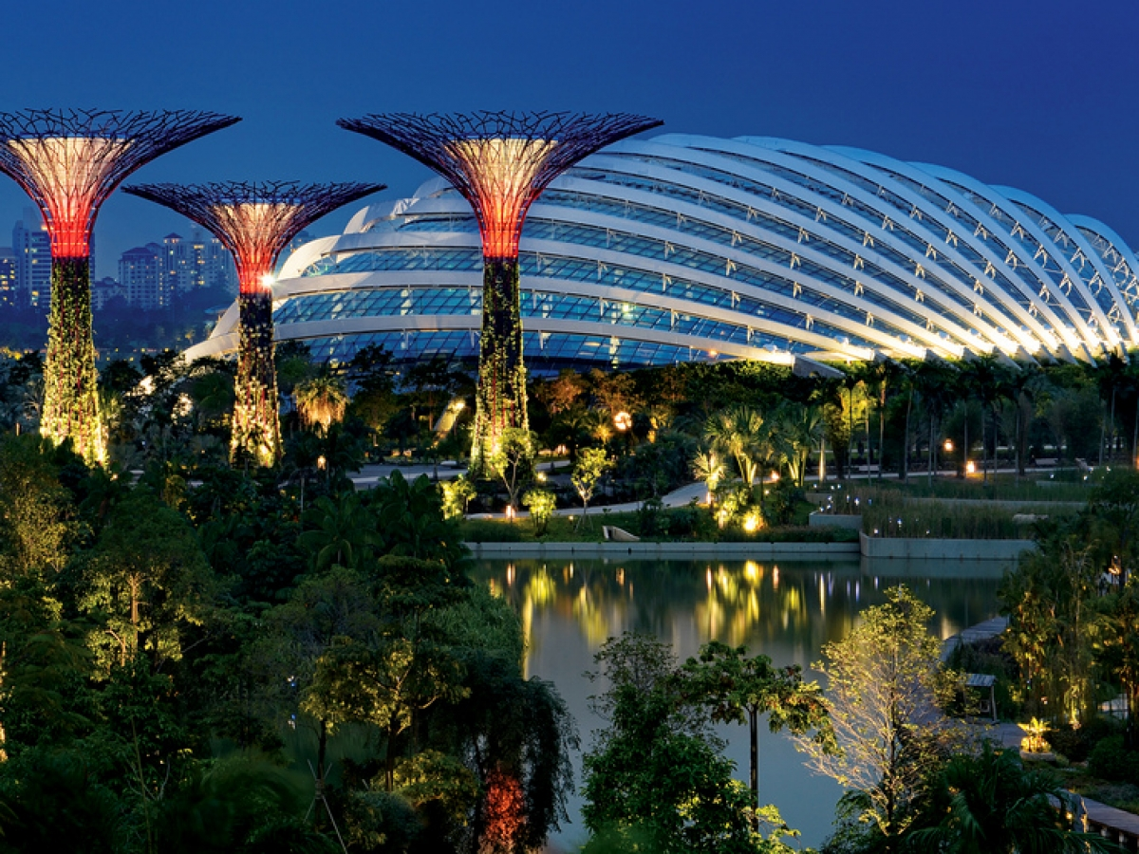
Synthetic Trees
Synthetic trees can capture CO₂ and store
Trials being done in “Biosphere 2”
A regular tree will absorb CO₂ during day light (when photosynthesizing) but then release CO₂ at night when only doing cellular respiration
Synthetic trees will absorb CO₂ both day and night

Slide 12
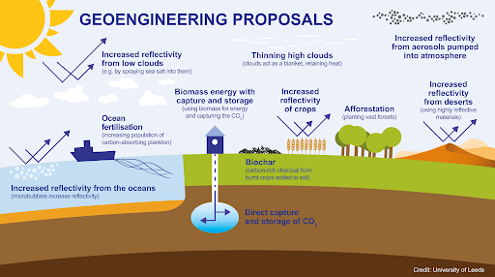
Geoengineering
CLOUD BRIGHTENING - Inject salt water into the sky in order to clouds whiter (more reflective)
GENETICALLY MODIFIED TREES – to absorb more CO₂
SATELLITE SHIELD – orbiting satellite act as a shield for UV rays
HIGH ALTITUDE BALLOONS – release reflective aerosol in the stratosphere

Slide 13
Ways that We can Impact Carbon Dioxide in our Atmosphere
Prevention | Clean Up
Cut fossil fuel use | Sequester CO₂ by planting trees and preserving forests and wetlands
Shift from coal to natural gas | Sequester carbon in soil
Use more sustainable agriculture and forestry | Sequester CO₂ deep underground (with no leaks allowed)
Put a price on greenhouse gas emissions | Remove CO₂ from smokestack and vehicle emissions
Repair leaky natural gas pipelines and facilities | Synthetic forests
Improve energy efficiency in homes and buildings
Shift to renewable energy resources
Reduce deforestation

Slide 14
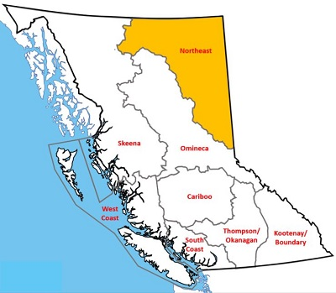
Canada CCS Pilots
Northeastern B.C. has a number of large natural-gas processing plants. Underground storage opportunities are reasonably close, and the technology and geological knowledge are available.
Alberta has 2 big projects for CCS
What might be Alberta’s drive to find sustainable CCS?

Slide 15
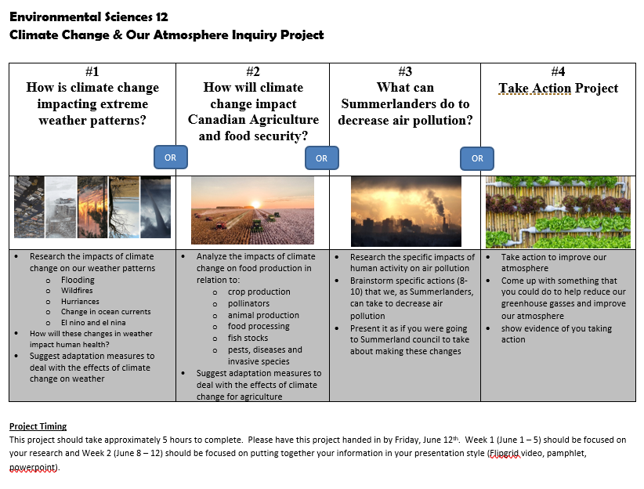
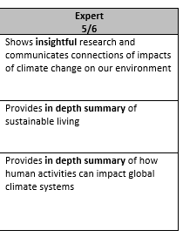
Due THIS WEEK (Friday, June 12th)

Slide 16
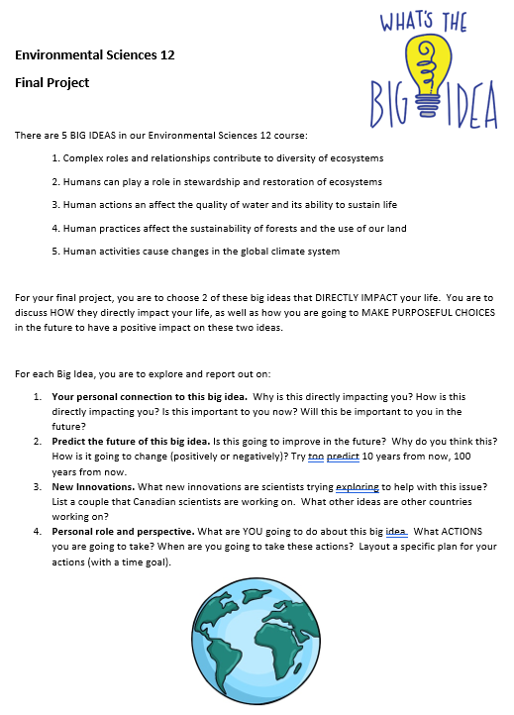
Final Project (due Friday, June 19th)

Slide 17
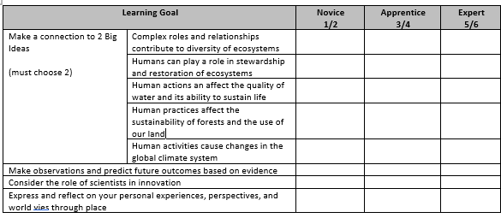
Final Project (due Friday, June 19th)

