Slide 1
Carbohydrates Skill Lab
Biology 12

Slide 2
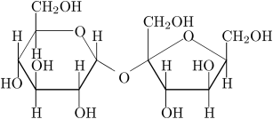
Which carbohydrate is this?

Slide 3
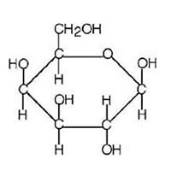
Which carbohydrate is this?

Slide 4
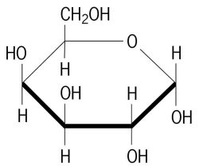
Which carbohydrate is this?

Slide 5
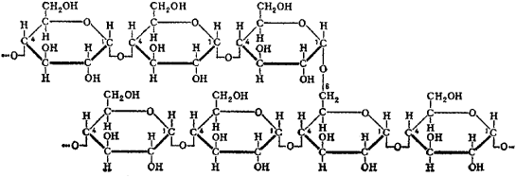
Which carbohydrate is this?

Slide 6
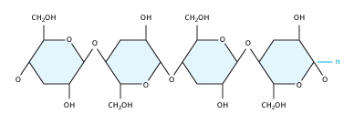
Which carbohydrate is this?

Slide 7
Which carbohydrate is this?

Slide 8
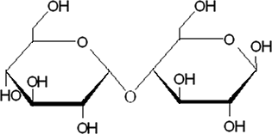
Which carbohydrate is this?

Slide 9
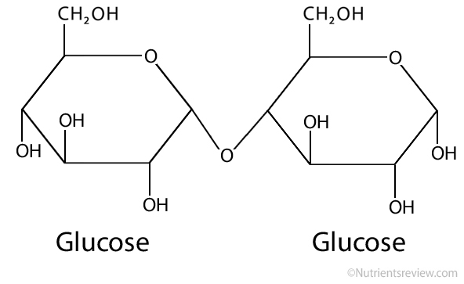
Which carbohydrate is this?

Slide 10
Which carbohydrate is this?

Slide 11
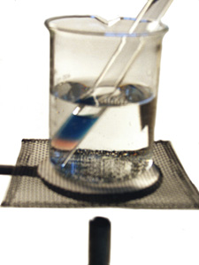
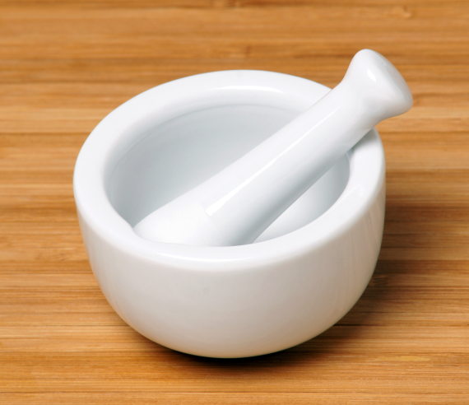
Simple Sugars
Test for the presence of monosaccharides
Must use liquid samples
Use water to moisten sample with mortar and pestle
Use hot water bath for 5 – 10 minutes

Slide 12
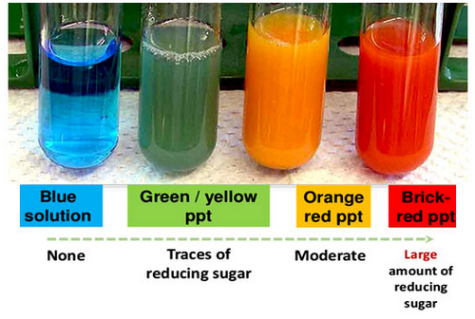
Benedicts Solution

Slide 13
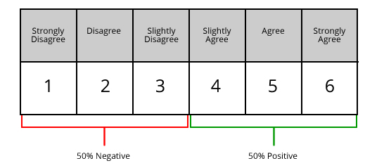
Likert Scale

Slide 14
Controls
Positive Control – definitely will be a YES
Negative Control – Definitely will be a NO

Slide 15
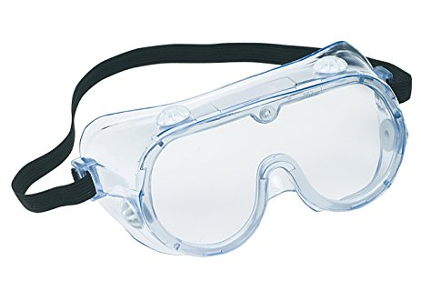
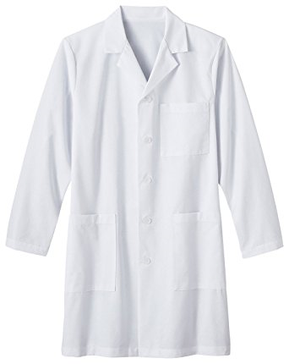
Safety

Slide 16
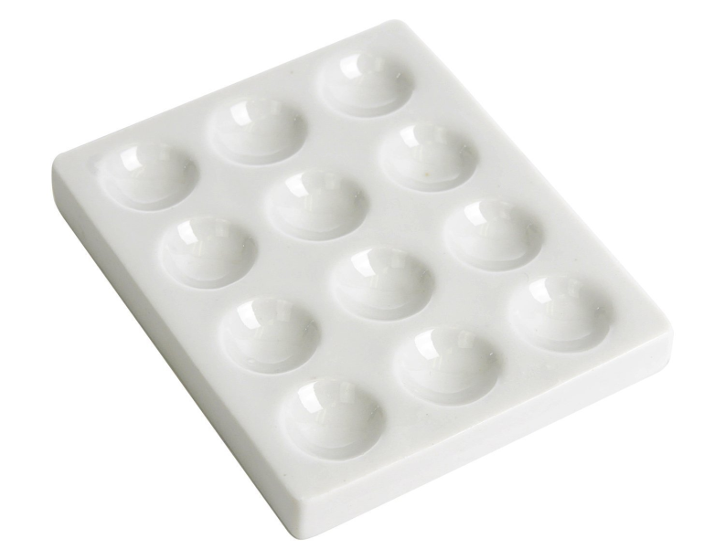
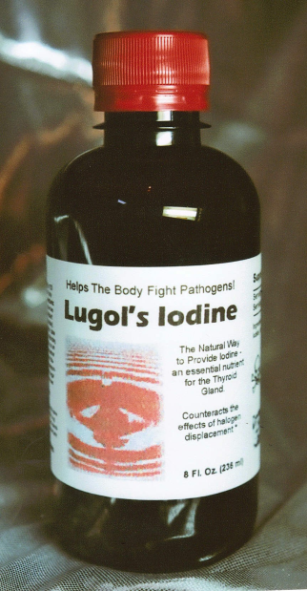
Complex Carbs (Starch)
Can use on a solid food item
Use a spot plate
Small pieces of food
2 – 3 drops lugols

Slide 17
Log Book
Big Question – What are you doing?
Procedure – what did you do? You might want redo this procedure later, so write enough detail that you can follow it again
Results – in a data table, or sketches of observations
Reflect – What worked well? What should you improve the next time you do a lab?

