Slide 1
Biomolecules
Nutrient Sort
Biology 12

Slide 2
Learning Goals
I will be able to recognize the molecular structure of a carbohydrate, lipid, protein, and nucleic acid

Slide 3
Nutrients That Your Body Needs:
1. Carbohydrates
2. Lipids
3. Protein
4. Nucleic Acids

Slide 4
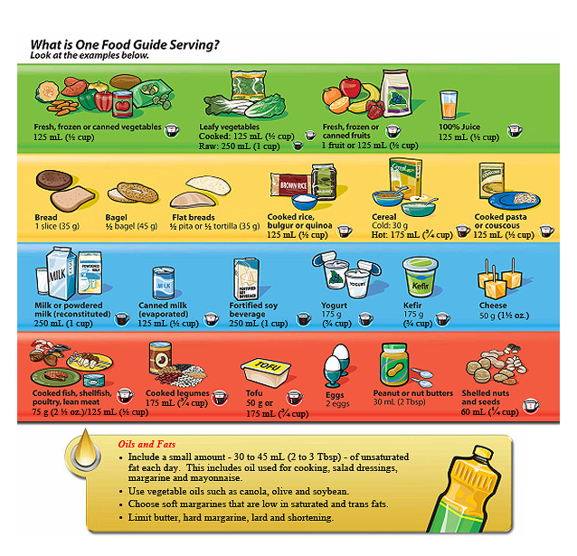

Slide 5
Elements that make up our nutrients
Abbreviation | Name | Atomic Number | Atomic Weight | Usual # of Bonds
C | carbon | 6 | 12 | 4
H | hydrogen | 1 | 1 | 1
N | nitrogen | 7 | 14 | 3
O | oxygen | 8 | 16 | 2
P | phosphorus | 15 | 30 | 5
S | sulfur | 16 | 32 | 2, [4, 6]

Slide 6
Molecular Sort
Divide up your molecules into patterns?
How many groups do you have? Describe WHY you think that is all similar.

Slide 7
Molecular Sort
If you had to get it down to JUST 4 GROUPS, what similar characteristics would you have?

Slide 8
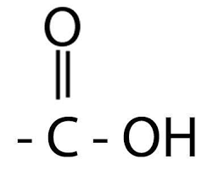
Everything will be
Organic based molecule
Backbone of carbon
Carboxyl group on one side

Slide 9
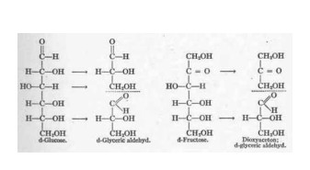
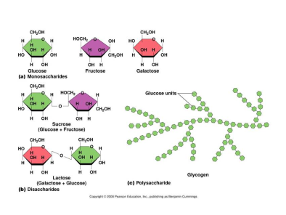
Carbohydrates
Linear or ringed carbon chain
OH off one side of C, with just H off other side of C

Slide 10
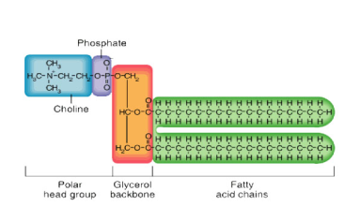
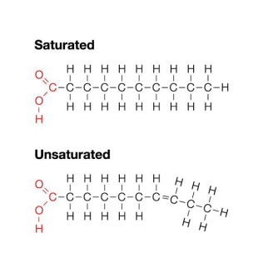
Lipids
Linear chain of carbon with JUST H off both sides

Slide 11
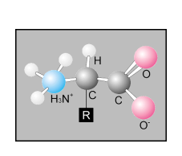
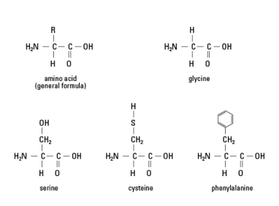
Protein
Amino acids will have NITROGEN on one side (anime group)

Slide 12
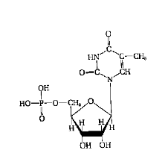
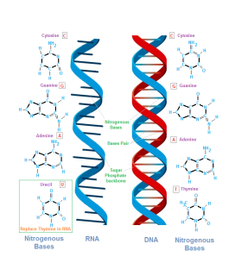
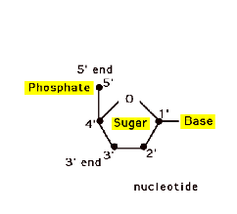
Nucleic Acids
Will have nitrogen ring off a 5 carbon sugar
Attaches to next by a PHOSPHATE group

