Slide 1
BC Wolf Cull
Environmental Sciences 11/12

Slide 2
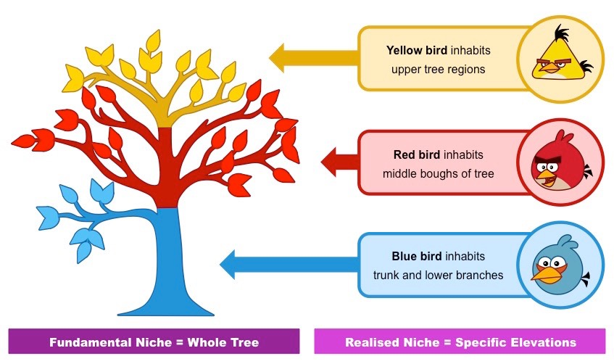
What roles do species play in ecosystems?
Niche – the role species play in ecosystem
Include everything that will effect the species survival and reproduction
How much water it needs
Amount of sunlight
Amount of food needed
What it feeds on
Temperature it needs

Slide 3
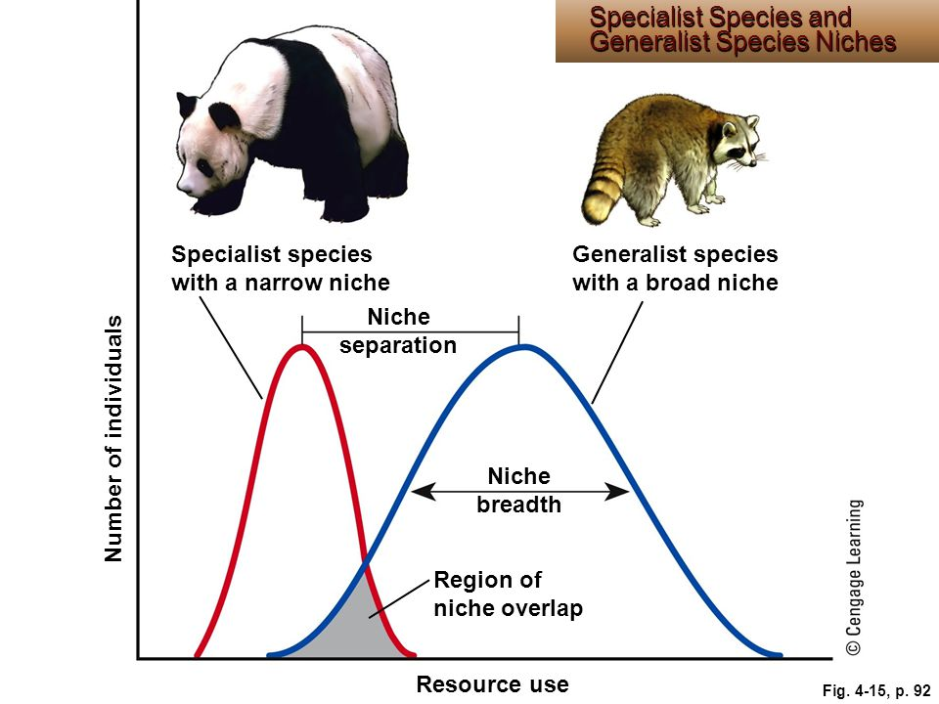
Generalist Species
Broad niche (like a raccoon)
Live in many places
Eat a variety of foods
Tolerate range of conditions
Examples: crows, coyotes, sparrows, white tailed deer

Slide 4
Specialist Species
narrow niche (like a Giant Panda)
Live in only one type of habitat
Eat one a couple types of food
Must have a maintained temperature
Very sensitive to environmental changes
Have fewer competitors in an environment
Examples: giant panda

Slide 6
Wolves in BC
Watch the linked video
Take notes
Share notes with table team at the end to bulk up your notes ☺

Slide 7
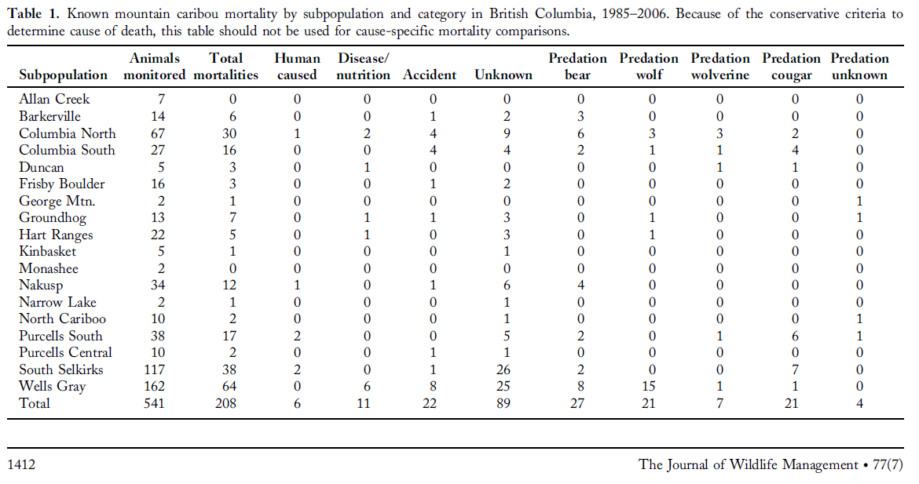
What does this data tell us?

Slide 8
What does this data tell us?

Slide 9
Your Task
As a table team do some research you have about the current wolf cull
Use the ipads to research information about the wolf cull
What are the statistics about caribou depletion?
What are the issues about wolf population increases?
What are BOTH sides of view and what are BOTH sides justification for their stance?
What is the history of the BC wolf culls (how did it work in the past)?
Share as a class and take notes on the issue and sides of the issue

Slide 10
Ticket Our the Door Journal Entry
What is your opinion about the BC wolf cull?
Do you think it is necessary to hep sustain the caribou population?
Does saving one population justify killing of another? Why or why not?

