Slide 1
Aquifers
Environmental Sciences 12

Slide 2
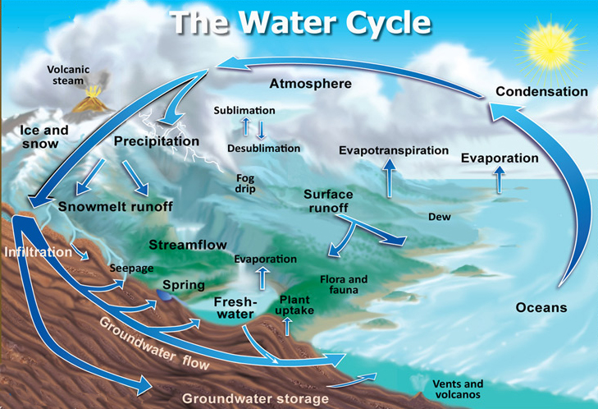
Water Cycle

Slide 3
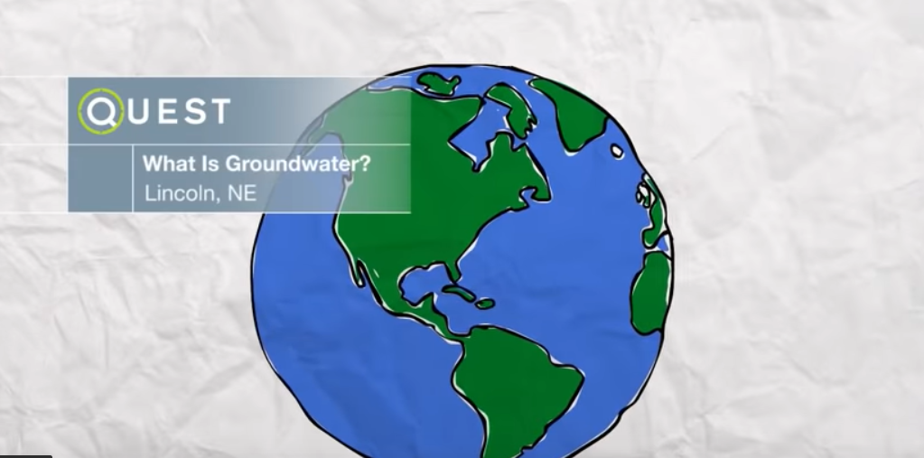
What is Ground Water?

Slide 4
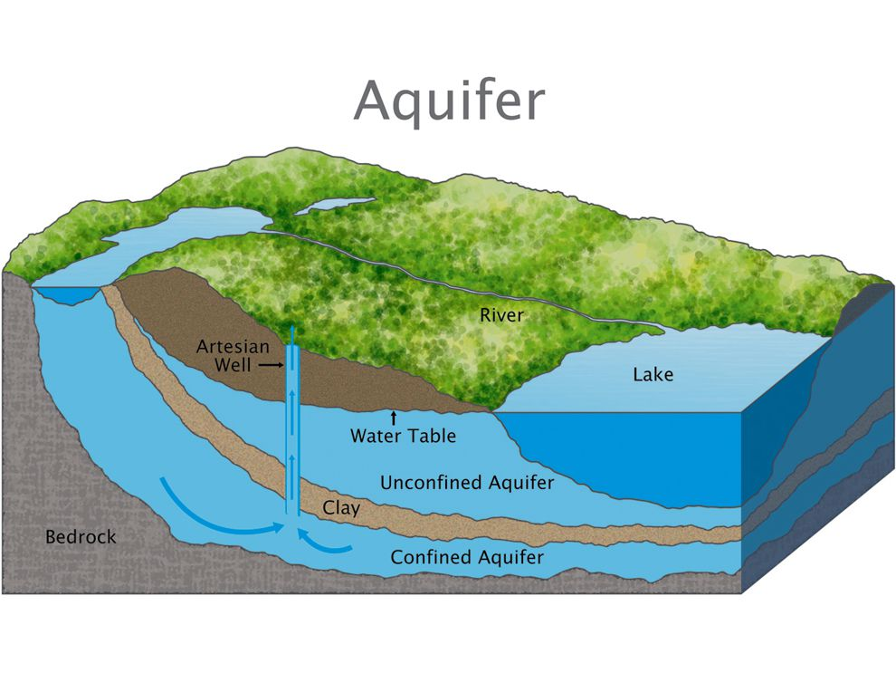
What is an aquifer?
Confined aquifer → layer of non-porous rock above water. Challenging and expensive to drill into. Can build up pressure
Unconfined aquifer →directly feed into lake. Only soil above. Cheaper to use as welled water

Slide 5
Ogallala Aquifer

Slide 6
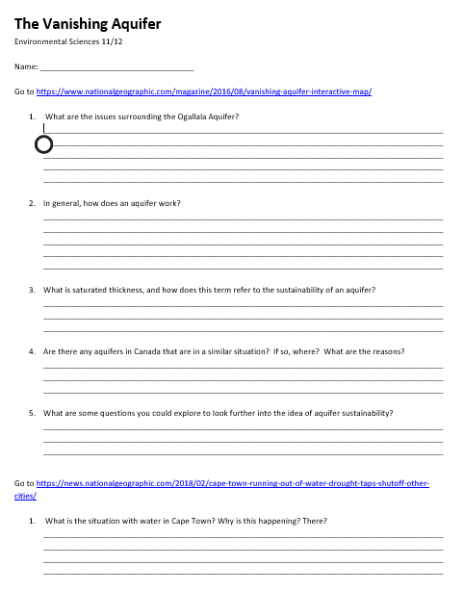
Aquifer Search
Go to the websites
Read and find the info

