Slide 1
Applications of Quadratic Functions
FOM 11
June 10th

Slide 2
What you need for today

Slide 3
Using Desmos for Parabolas
Type in the equation y = 2(x + 2)² + 1 into Desmos
Using the graph, what is the:
axis of symmetry: _________________________
y-intercept: __________________________
x-intercept(s): _________________________
Domain: _____________________________
Range: _______________________________

Slide 4
Using Desmos for Parabolas
Type in the equation y = $\frac{1}{3}$x² + 2x + 1 into Desmos
Using the graph, what is the:
axis of symmetry: _________________________
y-intercept: __________________________
x-intercept(s): _________________________
Domain: _____________________________
Range: _______________________________

Slide 5
Using Desmos for Parabolas
Type in the equation y = -2(x + 4)(x - 4) into Desmos
Using the graph, what is the:
axis of symmetry: _________________________
y-intercept: __________________________
x-intercept(s): _________________________
Domain: _____________________________
Range: _______________________________

Slide 6
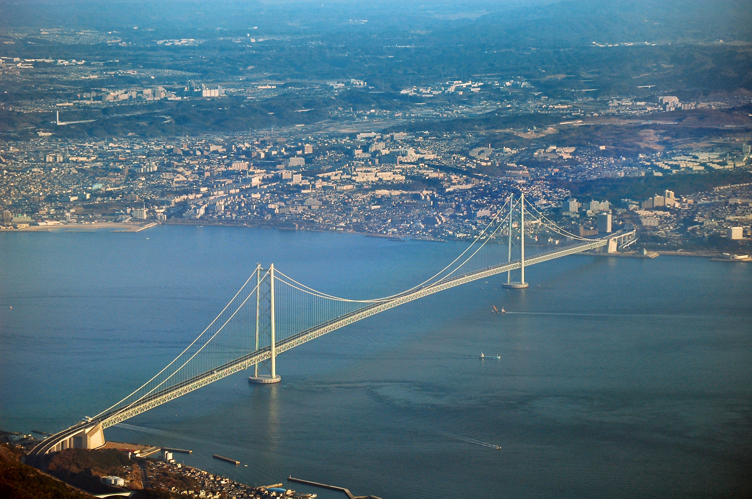
When do we use quadratics to model a situation?
Speed of an object
Trajectory of an object
Profit
Suspension bridges
architecture

Slide 7
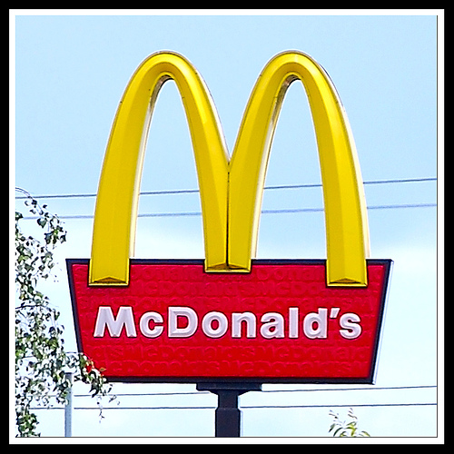
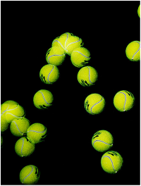
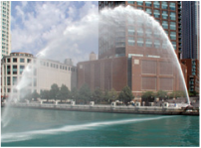
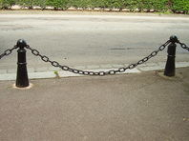
ParabolAs are EVERYWHERE!

Slide 8
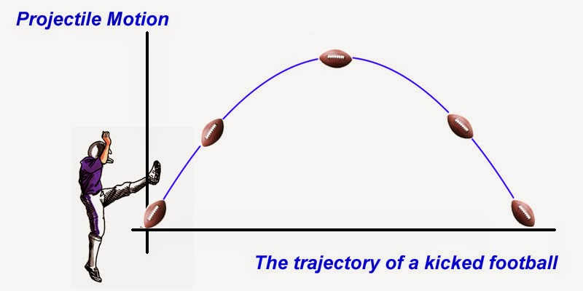
Trajectory will be a parabola with a negative a value

Slide 9
Cole is trying a new sport. He becomes the punter for a football team. He kicks the football, whose hegith of the path of the football is modelled by the equation
f(x) = -5(x – 1.5)² + 12.25
X = time (s)
Y = height (m)
f(x) = -5(x – 1.5)² + 12.25

Slide 10
Graph the function using desmos y = -5(x – 1.5)² + 12.25.
What is the maximum height of the football?
Determine the time it takes for the football to reach its maximum height
Determine the height of the football above the ground as the punter makes contact with the football
Determine the height of the football above the ground 0.5 seconds after contact
Determine after how many seconds the football is 10 metres above the ground

Slide 11
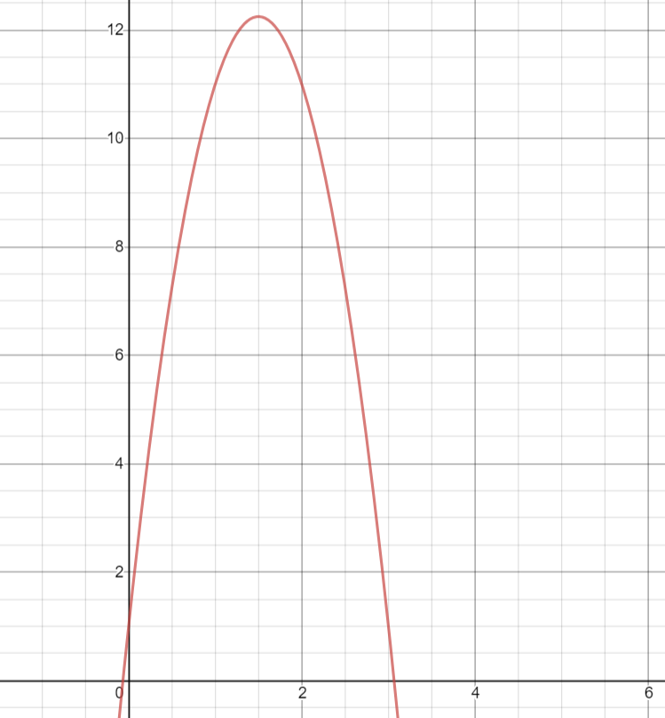
What is the maximum height (y axis) of the football?
Determine the time (x axis) it takes for the football to reach its maximum height
Determine the height of the football above the ground as the punter makes contact with the football (Height at time 0)
Determine the height of the football above the ground 0.5 seconds after contact
Determine after how many seconds the football is 10 metres above the ground

Slide 12
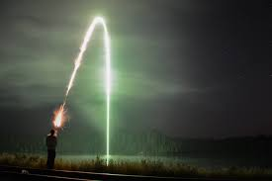
An aerial flare is a type of pyrotechnic which, when fired into the air, produces a brilliant light without causing a fire or an explosion. A stranded camper fires a flare to signal his location to other campers in his group. The flare follows the path of
f(x) = -4.9(x – 4.3)² + 92
x = the number of seconds which have elapsed since the flare was fired
y = the height of the flare

Slide 13
Graph the function using desmos y = - 4.9(x – 4.3)² + 92
What is the maximum height of the flare?
Determine the time it takes for the flare to reach its maximum height.
Determine the height of the flare above the ground 6.3 seconds after it is fired.
Determine the height of the flare above the ground at its firing point
Determine after how many seconds it took for the flare to hit the ground

Slide 14
The Beanery sells a latte for $4. At this price, the beanery will sell 100 lattes each day. The owners know from past years that they will sell 5 fewer Lattes per DAY for each price increase of 0.25. What function models the owners’ earnings, if x represents the number of price increases in dollars? Using desmos, what is the maximum revenue the beanery could make?

Slide 15
Finding an equation

Slide 16
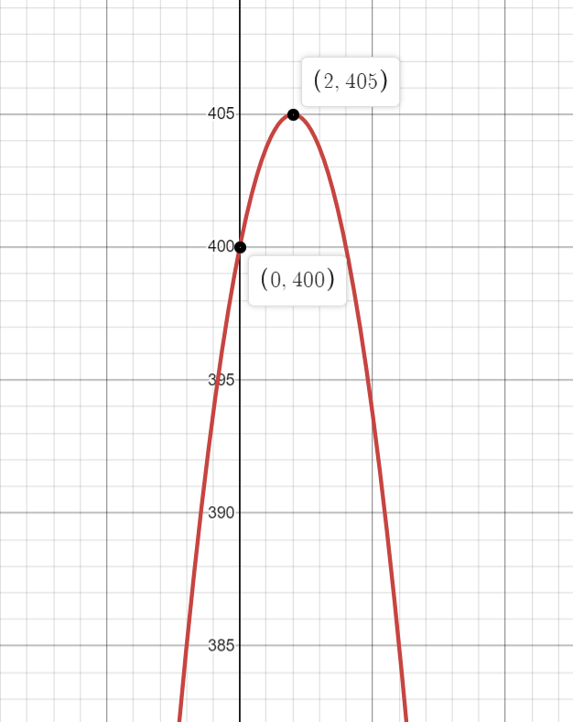
The Graph

Slide 17
Jack is a baker. He sells strawberry cheesecakes for $25. At this price, he can sell 200 cheesecakes every week. He is wanting to increase his earnings, but from his research, he knows that he will sell 5 fewer cheesecakes per week for each price increase of $1. What is an equation that could model Jack’s potential earnings?

Slide 18
The Equation

Slide 19
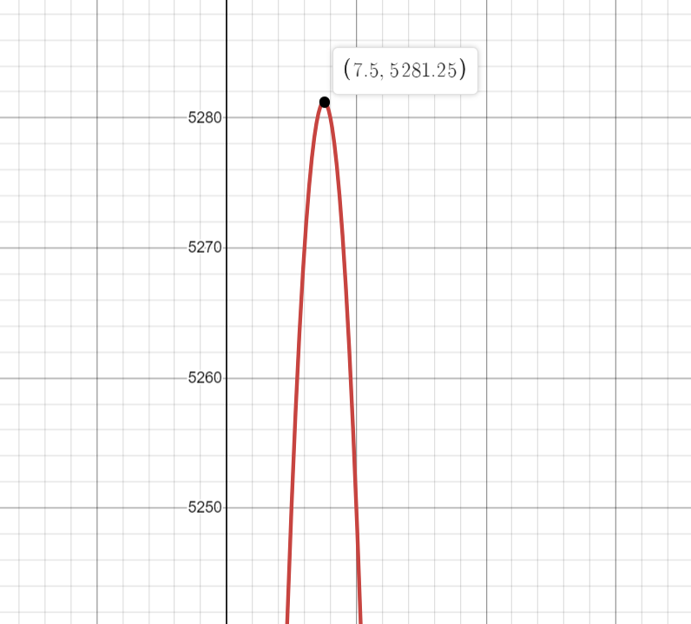
The Graph

Slide 20
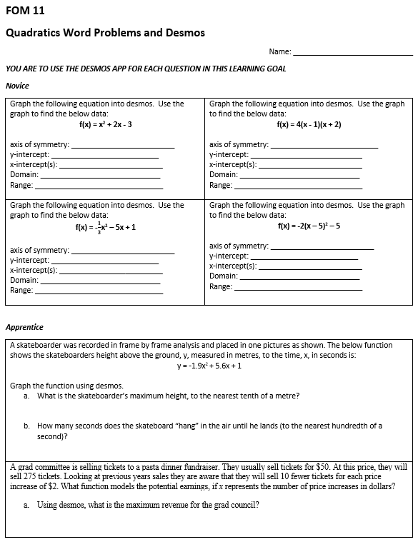
To Do:
Desmos and Word Problems worksheet
Once you are done, check the ANSWER KEY on my website

