Slide 1
Air Pollution and Greenhouse Gases
Environmental Sciences
May 26th

Slide 2
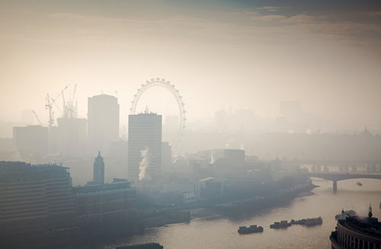
What is Air Pollution?
Any gas or solid in the atmosphere that is in high enough concentration to harm organisms or ecosystems
Comes from natural and anthropogenic causes
Natural
Wind blown
Volcanic gases and dust
Wildfires
Volatile plant products
Anthropogenic (human caused)
Cars
Factories
Burning of fossil fuels

Slide 3
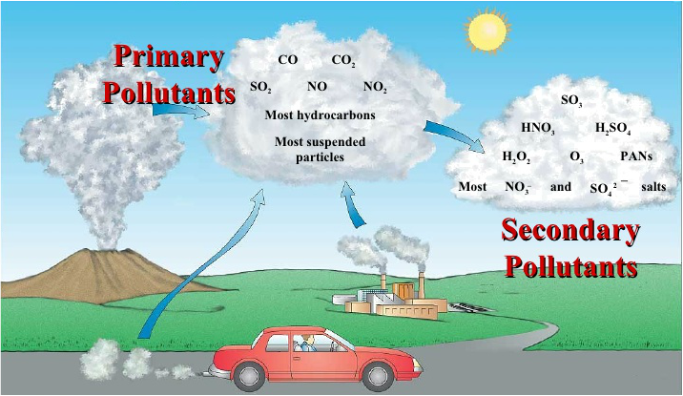
Classification of Air Pollutants
Primary
Chemicals emitted directly into the air
Secondary
Not directly emitted into the air
Example #1→ tropospheric ozone. Created when hydrocarbons and nitrogen oxide react together in sunlight
Example #2 → Acid Rain. Create when Sulphur dioxide reacts with water

Slide 4
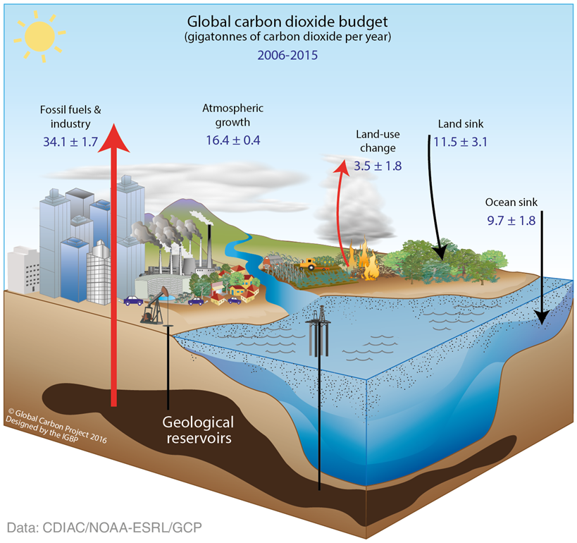
Carbon Oxides
Carbon monoxide
Highly toxic gas
Formed from vehicle exhaust, burning of forests and grasslands, smoke stacks
Reduced the bodies ability of transport oxygen in blood
Carbon dioxide
93% of CO₂ in the atmosphere is from natural carbon cycle
7% is from human activity
Strong connection between CO₂ rise and atmospheric temperature rise
Main greenhouse gas

Slide 5
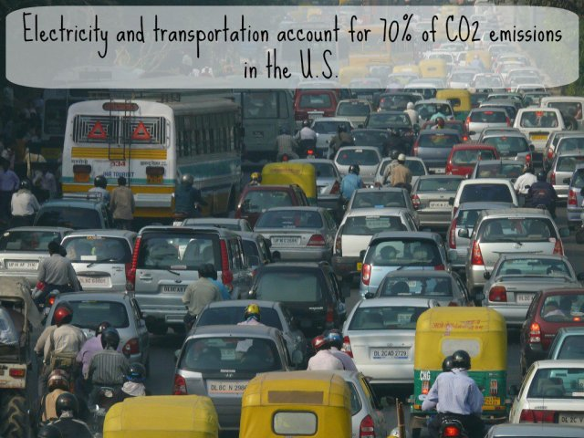
Carbon Dioxide

Slide 6
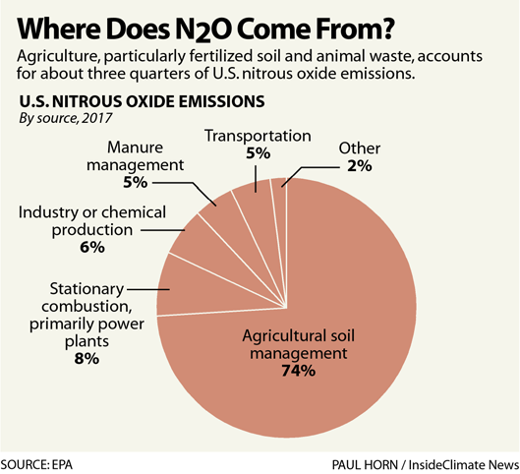
Nitrogen Oxides and Nitric Acid
NO (nitric oxide) forms when nitrogen and oxygen gas react under high temperatures in car engines and power plants
Lightning and certain bacteria in soil can produce NO
NO reacts with O₂ to form nitrogen dioxide with then reacts with water to form nitric acid (HNO₃)
At high levels nitrogen oxides can irritate skin, eyes, an throats
can also suppress plant growth

Slide 7
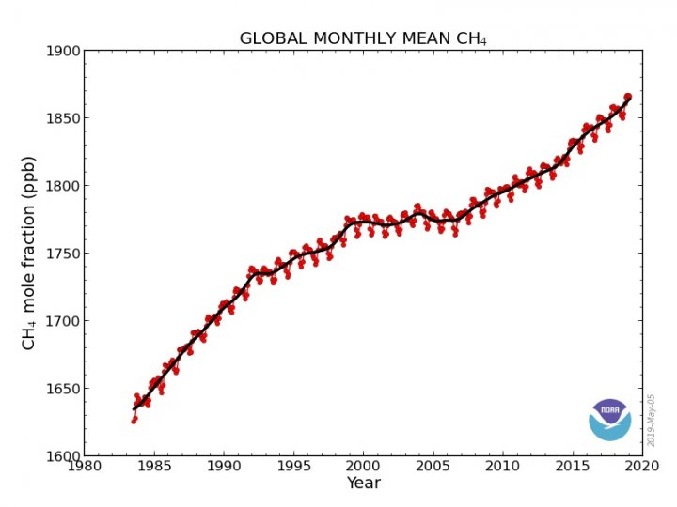
Volatile Organic Compounds (VOCs)
Organic compounds that exist as a gas
Methane (CH₄) and hydrocarbons
Methane is 25 times stronger than CO₂ at warming atmosphere
1/3 of methane comes from natural sources such as plants, wetlands, and termites
2/3 of methane is from landfills, gas wells, pipelines and cattle

Slide 8
The Other Greenhouse Gases

Slide 9
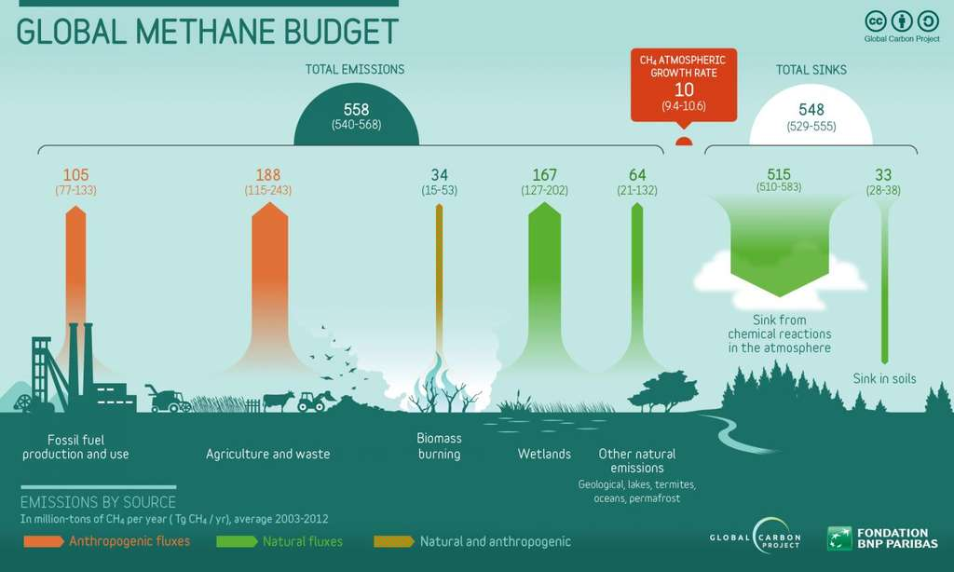

Slide 10
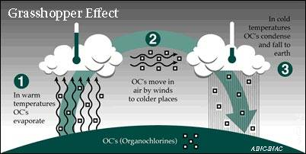
Factors that INCREASE Air Pollution
Urban highrise buildings
slow wind speed
Mountains
Reduce air flow in valleys
High temperatures
Promote chemical reactions and formation of tropo.ozone
VOC emissions from wetland
Wetland plants release methane
Grasshopper effect
Air pollutants are transported at high altitudes by wind
Pollutants can travel to polar areas (haze over the Arctic)
Polar bears have high levels of toxins in body
Temperature Inversion
Cooler air stay close to earths surface and trapped by warmer less dense air

Slide 11
Factors that DECREASE Air Pollution
Heavy particulates settle out due to gravity
Rain and Snow clean air
Particulates and oxides adhesive to water and will come out of air
Salty Sea
Will wash out pollutants and particulate matter in air
Winds
Sweep pollutants away and dilutes them by mixing them with cleaner air
Chemical Reactions
Often a precipitate will be made with water from rain and wash the air pollution down to the earth

Slide 12
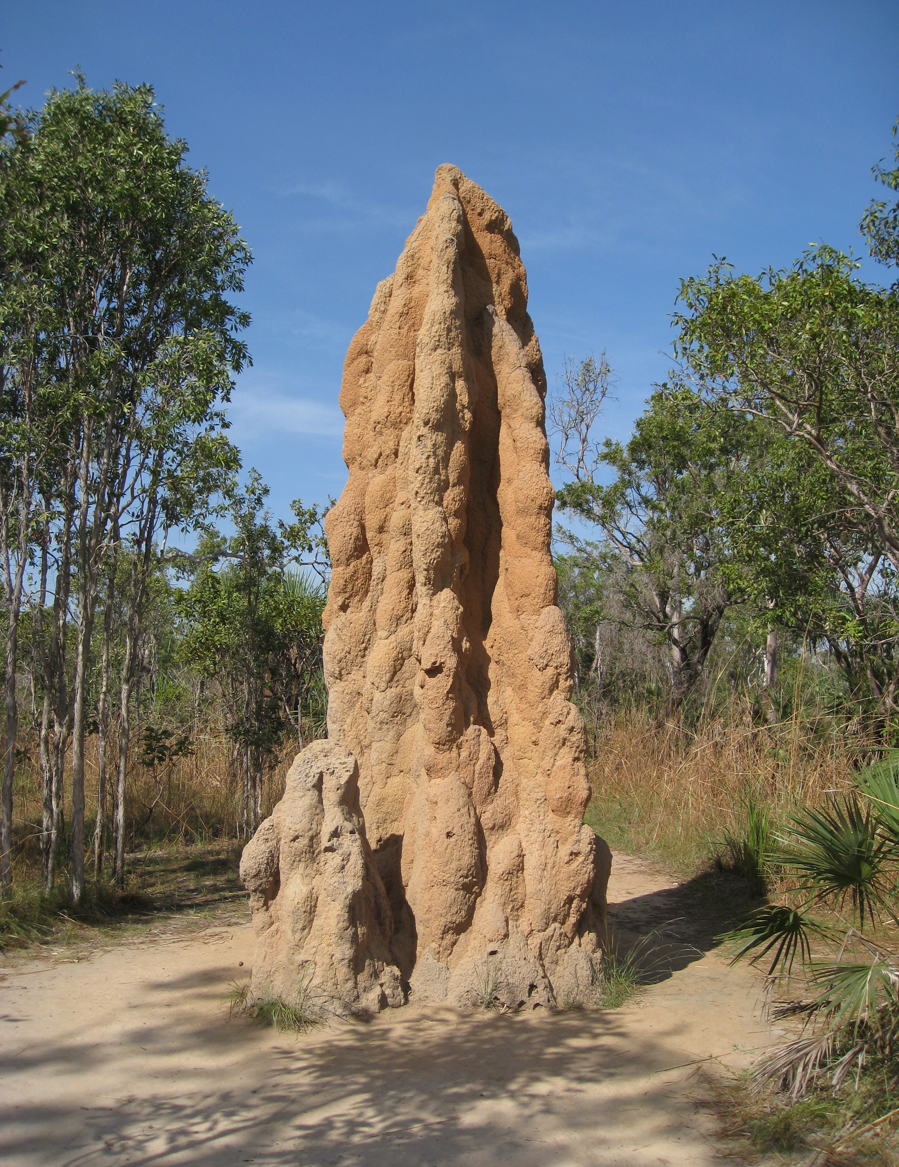
Termite Mounds
Termite mounds come with their own methane filter
Bacteria in the soil of a termite mound filters out about 50% of the methane from termites, preventing it from methane being released into the atmosphere
How could this be used to help our atmospheric methane?

Slide 13
Canadian Air Pollution Policy and Laws
1999 – Canadian Environmental Protection Act
Main national legislation about pollution
Focus on Greenhouse Gas emissions
Air quality standards for vehicles
Aircare – 1992 – 2014 cars in BC needed to pass an air quality test in order to be insured
2016 – Pan-Canadian Framework on Clean Growth and Climate Change
Reduce 30% below our 2005 levels by 2030

Slide 14
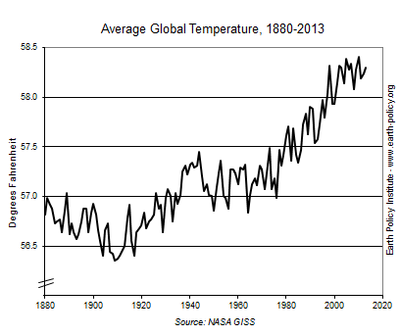
Air Pollution and Climate Change
Particulate matter holds on to heat
greenhouse gases (carbon dioxide and methane) also hold on to heat
Cause an increase in our atmospheric temperatures

Slide 15
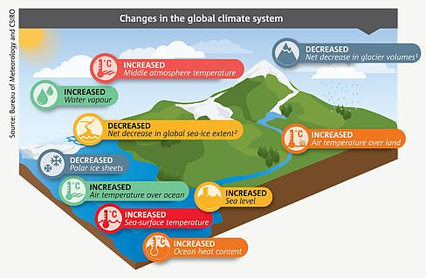
Understanding Climate Change

Slide 16
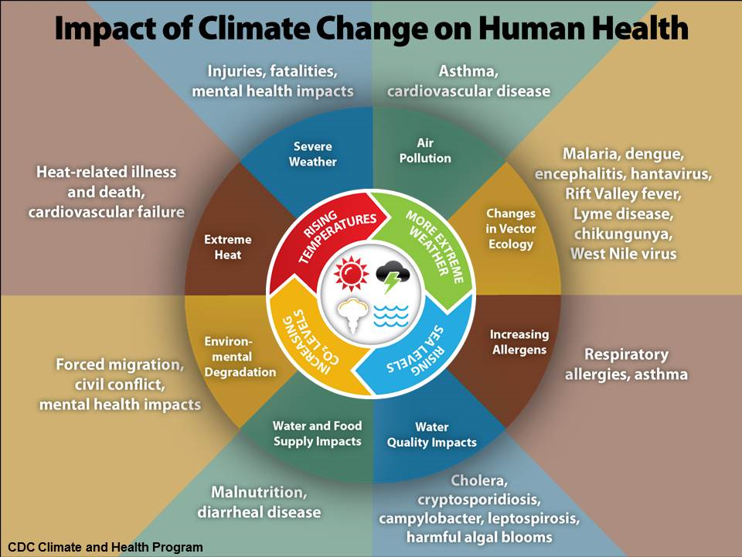
Impact of Climate Change

Slide 17
Now What????
This is where we are at (like it or not)
Now what….
What can we be doing to cool our atmosphere?
Is reducing emissions from now enough?
Can we remove particulate matter and GHG from our atmosphere?

Slide 18
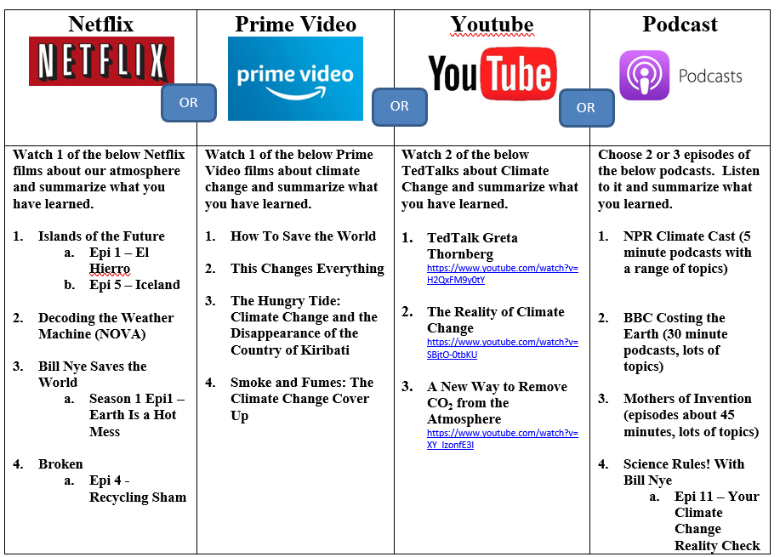
This Week’s Project
The Media Project
Choose one of the options
Answer 4 questions about it:
What did you watch or listen to?
What were three big take aways for you from this learning?
What are the impacts you learned about to climate systems? (aim for 4+ connections)
What is the local, national, and global societal impact? (connect to the people, the land, and ecosystem)

Slide 19
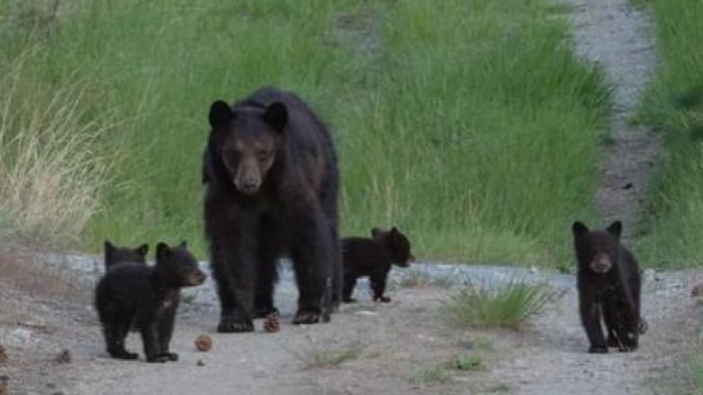
Thursdays Guest Speaker
Thursday, May 28
Zoe Dirk
Bear Aware and Wild Safe BC
Will focus specifically on Summerland Bear issue

